Slide 1
Just War Theory
Jus ad bellum
Right to engage in war
When?
Where?
For what reason?
To what end?
Jus in bello
Right conduct in war
How?
Who?
With what means?
In what way?

Slide 2
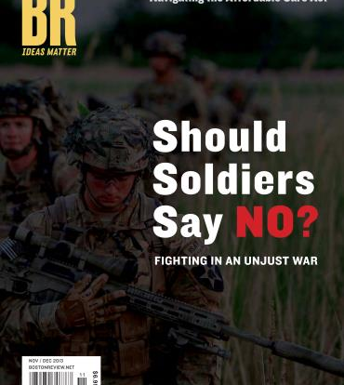
Just War Theory
Jus in bello
Right conduct in war
How?
Who?
With what means?
In what way?

Slide 3
The “War Convention” (Walzer, p. 44)
“the set of articulated norms, customs, professional codes, legal precepts, religious and philosophical principles, and reciprocal arrangements that shape our judgment of military conduct”
“terms of our judgments are most explicitly set forth in positive international law”:
  Work of “politicians and lawyers acting as representatives of sovereign states”
  Jurists who “codify their agreements”
But problem with international law:
  Decentralized legislative system
  Lacks “parallel judiciary”
Need for moral argument and common law understanding

Slide 4
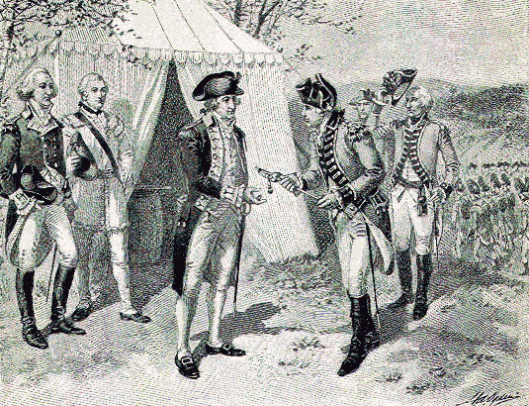
The War Convention
Historical Antecedents
Chivalry (traditional warrior code of honor)

Slide 5
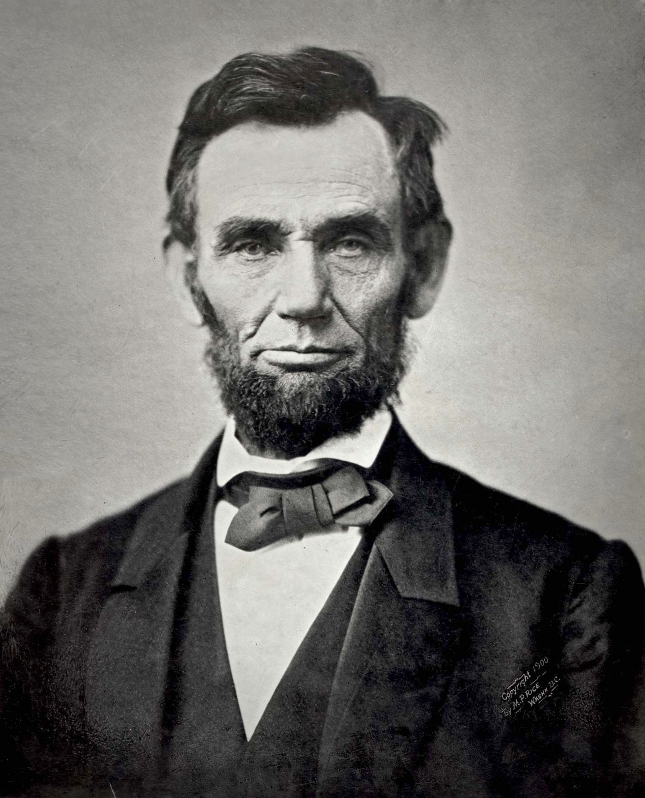
The War Convention
Historical Antecedents
Lieber Code, 1863
“General Orders 100. Instructions for the government of armies of the United States in the field” –Francis Lieber
Protection of civilians and civilian property
Treatment of Prisoners of War, deserters, spies, hostages, partisans
Rules for martial law in occupied territories

Slide 6
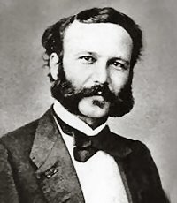
The War Convention
Historical Antecedents
Henri Dunant (1828-1910)
Swiss businessman, humanitarian
International Red Cross (Crescent), 1863
  Geneva Convention,
  1864 (1906, 1929, 1949)
  First Nobel Peace Prize,
  1901

Slide 7
The War Convention
Contemporary Legal Framework
The Hague Conventions, 1899, 1907
Nuremberg Trials, 1945-1946
International Criminal Court, The Hague, 2002
Geneva Conventions, 1949
1. For the amelioration of the condition of the wounded and sick in armed forces in the field
2. For the amelioration of the condition of the wounded, sick, and shipwrecked members of armed forces at sea
3. For the treatment of prisoners of war
4. For the protection of civilian persons in time of war
See http://www.icrc.org

Slide 8
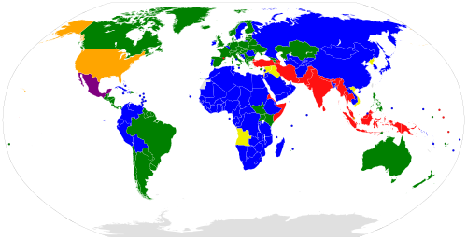
Signatories to Geneva Conventions and Protocols
Notes:
Green: Parties to GC I-IV and P I-III Blue: Parties to GC I-IV and P I-II
Purple: Parties to GC I-IV and P I and III Yellow: Parties to GC I-IV and P I
Orange: Parties to GC I-IV and P III Red: Parties to GC I-IV and no P

Slide 9
The War Convention
Relative and Absolute Rules
Utility (military necessity)
Proportionality (harm to civilians must not be “excessive” relative to anticipated military gain)
Human Rights
Noncombatant Immunity
    Wounded or Sick Soldiers, POWs
    Civilians
  Doctrine of Double Effect
  “Double Intention”

Slide 10
The War Convention
Questions of Category
Combatants / Noncombatants?
Sieges / Blockades / Strategic devastation = war against civilians?
Guerilla or “asymmetric” warfare and counterinsurgency?

Slide 11
The War Convention
Judicial responses
War Crimes (justifications claimed by ordinary soldiers)
  “Heat of battle”
  “Under orders” (“Nuremberg Defense”)
  a) ignorance
  b) duress
“Command responsibility” (officers and leaders)
Limit unintended harm to civilians (double effect / double intention)
    Hold combatants under their command to ethical standards

Slide 12
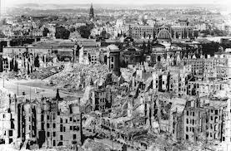
Supreme Emergency, or Not?
When does a nation have a legitimate right to “override the rights of innocent people and shatter the war convention”?
UK “Strategic Air Offensive”
  Against Germany in WWII
  Justification?
  Choice of nonmilitary targets (cities)
  Continuation past justification
  Fate of Arthur “Bomber” Harris
Dresden, Germany, 13-15 February, 1945

Slide 13
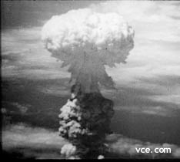
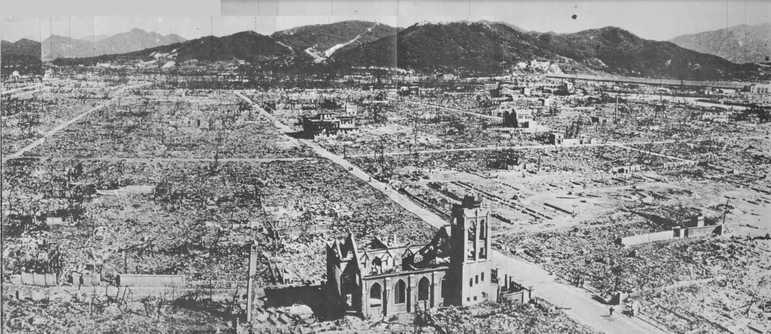
Supreme Emergency, or Not?
When does a nation have a legitimate right to “override the rights of innocent people and shatter the war convention”?
Hiroshima
    Justification?
    Ethics of “calculation”

Slide 14
Leon Tolstoy, War and Peace
“And what is war, what is needed for success in war, what are the morals of the military world? The object of warfare is murder, the means employed in warfare – spying, treachery, and the encouragement of it, the ruin of a country, the plunder of its inhabitants . . . trickery and lying, which are called military strategy; the morals of the military class – absence of all independence, that is, discipline, idleness, ignorance, cruelty, debauchery, and drunkenness.”

Slide 15
Walzer and the War Convention
Cynicism or Indignation?
“War is so awful that it makes us cynical about the possibility of restraint, and then it is so much worse that it makes us indignant at the absence of restraint. Our cynicism testifies to the defectiveness of the war convention, and our indignation to its reality and strength.” (p. 44)

