Slide 1
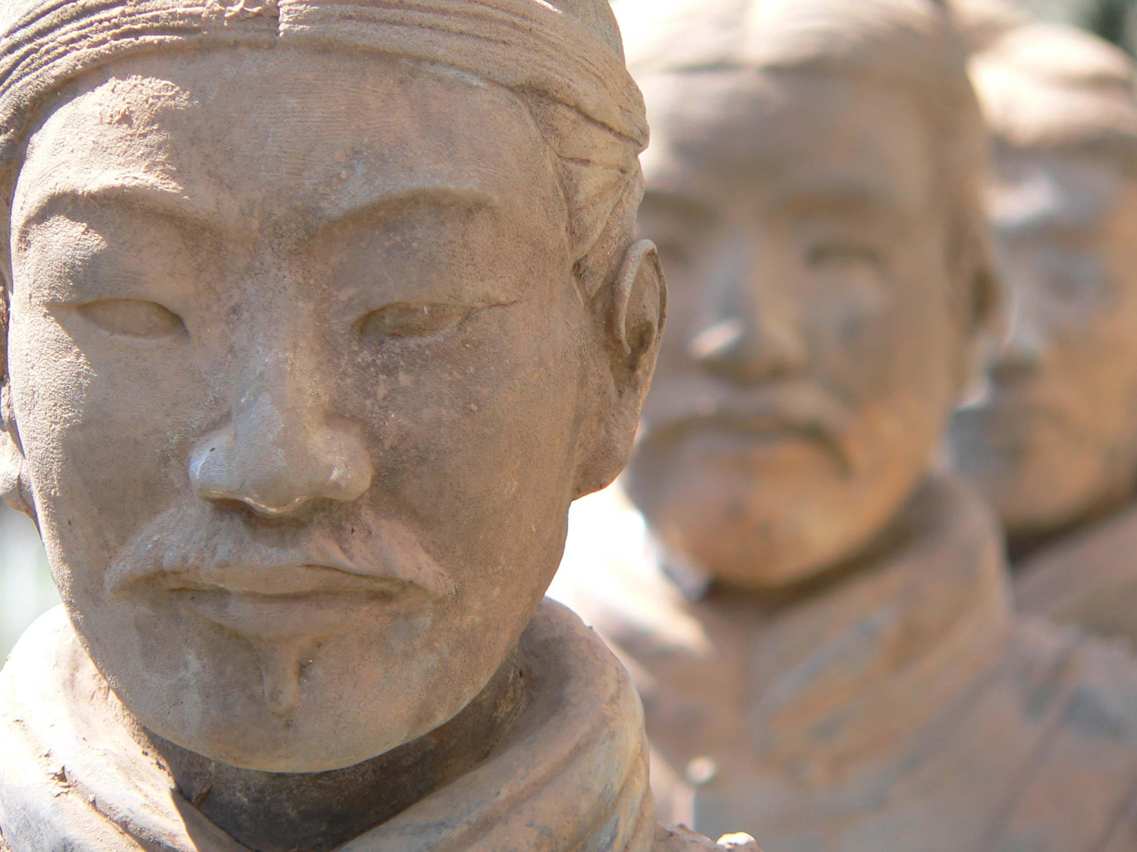
孫子兵法
Sun Tzu, Art of War
Historical Existence?
Inconclusive, but probably
6th century BCE
Contemporary of
Confucius, 551-479 BCE
Homer, 8th century BCE
Notes:
Sūnzǐ Bīngfǎ, military methods or rules for soldiers
Terracotta Army, Emperor Qin Shi Huang, 259-210 BCE

Slide 2
孫子兵法
Sun Tzu, Art of War
Oldest extant version:
2nd century BCE, but only discovered in 1972
(bamboo slips)
Traditional version clearly includes additions, emendations, and changes
Text we read is product of many authors
Notes:
Sūnzǐ Bīngfǎ, military methods or rules for soldiers
Terracotta Army, Emperor Qin Shi Huang, 259-210 BCE

Slide 3
孫子兵法
Sun Tzu, Art of War
Organization:
Fragmented quotations
attributed to Sun-Tzu and organized into 13 chapters.
Reader needs to organize pieces into the whole.
Easy for individual quotations to be applied in different ways.
Notes:
Sūnzǐ Bīngfǎ, military methods or rules for soldiers
Terracotta Army, Emperor Qin Shi Huang, 259-210 BCE

Slide 4
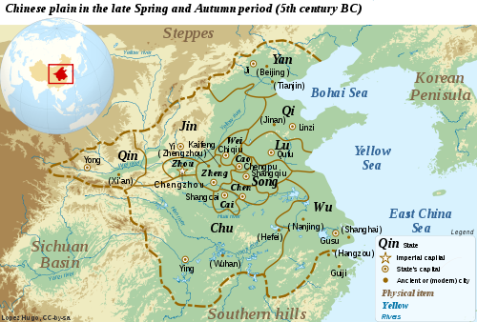
Historical Context: Collapse of Zhou dynasty, Ancient China
Zhou, 1045-256 BCE,
largely figurehead monarchs, power devolved to local lords
Spring and Autumn Period, 722-481 BCE Warring States Period, 481-221 BCE
Qin dynasty, 221 BCE
Notes:
Sūnzǐ Bīngfǎ, military methods or rules for soldiers
Terracotta Army, Emperor Qin Shi Huang, 259-210 BCE

Slide 5
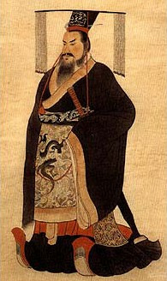
Qin Shi Huang First Emperor of unified China, buried in Yuan Terracotta Army
Notes:
Sūnzǐ Bīngfǎ, military methods or rules for soldiers
Terracotta Army, Emperor Qin Shi Huang, 259-210 BCE

Slide 6
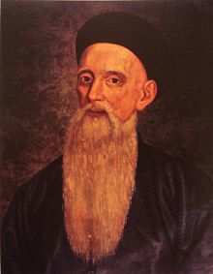
Jean Joseph Amiot
French Jesuit Missionary
1718-1793
Became Mandarin
Confidant of Emperor Qianlong
Translator of Chinese Classics into Western languages, including Confucius and Sun-Tzu
Influence of Sun-Tzu on Western military strategists from Napoleon to Colin Powell (more on this later)

Slide 7
1. Sun Tzu said: The art of war is of vital importance to the state. 2. It is a matter of life and death, a road (Tao) either to safety or to ruin. Hence it is a subject of inquiry which can on no account be neglected.

Slide 8
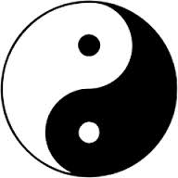
Tao and Taoism
Holistic, dynamic view of natural world, fluid, ever-changing
Dualism of action and reaction (ying and yang)
Tao = path or way

Slide 9
The Five Factors
Tao (moral law: accord of people with ruler)
Heaven (natural conditions)
Earth (terrain and environment)
The Commander (leadership skills, knowledge)
Method and Discipline

Slide 10
“All warfare is based on the way (Tao) of deception” (I: 18)
“Hence, when able to attack, we must seem unable; when using our forces, we must seem inactive; when we are near, we must make the enemy believe we are far away; when far away, we must make him believe we are near.” (I: 19)
“Hence to fight and conquer in all your battles is not supreme excellence; supreme excellence consists in breaking the enemy’s resistance without fighting.” (III: 2)
Value of stealth, speed and surprise to overcome force
Turn adversity into advantage, weakness into strength
“Appear where you are not expected.” (I: 24)
The indirect (ch’i) versus the direct (cheng): “lead on to each other in turn. . . like moving in a circle.” (V: 11)

Slide 11
What happened to Glory, Honor, Courage?
Sun-Tzu’s approach seems all practical, cold- hearted even, but his thought actually emanates from a sense of the horrors of war:
Notice his calculation on XIII: 1 where fielding an army of 100,000 will deprive 700,000 families of life and livelihood.
“There is no instance of a country having benefited from prolonged warfare.” (II: 1)

Slide 12
What happened to Glory, Honor, Courage?
XII:
Move not unless you see an advantage; use not your troops unless there is something to be gained; fight not unless the position is critical.
No ruler should put troops into the field merely to gratify his own spleen; no general should fight a battle simply out of pique.
If it is to your advantage, make a forward move; if not, stay where you are.
Anger may in time change to gladness; vexation may be succeeded by content.
But a kingdom that has once been destroyed can never come again into being; nor can the dead ever be brought back to life.
Hence the enlightened ruler is heedful, and the good general full of caution. This is the way (Tao) to keep a country at peace and an army intact.

Slide 13
What happened to Glory, Honor, Courage?
Even insubordination can be allowed if aligned with the Tao:
“If the Tao of fighting is sure to result in victory, then you must fight, even though the ruler forbid it; if the Tao of fighting will not result in victory, then you must not fight even at the ruler’s bidding.” (X: 23)

Slide 14
Remember Odysseus in the Iliad
Who wins the war and how?
Who uses stealth over strength, ruse rather than rage, cunning rather than brute courage?
Who gets the glory and honor?
Does it matter?
Odysseus polutropos --“of many ways”
What is a hero?

Slide 15
Influences
Napoleon Bonaparte,
Battle of Austerlitz,
December 2, 1805
Outcome:
Defeat and Dissolution of Holy Roman Empire (HRE)

Slide 16
Influences
Ludendorff and Hindenburg, German Generals
Western Offensive,
August, 1914
Aim: Attack France through neutral Belgium
Outcome:
Failed attack became bogged down in four bloody years of trench warfare (World War I)
Belgium as “focal terrain”; but under protection of UK

Slide 17
Influences
Admiral Isoroku Yamamoto
Attack on Pearl Harbor
December 7, 1941
Aim: Neutralize American ability to thwart Imperial Japanese expansion in the Pacific
Outcome:
Successful attack that only enraged and energized superior American industrial and military power

Slide 18
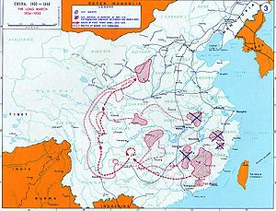
Influences
Mao Tse-Tung
Long March
October 1934-October 1935
Aim: Strategic retreat of Chinese communist army from threatened encirclement by nationalist forces.
Outcome:
8000 miles of very difficult terrain traversed in 370 days succeeded in preserving army to fight another day and in an unexpected area. Also solidified Mao’s leadership.

Slide 19
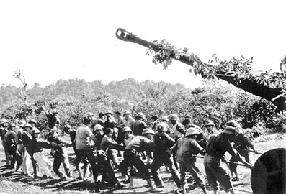
Vo Nguyen Giap
Battle of Dien Bien Phu
March-May 1954
Aim: Encircle and annihilate French colonial army by unexpectedly seizing surrounding high terrain and deploying massive artillery, much of it dragged by hand over mountains and ravine.
Outcome:
Massive defeat led to France surrendering Viet Nam to communist rule in the North and nationalist rule in the South.

Slide 20
Influences
Vo Nguyen Giap
Tet Offensive
January-February 1968
Aim: Surprise attack during Vietnamese New Year holiday, breaking ceasefire agreement to. gain strategic advantage over US and South Vietnamese positions.
Outcome:
Initial success led to military stalemate, but scenes of fighting energized American public opinion against continuing the war.

Slide 21
Influences
Colin Powell
Desert Storm
Jan 17 – Feb 28, 1991
Aim: Secure liberation of Kuwait, then occupied by Iraq, by feigning attack by sea while amassing overwhelming force to attack by land.

Slide 22
Role of Leadership
“The Tao of the true king must be to generously love his people.” (Tomb text attributed to Sun Tzu)
Remember the first factor in estimating the outcome of war is the Tao that “causes the people to be in complete accord with their ruler.” (I: 5)
Does military strategy as understood by Sun-Tzu really have more to do with politics and leadership?

Slide 23
Role of Leadership
Note the use and applicability of Sun-Tzu’s ideas to all kinds of other parts of life: business, management, negotiation, etc.
But if the Tao of the leader is “to generously love” the people, how should the leader be perceived by the people being led?
Or, “is it better to be feared than to be loved” as we learned from our previous author, Niccolò Machiavelli?

Slide 24
But why? And for what purpose?
Is there an ethics to this most brutal of human activities?
What justifies, if anything, what both Sun Tzu and Machiavelli recognize as the supreme horror that is war?
And, are there limits to what we consider to be acceptable ways to conduct war, unacceptable as the fact of war may be?

