Slide 1
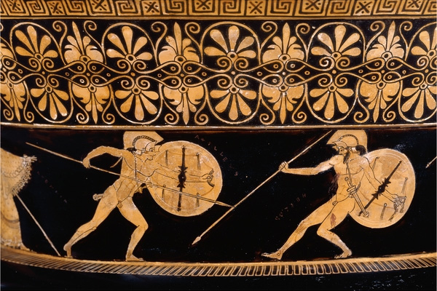
Lecture 3
Aristos Akhaiôn (Best of the Achaeans):
Value and Cultural Contradiction in
The Iliad

Slide 2
Review
(Human) Agency
A form of action that is
free
insofar as it is caused by the agent’s will
informed by reason (introspection, reflection, deliberation) and reasons
and without excessive constraint. (But what is excessive?)
“Man is free because he is a beginning.”
--Hannah Arendt

Slide 3
Iliad I.1-8
Rage—Goddess—sing the rage of Peleus’ son Achilles,
murderous, doomed, that cost the Achaeans countless losses,
hurling down to the House of Death so many sturdy souls,
great fighters souls, but made their bodies carrion,
feasts for the dogs and birds,
and the will of Zeus was moving towards its end.
Begin, Muse, when the two first broke and clashed,
Agamemnon lord of men and brilliant Achilles.

Slide 4
Review
Agency in the Iliad—read against a background of determination
a) Natural (physical and psychological determination)
b) political and economic (structural determination)
c) cultural (pedagogical determination, habitus)

Slide 5
Review
Agency in the Iliad—read against a background of determination
a) Natural (physical and psychological determination)
b) political and economic (structural determination)
c) cultural (pedagogical determination, habitus)

Slide 6
Review
Agency in the Iliad—read against a background of determination
a) Natural (physical and psychological determination)
b) political and economic (structural determination)
c) cultural (pedagogical determination, habitus)

Slide 7
When they came to the temple of Athena on the city’s height, Theano opened the doors for them, the beautiful daughter of Kisseus, and wife of Antenor the horse-tamer; the Trojans had made her priestess of Athena. All the women lifted up their hands with a great cry to Athena, and beautiful Theano took the robe and placed it on the knees of the lovely-haired goddess Athena, then spoke in prayer to the daughter of great Zeus:
‘Lady Athena, guardian of our city, queen among the goddesses, break now Diomedes’ spear, and grant that the man himself be brought down on his face in front of the Scaean gates – so that we may sacrifice here and now twelve heifers in your temple, yearlings never touched by the goad, if you will take pity on our town and the Trojans’ wives and their little children.’
Such was her prayer, but Pallas Athena shook her head in refusal.

Slide 8
Iliad 13.50-61
At once
each captain shouted out commands to his driver:
"Rein the team by the trench, good battle-order now!"
While the men themselves, armed for full assault,
leapt down and swarmed to the trench's edge on foot
and a long undying roar went up in the early dawn.
Well ahead of the war-cars they reached the brink,
closed ranks as drivers backed them yards behind.
But Zeus drove a swirl of panic deep in their lines
and down from the vaulting skies released a shower
raining blood, for Zeus was bent on hurling down
to the House of Death a rout of sturdy fighters.

Slide 9
Iliad 3. 183-194
. . . So they waited,
the old chiefs of Troy, as they sat aloft the tower.
And catching sight of Helen moving along the ramparts,
they murmured one to another, gentle, winged words:
“Who on earth could blame them? Ah, no wonder
the men of Troy and Argives under arms have suffered
years of agony all for her, for such a woman.
Beauty, terrible beauty!
A deathless goddess—so she strikes our eyes!
But still,
Ravishing as she is, let her go home in the long ships
and not be left behind . . . for us and our children
down the years an irresistible sorrow

Slide 10
Iliad 3. 183-194
. . . So they waited,
the old chiefs of Troy, as they sat aloft the tower.
And catching sight of Helen moving along the ramparts,
they murmured one to another, gentle, winged words:
“Who on earth could blame them? Ah, no wonder
the men of Troy and Argives under arms have suffered
years of agony all for her, for such a woman.
Beauty, terrible beauty!
A deathless goddess—so she strikes our eyes!
But still,
Ravishing as she is, let her go home in the long ships
and not be left behind . . . for us and our children
down the years an irresistible sorrow

Slide 11
Iliad 4. 136-146
He flipped the lid of his quiver, plucked an arrow
fletched and never shot, a shaft of black pain.
Quickly notching the sharp arrow on the string
he swore to Apollo, Wolf-god, glorious Archer,
he’d slaughter splendid victims, newborn lambs
When he marched home to Zela’s sacred city.
Squeezing the nock and string together, drawing
the gut back to his nipple, iron head to the handgrip
till he flexed the great weapon back in a half-circle curve—
the bow sprang! the string sang out, arrow shot away
razor sharp and raging to whip through the Argive ranks!

Slide 12
Iliad 3. 183-194
. . . So they waited,
the old chiefs of Troy, as they sat aloft the tower.
And catching sight of Helen moving along the ramparts,
they murmured one to another, gentle, winged words:
“Who on earth could blame them? Ah, no wonder
the men of Troy and Argives under arms have suffered
years of agony all for her, for such a woman.
Beauty, terrible beauty!
A deathless goddess—so she strikes our eyes!
But still,
Ravishing as she is, let her go home in the long ships
and not be left behind . . . for us and our children
down the years an irresistible sorrow

Slide 13
Review II
Competing models of authority in the Iliad
a) “Charismatic” (Achilles): Authority is a function of power
χάρισμα– a divinely conferred power
“[T]he authority of the extraordinary and personal gift of grace” (Max Weber)
b) “Traditional” (Agamemnon): Power derives from a right relation
to the sources of authority
“[T]he authority of the eternal yesterday” (Max Weber)

Slide 14
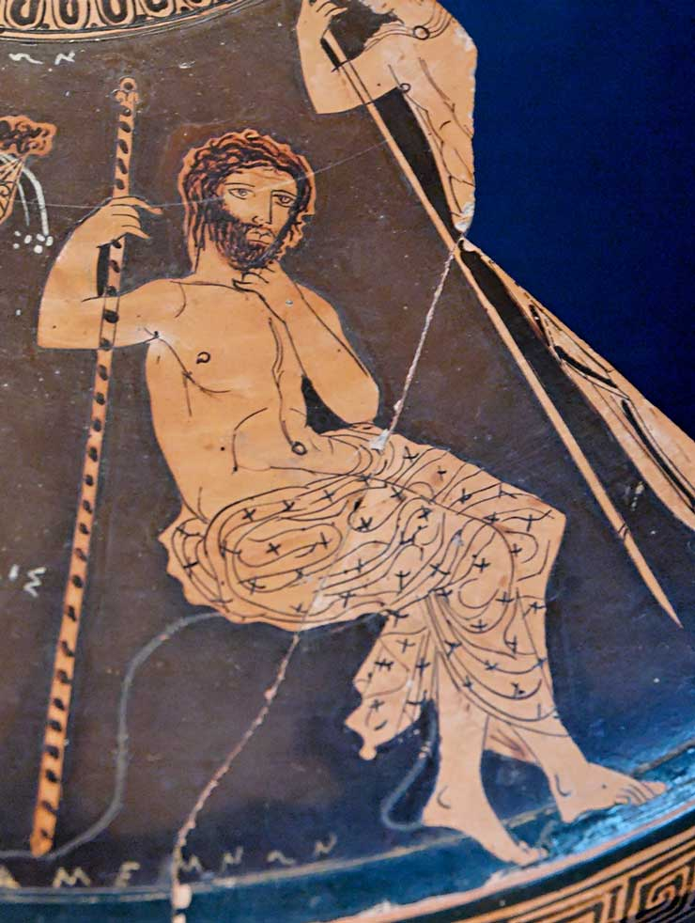
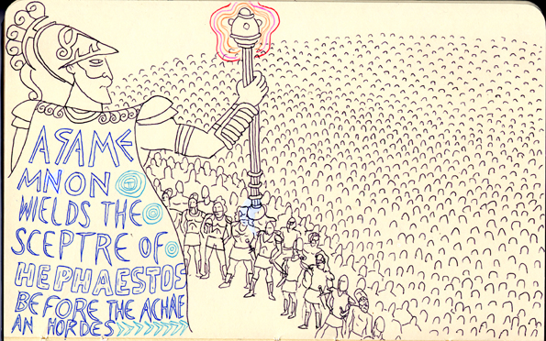
Scepter (σκῆπτρον, skeptron) of Agamemnon

Slide 15
Thersites’ Challenge: Iliad 2.262-281
Still moaning and groaning mighty Atrides—why now?
What are you panting after now? Your shelters packed
with the lion’s share of bronze, plenty of women too,
crowding your lodges. Best of the lot, the beauties
we hand you first, whenever we take some stronghold.
Or still more gold you’re wanting? More ransom a son
of the stallion-breaking Trojans might fetch from Troy?—
though I or another hero drags him back in chains . . .
Or a young woman, is it?—to spread and couple,
to bed down for yourself apart from the troops?
How shameful for you, the high and mighty commander,
to lead the sons of Achaea into bloody slaughter!
Sons? No, my soft friends, wretched excuses—
women, not men of Achaea! Home we go in our ships!
Abandon him here in Troy to wallow in all his prizes—
he’ll see if the likes of us have propped him up or not.
Look—now it’s Achilles, a greater man he disgraces,
seizes and keeps his prize, tears her away himself.
But no gall in Achilles, Achilles lets it go.
If not, Atrides, that outrage would have been your last.

Slide 16
Thersites’ Challenge: Iliad 2.262-281
Still moaning and groaning mighty Atrides—why now?
What are you panting after now? Your shelters packed
with the lion’s share of bronze, plenty of women too,
crowding your lodges. Best of the lot, the beauties
we hand you first, whenever we take some stronghold.
Or still more gold you’re wanting? More ransom a son
of the stallion-breaking Trojans might fetch from Troy?—
though I or another hero drags him back in chains . . .
Or a young woman, is it?—to spread and couple,
to bed down for yourself apart from the troops?
How shameful for you, the high and mighty commander,
to lead the sons of Achaea into bloody slaughter!
Sons? No, my soft friends, wretched excuses—
women, not men of Achaea! Home we go in our ships!
Abandon him here in Troy to wallow in all his prizes—
he’ll see if the likes of us have propped him up or not.
Look—now it’s Achilles, a greater man he disgraces,
seizes and keeps his prize, tears her away himself.
But no gall in Achilles, Achilles lets it go.
If not, Atrides, that outrage would have been your last.

Slide 17
Thersites’ Challenge: Iliad 2.262-281
Still moaning and groaning mighty Atrides—why now?
What are you panting after now? Your shelters packed
with the lion’s share of bronze, plenty of women too,
crowding your lodges. Best of the lot, the beauties
we hand you first, whenever we take some stronghold.
Or still more gold you’re wanting? More ransom a son
of the stallion-breaking Trojans might fetch from Troy?—
though I or another hero drags him back in chains . . .
Or a young woman, is it?—to spread and couple,
to bed down for yourself apart from the troops?
How shameful for you, the high and mighty commander,
to lead the sons of Achaea into bloody slaughter!
Sons? No, my soft friends, wretched excuses—
women, not men of Achaea! Home we go in our ships!
Abandon him here in Troy to wallow in all his prizes—
he’ll see if the likes of us have propped him up or not.
Look—now it’s Achilles, a greater man he disgraces,
seizes and keeps his prize, tears her away himself.
But no gall in Achilles, Achilles lets it go.
If not, Atrides, that outrage would have been your last.

Slide 18
Thersites’ Challenge: Iliad 2.262-281
Still moaning and groaning mighty Atrides—why now?
What are you panting after now? Your shelters packed
with the lion’s share of bronze, plenty of women too,
crowding your lodges. Best of the lot, the beauties
we hand you first, whenever we take some stronghold.
Or still more gold you’re wanting? More ransom a son
of the stallion-breaking Trojans might fetch from Troy?—
though I or another hero drags him back in chains . . .
Or a young woman, is it?—to spread and couple,
to bed down for yourself apart from the troops?
How shameful for you, the high and mighty commander,
to lead the sons of Achaea into bloody slaughter!
Sons? No, my soft friends, wretched excuses—
women, not men of Achaea! Home we go in our ships!
Abandon him here in Troy to wallow in all his prizes—
he’ll see if the likes of us have propped him up or not.
Look—now it’s Achilles, a greater man he disgraces,
seizes and keeps his prize, tears her away himself.
But no gall in Achilles, Achilles lets it go.
If not, Atrides, that outrage would have been your last.

Slide 19
Thersites’ Challenge: Iliad 2.287-290; 309-318
Who are you to wrangle with kings, you alone?
No one, I say—no one alive less soldierly than you,
none in the ranks that came to Troy with Agamemnon.
…
And he cracked the scepter across his back and shoulders.
The rascal doubled over, tears streaking his face
and a bloody welt bulged up between his blades,
under the stroke of the golden scepter’s studs.
He squatted low, cringing, stunned with pain,
blinking like some idiot…
rubbing his tears dumbly with a fist.
Their morale was low, but the men laughed now,
good hearty laughter breaking over Thersites head—
glancing at neighbors, they would shout, “A terrific stroke!”

Slide 20
Iliad 1.211:
“What if you are a great soldier? That’s just a gift of the gods.”
1.340-341:
“What if the everlasting gods have made a spearman of him?
Have they entitled him to hurl abuse at me? ”

Slide 21
Iliad 1.416-422
“Mother!
You gave me life, short as that life will be,
so at least Olympian Zeus thundering up on high,
should give me honor—but now he gives me nothing.
Atreus’ son Agamemnon, for all his far-flung kingdoms—
the man disgraces me, seizes and keeps my prize,
he tears her away himself!”

Slide 22
Aidos (Αἰδώς): Iliad 15.574-595
“So fight by the ships, all together. And that comrade
who meets his death and destiny, speared or stabbed,
let him die! He dies fighting for fatherland—
no dishonor there!
He’ll leave behind him wife and sons unscathed,
his house and estate unharmed—once these Argives
sail for home, the fatherland they love.”
That was his cry
as Hector put fresh fighting spirit in each man.
But Ajax fired the trips on his side too:
“Shame, you Argives! all or nothing now—
die, or live and drive defeat from the ships!
…
Quick, better to live or die, once and for all,
than die by inches, slowly crushed to death—
helpless against the hulls in the bloody press—
by far inferior men!

Slide 23
Tîmê: Iliad 12.359-373
Glaucus,
why do they hold us both in honor, first by far
with pride of place, choice meats and brimming cups,
in Lycia where all our people look on us like gods?
Why make us lords of estates along the Xanthus’ banks,
rich in vineyards and plowland rolling wheat?
So that now the duty’s ours—
we are the ones to head our Lycian front,
brace and fling ourselves in the blaze of war,
so a comrade strapped in combat gear may say,
‘Not without fame, the men who rule in Lycia,
these kings of ours who eat fat cuts of lamb
and drink sweet wine the finest stock we have.
But they owe it all to their own fighting strength—
our great men of war, they lead our way in battle!’

Slide 24
Kleos aphthiton (unperishing glory): Iliad 12.374-381
Ah my friend, if you and I could escape this fray
and live forever, never a trace of age, immortal,
I would never fight on the front lines again
or command you to the field where men win fame.
But now, as it is, the fates of death await us,
thousands posed to strike, and not a man alive
can flee them or escape—so in we go for attack!
Give our enemy glory or win it for ourselves!

Slide 25
The Warrior Ethic Against Itself
tîmê: honor, wealth, status—given to the warrior while he lives BUT: desert is proved only by risking everything
War secures the values of the community, but only by abrogating those values:
Glory is purchased with death
→ All combat is personal
The virtue (arêtê) that secures the community also threatens it. A defensive ethic needs an offensive War.

Slide 26
Achilles Refusal: 9.372-522
I will say it outright. That seems best to me.
Will Agamemnon win me over? Not for all the world,
nor will all the rest of Achaea's armies.
No, what lasting thanks in the long run
for warring with our enemies, on and on, no end?
One and the same lot for the man who hangs back
and the man who battles hard. The same honor waits
for the coward and the brave. They both go down to Death,
the fighter who shirks, the one who works to exhaustion.
And what's laid up for me, what pittance? Nothing —
and after suffering hardships, year in, year out,
staking my life on the mortal risks of war.
Like a mother bird hurrying morsels back
to her unfledged young — whatever she can catch —
but it's all starvation wages for herself.

Slide 27
Achilles Refusal: 9.372-522
I will say it outright. That seems best to me.
Will Agamemnon win me over? Not for all the world,
nor will all the rest of Achaea's armies.
No, what lasting thanks in the long run
for warring with our enemies, on and on, no end?
One and the same lot for the man who hangs back
and the man who battles hard. The same honor waits
for the coward and the brave. They both go down to Death,
the fighter who shirks, the one who works to exhaustion.
And what's laid up for me, what pittance? Nothing —
and after suffering hardships, year in, year out,
staking my life on the mortal risks of war.
Like a mother bird hurrying morsels back
to her unfledged young — whatever she can catch —
but it's all starvation wages for herself.

Slide 28
From me alone, Achilles
of all Achaeans, he seizes, he keeps the bride I love . . .
Well let him bed her now —
enjoy her to the hilt!
Why must we battle Trojans,
men of Argos? Why did he muster an army, lead us here,
that son of Atreus? Why, why in the world if not
for Helen with her loose and lustrous hair?
Are they the only men alive who love their wives,
those sons of Atreus? Never! Any decent man,
a man with sense, loves his own, cares for his own
as deeply as I, I loved that woman with all my heart,
though I won her like a trophy with my spear . . .
But now that he's torn my honor from my hands,
robbed me, lied to me — don't let him try me now.
I know him too well — he'll never win me over!

Slide 29
From me alone, Achilles
of all Achaeans, he seizes, he keeps the bride I love . . .
Well let him bed her now —
enjoy her to the hilt!
Why must we battle Trojans,
men of Argos? Why did he muster an army, lead us here,
that son of Atreus? Why, why in the world if not
for Helen with her loose and lustrous hair?
Are they the only men alive who love their wives,
those sons of Atreus? Never! Any decent man,
a man with sense, loves his own, cares for his own
as deeply as I, I loved that woman with all my heart,
though I won her like a trophy with my spear . . .
But now that he's torn my honor from my hands,
robbed me, lied to me — don't let him try me now.
I know him too well — he'll never win me over!

Slide 30
Ah but now,
since I have no desire to battle glorious Hector,
tomorrow at daybreak, once I have sacrificed
to Zeus and all the gods and loaded up my holds
and launched out on the breakers — watch, my friend,
if you'll take the time and care to see me off,
and you will see my squadrons sail at dawn,
fanning out on the Hellespont that swarms with fish,
my crews manning the oarlocks, rowing out with a will,
and if the famed god of the earthquake grants us safe passage,
the third day out we raise the dark rich soil of Phthia.
There lies my wealth, hoards of it, all I left behind
when I sailed to Troy on this, this insane voyage —
and still more hoards from here: gold, ruddy bronze,
women sashed and lovely, and gleaming gray iron,
and I will haul it home, all I won as plunder.
All but my prize of honor . . .
he who gave that prize has snatched it back again —
what outrage! That high and mighty King Agamemnon,
that son of Atreus!

Slide 31
Ah but now,
since I have no desire to battle glorious Hector,
tomorrow at daybreak, once I have sacrificed
to Zeus and all the gods and loaded up my holds
and launched out on the breakers — watch, my friend,
if you'll take the time and care to see me off,
and you will see my squadrons sail at dawn,
fanning out on the Hellespont that swarms with fish,
my crews manning the oarlocks, rowing out with a will,
and if the famed god of the earthquake grants us safe passage,
the third day out we raise the dark rich soil of Phthia.
There lies my wealth, hoards of it, all I left behind
when I sailed to Troy on this, this insane voyage —
and still more hoards from here: gold, ruddy bronze,
women sashed and lovely, and gleaming gray iron,
and I will haul it home, all I won as plunder.
All but my prize of honor . . .
he who gave that prize has snatched it back again —
what outrage! That high and mighty King Agamemnon,
that son of Atreus!

Slide 32
Ah but now,
since I have no desire to battle glorious Hector,
tomorrow at daybreak, once I have sacrificed
to Zeus and all the gods and loaded up my holds
and launched out on the breakers — watch, my friend,
if you'll take the time and care to see me off,
and you will see my squadrons sail at dawn,
fanning out on the Hellespont that swarms with fish,
my crews manning the oarlocks, rowing out with a will,
and if the famed god of the earthquake grants us safe passage,
the third day out we raise the dark rich soil of Phthia.
There lies my wealth, hoards of it, all I left behind
when I sailed to Troy on this, this insane voyage —
and still more hoards from here: gold, ruddy bronze,
women sashed and lovely, and gleaming gray iron,
and I will haul it home, all I won as plunder.
All but my prize of honor . . .
he who gave that prize has snatched it back again —
what outrage! That high and mighty King Agamemnon,
that son of Atreus!

Slide 33
Mother tells me,
the immortal goddess Thetis with her glistening feet,
that two fates bear me on to the day of death.
If I hold out here and I lay siege to Troy,
my journey home is gone, but my glory never dies.
If I voyage back to the fatherland I love,
my pride, my glory dies . . .
true, but the life that's left me will be long,
the stroke of death will not come on me quickly.

