Slide 1
Transition: From Troy to the Thirty Years’ War
Grimmelshausen’s Simplicius Simplicissimus and Modes of Representing History

Slide 2
Exploring Bertolt Brecht: A Workshop for Non-Actors
When: Friday, October 23, 11:00 a.m.
Where: Biological Sciences 3 (BS3), Room 1200

Slide 3
Prof. John H. Smith
Dept. of European Languages and Studies
jhsmith@uci.edu
Office Hours: Thursdays, 1:00 – 3:00
213 Humanities Instructional Building
Please visit me….

Slide 4
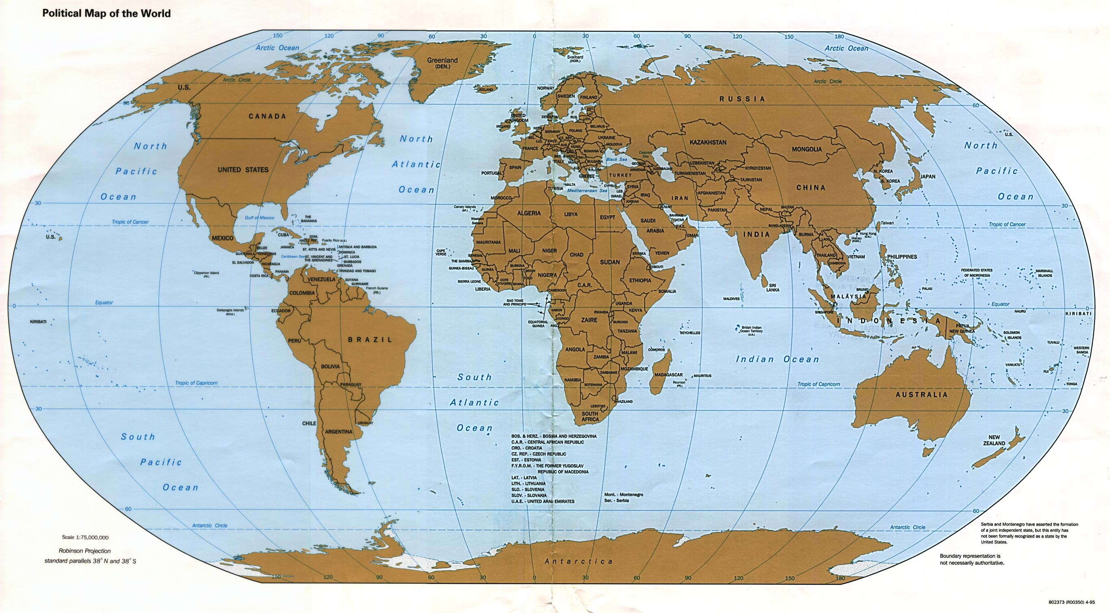
Where have we been and where are we going?
Troy (Iliad) →
France /
Germany
(Weil) →
U.K. (Oswald)
Thirty Years’ War /
Germany
( = Central
Europe) → Germany
(Grimmelshausen
and Brecht) →
U.S. (NYC)
(Walter)
Both Prof. Izenberg’s and my lectures deal with inheritances of the past in the contemporary world.

Slide 5
When have we been, and when will we have been by week 7? A (partial) history of wars (in the West)….
TROJAN WAR (c. 1300-1200 BCE)
Peloponnesian War -- Athens and Sparta(431-404 BCE)
(Caesar’s) Gallic Wars (58-50 BCE)
The Crusades (1095-1272 CE)
THIRY YEARS’ WAR (1618-1648)
Civil War (1860-1865)
World War I (1914-1918)
WORLD WAR II (1939-1945)
Vietnam War (1954-1975)
First Gulf War (1990-91)
SECOND GULF WAR (2003-11)

Slide 6
Although I am not a historian….
….we are turning to a reflection on History.
But recall Prof. Izenberg’s statement:
“History, as story is as ‘made’ as poetry.”

Slide 7
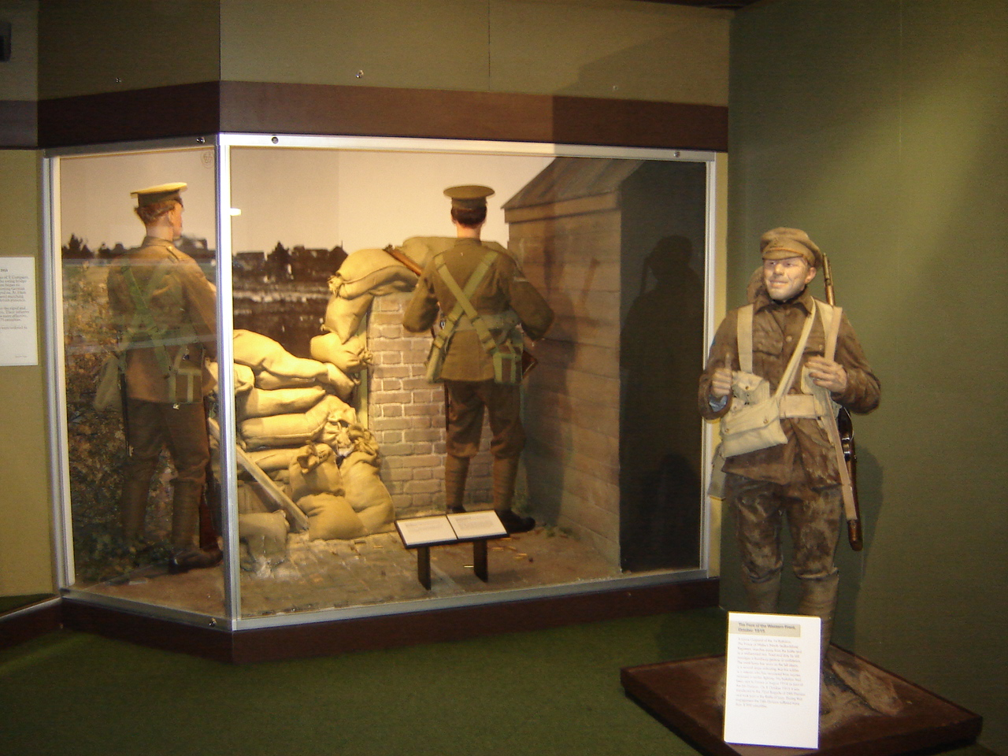
The Thirty Years’ War might be far away and foreign, but we’re not treating it as a dead, “museal” object.

Slide 8
Rather, our job is to understand the past both as it is different from us and as it continues to be relevant for us.
The Thirty Years’ War and Grimmelshausen, we’ll see, were important for a playwright during WWII and through him for our immediate present.

Slide 9
The “big picture”
Why are we reading this bizarre book by Grimmelshausen?
The period from ca. 1500 to the end of the Thirty Years’ War was one of major upheaval and transition in Europe.
It gave birth to fundamental features of our world, i.e., “modernity” in the West.

Slide 10
What new features of “modernity” might we encounter in this text?
A new kind of individual who learns to live with chaos and change by adapting. (You’ll see that in Macchiavelli as well.)
A new kind of non-denominational Christian piety, a form of “natural” religion (after the fighting between Catholics and Protestants).
A new political order, international relations organized around nation-states.

Slide 11
I will concentrate on points 1 and 3: The emergence of a new kind of individual and of a new political order.
But to see any of this will take a lot of interpretive work on our part, and for that we’ll need some tools….

Slide 12
HISTORY as STORY and REPRESENTATION
A basic distinction when considering how we tell the history/story of war:
Res gestae Latin for the things that happened
vs.
Historia rerum gestarum Latin for the telling of those things, the story of the events (res gestae)
We need to be asking questions as we look at historia.

Slide 13
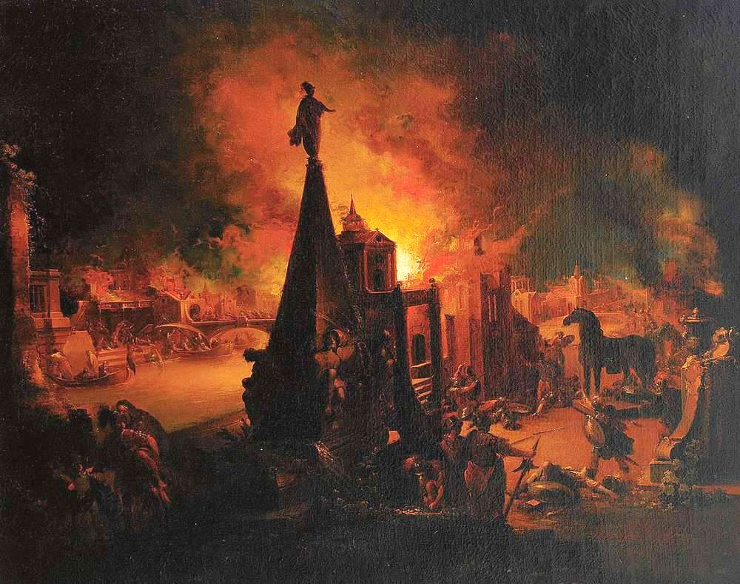
How is the story of a war “told”?
As dramatic spectacle?
Johann Georg Trautmann (1713-1765),
“Troy Burns”

Slide 14
And also…
Who speaks and what do we see in any given re-presentation of the past?
What exactly is being “made present again”? From whose point of view?
WHY?
READ “Representing History” by Prof. Jane O. Newman in the HCC Writer’s Handbook

Slide 15
How is the story shaped? The Power of Genre
Genre - The term for any category of literature or other forms of art (painting, music, film) based on some set of stylistic criteria or content-driven classificatory categories.
EPIC - “An extended narrative poem in elevated or dignified language,” celebrating the feats of a “legendary” and usually upper-class or ruling-class “hero.”
PICARESQUE - A prose-fiction narrative, usually satirical, usually humorous (often obscene); it follows a lower-class “hero” (picaro) as he undergoes ‘adventures’ and tries to survive by his wits in a corrupt world…
The picaresque is the “underbelly” of epic . It tells war “from below”…

Slide 16
The picaresque genre has its origins in the 17th-century Spain.
See the footnote on page 1 of our text where there is an allusion to Cervantes (one of the main founders of the picaresque)!
While the main character appears as a “simpleton” with childlike naiveté, Grimmelshausen is making a conscious stylistic decision, choosing a particular form for his story.

Slide 17
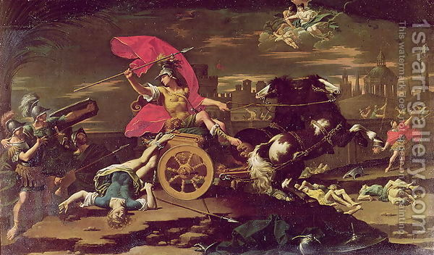
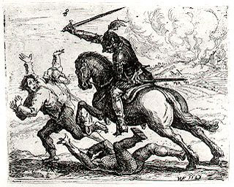
Compare these genres of painting:
Hans Ulrich Franck (1603-75) “Der Geharnischte Reiter” (Knight in Armor) – etching, 11 x 13 cm.
Donato Creti (1671-1749), “Achilles Dragging Hektor’s Body around the Walls of Troy”
(95 x 56 inches) = 8 feet x 4 and 1/2 feet

Slide 18
“History from Above”/Epic or Heroic “History Painting”—usually large, oil
Donato Creti (1671-1749), “Achilles Dragging Hektor’s Body around the Walls of Troy”
(95 x 56 inches) = 8 feet x 4 and 1/2 feet

Slide 19
Versus “History from Below”? Similar scene, but different genre and medium (etching) / Look at both the content and the scale of the figures (and the image)
Hans Ulrich Franck (1603-75) “Der Geharnischte Reiter” (Knight in Armor) – etching, 11 x 13 cm.

Slide 20
Battle of White Mountain (outside Prague) Defeat of Frederick V, 1620

Slide 21
Travelers ambushed outside a village

Slide 22
Even further “below” – and reversing the power-authority relation…
Hans Ulrich Franck (1603-75) -“Die Rache der Bauern” (The Revenge of the Peasants) – Even more “un-Iladic” and “Grimmelshausen-ian” (Simplicissimus, Book One, p. 23)

Slide 23
So… HCC (Fall, 2015): Weeks 1-3 → Week 4 From epic to picaresque
→
Shift in genre / shift in point-of-view / shift in the “world
of war” that we – and the texts – are “judging”…

Slide 25
To think about the specific genre is to emphasize how the events are represented, from what perspective.
Prof. Izenberg referred to this as the “madeness” of a work as “artifactualization.”
Grimmelshausen creates, “artifactualizes,” a world very different from Homer’s—because his world is very different.

Slide 26
Another genre and way of re-presenting war: Example #1: ‘Real-time’ war poetry / Andreas Gryphius, “Tränen des Vaterlandes” (“Tears Of the Fatherland”) (1636) (Thirty Years’ War: 1618-1648)
Wir sind doch nunmehr ganz, ja mehr denn ganz verheeret! Der frecher Völker Schar, die rasende Posaun, Das vom Blut fette Schwert, die donnernde Karthaun Hat aller Schweiß und Fleiß und Vorrat aufgezehret. Die Türme stehn in Glut, die Kirch ist umgekehret, Das Rathaus liegt im Graus, die Starken sind zerhaun, Die Jungfraun sind geschänd't, und wo wir hin nur schaun, Ist Feuer, Pest und Tod, der Herz und Geist durchfähret. Hier durch die Schanz und Stadt rinnt allzeit frisches Blut. Dreimal sind's schon sechs Jahr, als unsrer Ströme Flut, Von Leichen fast verstopft, sich langsam fortgedrungen. Doch schweig' ich noch von dem, was ärger als der Tod, Was grimmer denn die Pest und Glut und Hungersnot: Daß auch der Seelen Schatz so vielen abgezwungen.

Slide 27
REMINDER: We’re reading a translation of a text originally written in German (that’s true of the readings for this week, Grimmelshausen, and next week, Brecht, as well).

Slide 28
Learn German!!

Slide 29
Full now—yea, more than full--behold our devastation: The frantic drum beat, and the brazen horde, The thundering siege gun, and the blood-slick sword Devour all diligence, and sweat, and careful preparation. The church is overthrown; our mighty men are slain; The town hall lies in dust; our towers burn; Virgins are raped; and everywhere we turn Are fire, plague, and death to pierce us—heart and brain. Down walls and through the town runs always fresh-spilled blood For eighteen summers now, our river's yearly flood Near-choked with corpses, has pushed slowly, slowly on But nothing will I say of one thing—worse, I know, Than death, more grim than plague, or fire, or hunger's woe: Those pillaged souls from whom even hope of heaven is gone.

Slide 30
What kind of an “artifactualization” of war is this? What’s the tension between content and form?
An attempt to impose form and order on a destructive and chaotic world.

Slide 31
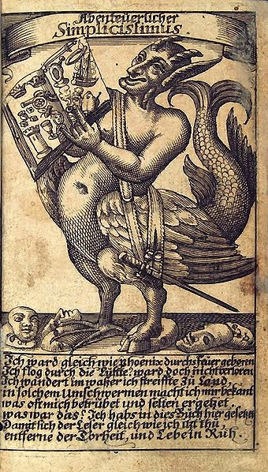
Re-presenting the Thirty Years’ War / Example #2: From Sonnet to Picaresque
→ Hans Jakob Christoffel von Grimmelshausen (1621-76)
- Der abenteuerliche Simplicissimus Teutsch, d.h. die Beschreibung des Lebens eines seltsamen Vaganten, genannt Melchior Sternfels von Fuchsheim = The Adventurous Simplicissimus, German, i.e., the Description of the life of an odd vagrant named Melchior Sternfels von Fuchsheim (1668)
- About the Thirty Years’ War, but written twenty years after the end of the war…
Frontispiece illustration of Simplicissimus

Slide 32
Learn German!!

Slide 33
Note for weeks 5 and 6
Grimmelshausen also wrote:
- Die Ertzbetrügerin und Land-störtzerin Courasche = The Life of the Cunning Vagabond, Courage... (1669) – Also about the Thirty Years‘ War...
This second text was one of the texts Bertolt Brecht used to write his play, Mother Courage and her Children (1939), that we‘ll be reading for next week...

Slide 34
The frontispiece: A guide to the novel?
What is this creature?

Slide 35
Satyr
one of a class of lustful, drunken woodland gods. In Greek art they were represented as a man with a horse's ears and tail, but in Roman representations as a man with a goat's ears, tail, legs, and horns. (Here a relative, the faun from the Chronicles of Narnia)

Slide 36
What genre might be associated with a satyr?
Satire
ˈsaˌtī(ə)r/noun the use of humor, irony, exaggeration, or ridicule to expose and criticize people's stupidity or vices, particularly in the context of contemporary politics and other topical issues.

Slide 37
What else can you say about the figure?
What about the book he’s holding?

Slide 38
Does it look like a sonnet, or even Homer’s Illiad?
The genre of the Picaresque shows the war from below, a jumble of episodes and events, out of control (including the “hero’s” body…)

Slide 39
“I was born in fire like the phoenix. I flew through the air, but did not get lost. I travelled over water; I journeyed over the land. In the course of such wanderings, I became acquainted with things that often saddened and seldom pleased me. What then? I have put it all in this book, so that readers, just like me, may abandon folly and live in peace.”
- The “Phoenix” (which accompanied this frontispiece in the original edition)

Slide 40
This is a chaotic book, with a chaotic character, experiencing chaotic events—peasants torturing soldiers on one page, soldiers torturing peasants on another; an idyllic, peaceful farm on one page, plundering and rape on another….
A representation “from below” of its time.
Not a literal chronicle of events, but a representation to make a point about his time.

Slide 41
“Tree of the Estates”: Another “artifactualization,” a “world” within the novel

Slide 42
Simplicius’s dream (Book 1, Chaps. 15-18)
Grimmelshausen gives us a clue in the text that we need to read this as a story and not as a literal presentation of facts.
The dream of the “tree” that represents society. On one of the trees is the following:
The giant oak when battered by storm and badly hurt
Casts off a branch or two, worse damage to avert
Through internecine wars and through fraternal strife
All things are overturned and suffering grows rife

Slide 43
This “allegorical” representation of Grimmelshausen’s world is a signal to us that the novel, too, is an artifact, a “made” story or historia.

Slide 44
Thus, concerning genre and history
We are reading a fictionalized autobiography.
This is not the life of Grimmelshausen but the story of a figure who receives the name “Simplicius.”
The res gestae (events told) need to be understood in light of the historia (the mode of narration).
And yet, while this novel cannot be taken as history, we need to understand something about the history of the period to fully appreciate what it’s doing. What are the “internecine wars”?

Slide 45
Full disclosure: We are reading only part of Grimmelshausen’s novel!
We are reading:
Books One and Two = the travels and wanderings…
We are not reading (although you could read…):
Books Three, Four, and Five = more travels and wanderings…
Book Six = the “abandonment of folly” and “living in peace” on an island.

Slide 46
The historical Thirty Years’ War (1618-48) was itself a jumble… A prolonged and mixed-up – BUT NEVER HUMOROUS – war full of many “episodes,” with many participants, “causes,” and “outcomes”…
A “European” war
The central player was the (Catholic) Holy Roman Empire (ruled by the Habsburgs), where it was fought.
Different stages based on other countries who entered in to fight against the HRE.
The Bohemian-Palatinate War (1618-23)
The Danish-Dutch / Lower Saxon War (1623-9)
Swedish War (1630-35) (LUTHERANS)
French War (1635-48) (weird because Catholic France stepped in to fight with the Protestants)
This “succession of wars became so dense
that it was perceived at its height and thereafter
as a single war…” (Johannes Burckhardt)

Slide 47
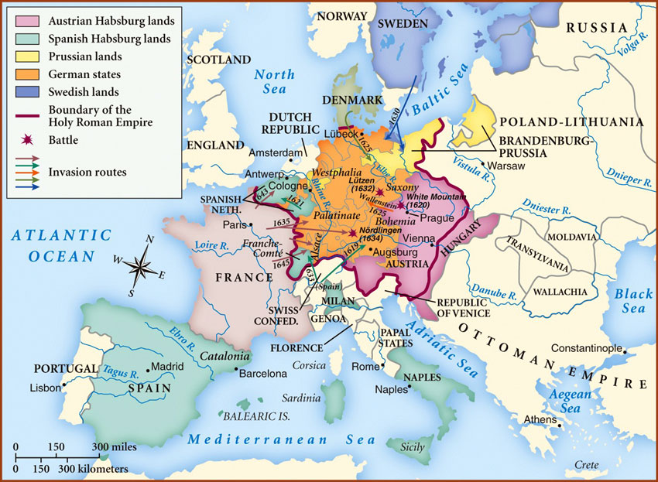

Slide 48
On the ground…
The Thirty Years’ War was characterized by a constant back-and-forth of armies through the territory that is now basically Germany.
Protestants would sweep in, ransack and pillage; then the Catholics; then the Protestants again….
Both horrible and confusing for the people on the ground (esp. non-literate peasants)

Slide 49
The Thirty Years’ War…
What was it about, what were its causes?
Was it:
1. a “war of religion” / conflict between Catholics and Protestants, OR
2. a (German / central European) constitutional war over politics; OR
3. a “war of European state-building”…?

Slide 50
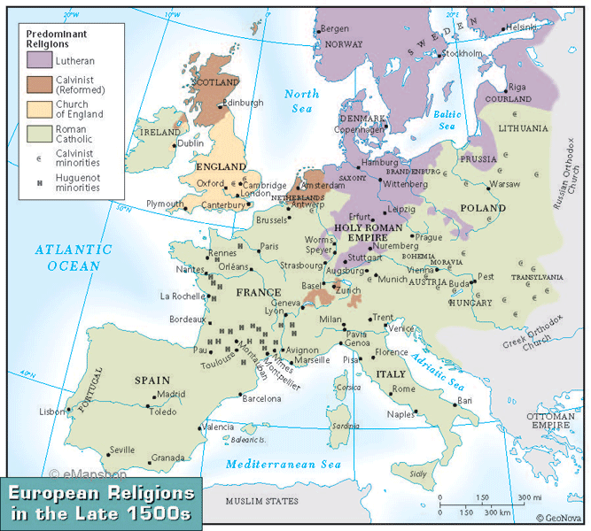
1. A war of religion?
Fracturing of medieval Christendom by Martin Luther and the Protestant Reformation
“95 Theses” posted on the church in Wittenberg, 1517.

Slide 51
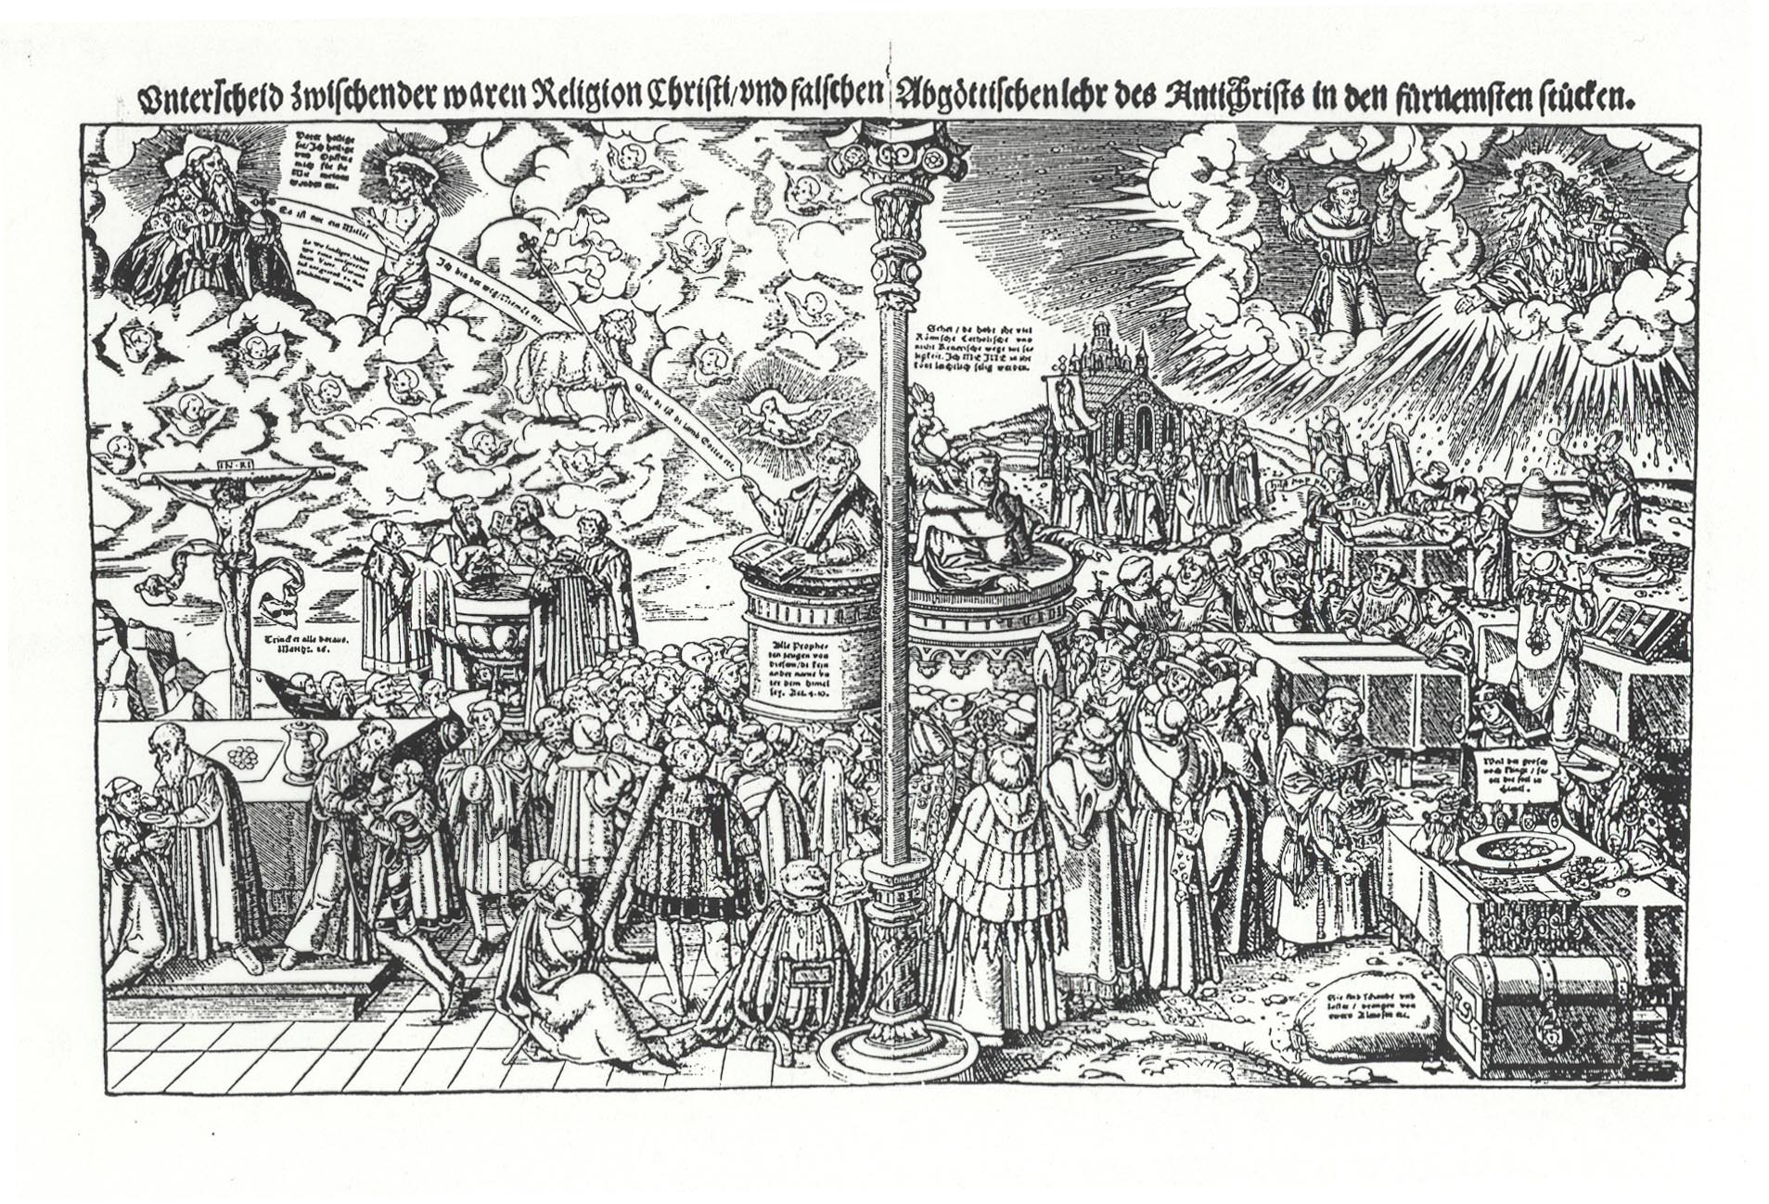
Lucas Cranach, “The Difference Between the True Religion of Christ [Protestantism]
and the False Idolatrous Teaching of the [Catholic] Antichrist” (1545)

Slide 52
2. A “constitutional” war? Power struggles in the Holy Roman Empire

Slide 53
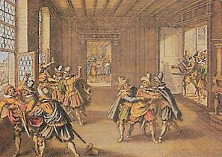
The immediate cause
A struggle between different levels of rulers in that jumble of the Holy Roman Empire.
Protestant assembly of lords is angry that they have lost privileges, and throws Catholic representatives of the King of Bohemia, Ferdinand II (who was also the future Emperor of the HRE) out of a window in the Prague Castle.
“Defenestration” of Prague, May 23rd, 1618

Slide 54
A contemporary woodcut

Slide 55
OR: 3. Third “cause”: The Thirty Years’ War as a war of European state-building
The “nation-states” of France and Sweden vs. the ”universal” Holy Roman Empire
of the German Nation (HRE)

Slide 57
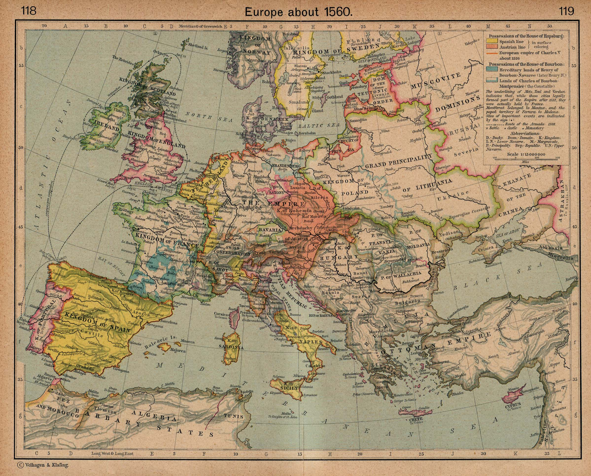

Slide 58
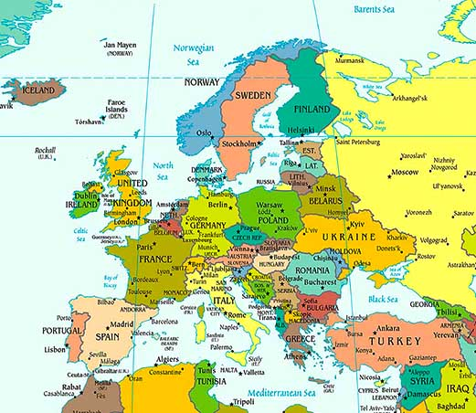

Slide 59
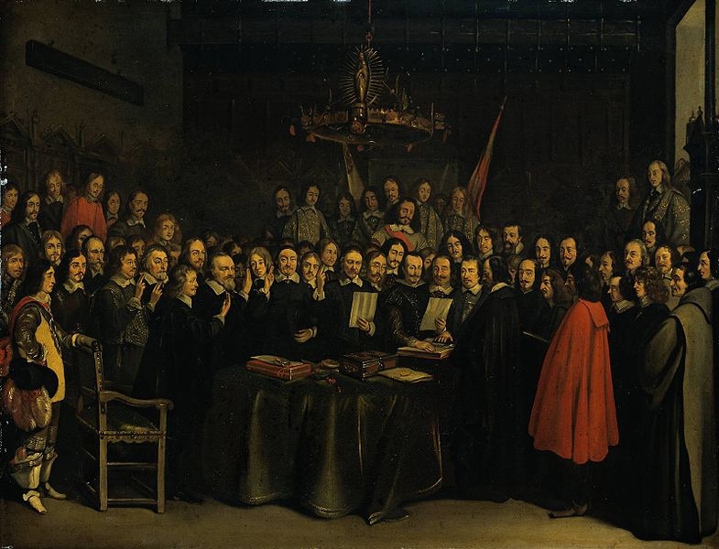
Finally brought to an end by….
The Treaty of Westphalia (1648)
109 signatories!
Considered by many to be the establishment of the modern “nation-state” system.
Major milestone in international law.

Slide 60
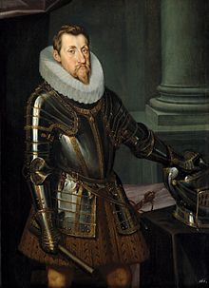
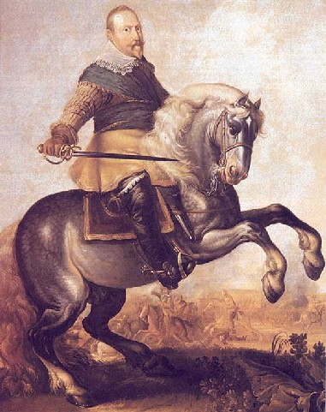
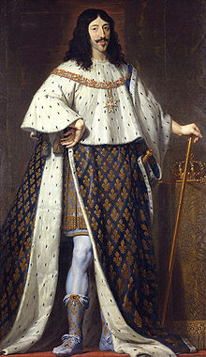
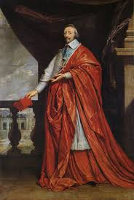
The Major Actors
King
Gustavus
Adolphus
of Sweden
(1594-1632)
Holy Roman Emperor
Ferdinand II
(1578-1637)
Cardinal
Richelieu
(1585-
1642)
King Louis XIII
of France (1601-43)

Slide 61
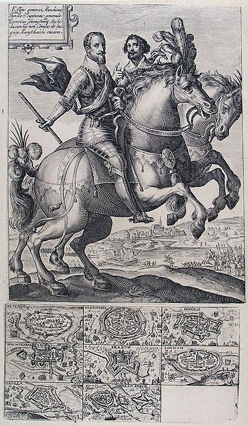
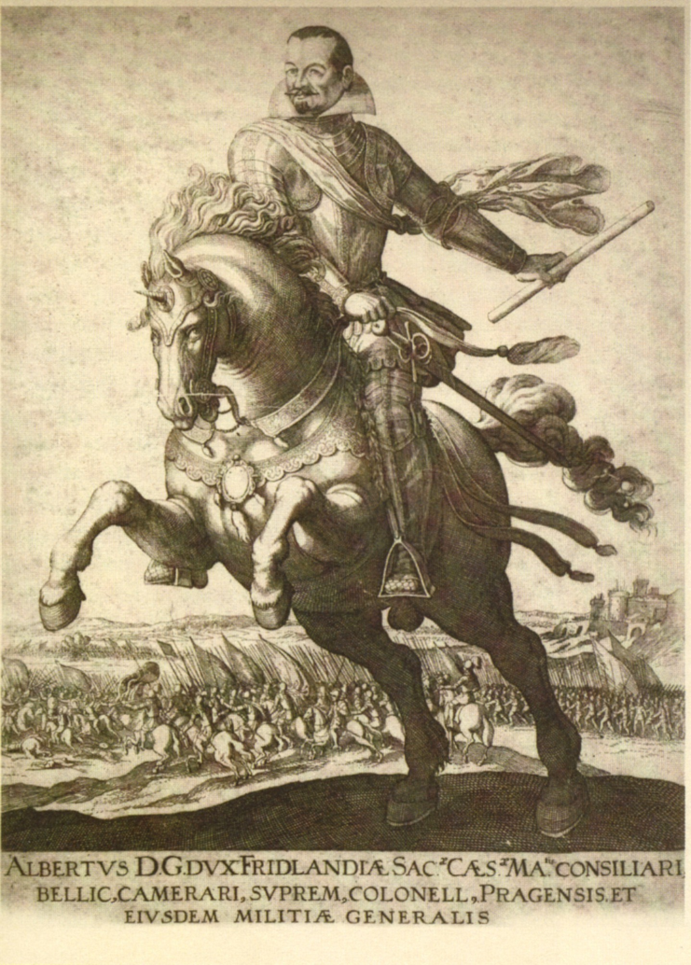
Or some of the great generals of the war….
Albrecht Wenzel Eusebius von Wallenstein
(1583-1634)
Ambrogio Spinola (1569-1630)

Slide 62
Do we see any of these guys in Grimmelshausen, Simplicissimus? (only very occasionally)
Why not?
The picaresque genre gives a selective point of view that is only indirectly concerned with “big history” from above.
What we don’t see is part of the message! ( = “subtractive” logic of Alice Oswald’s Memorial…)

Slide 63
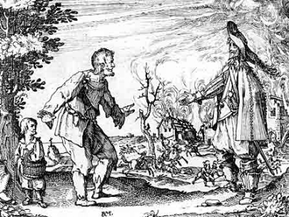
Instead, we might see something like this woodcut of a farmer begging before a burning house….

Slide 64
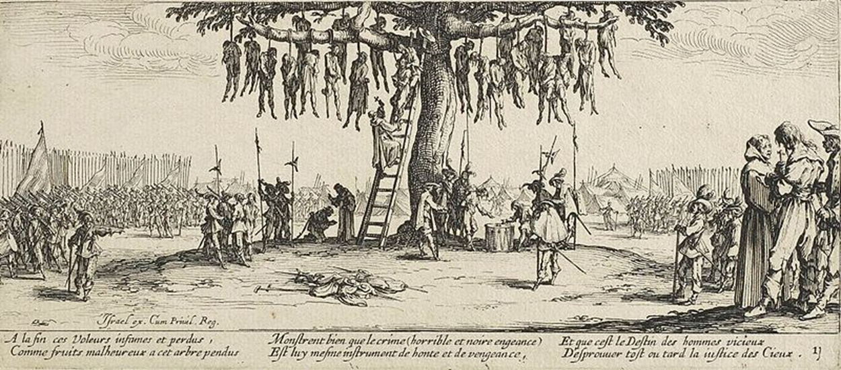
Or scenes like this famous one of the treatment of heretics….
Jacques Callot, “The Hanging” (from his series, “The Horrors of War,” 1632-3)

Slide 65
In fact, much of the war was fought by mercenaries and conscripts.

Slide 66
Thirty Years’ War—some statistics
The historian Langer claims that Sweden alone destroyed 2000 castles, 18,000 villages and 1500 towns in Germany. If his figures are accurate, the number of towns destroyed represented one-third of all German towns.
Certain cities were hit very hard by war. Probably the best example was Magdeburg. In 1618, it had a population of 25,000 with a further 35,000 in the surrounding rural area. In 1635, there were only 400 homes left standing in the city and by 1644, its population had fallen to 2,464.
The accepted figures are that urban areas experienced a 33% population loss while rural areas experienced a 40% loss.

Slide 67
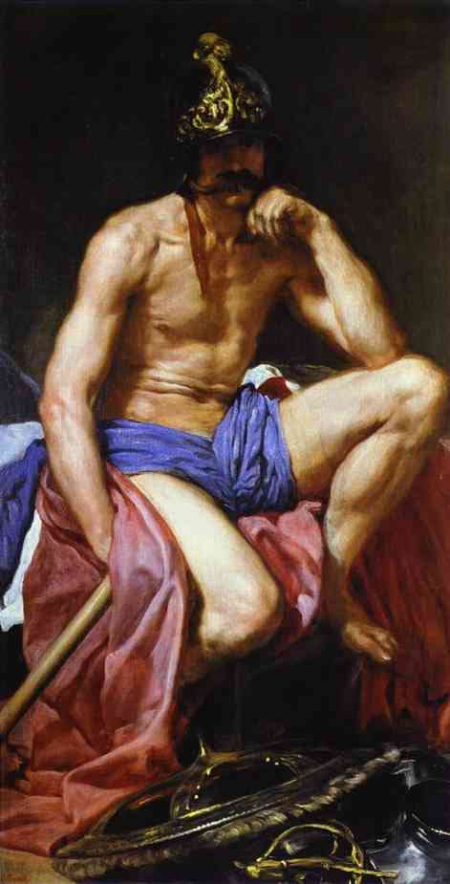
“Mars Resting” (the god of war) by Diego Velázquez, ca. 1639-41)

Slide 68
Questions to ponder as you read through this jumble of a book:
What “image” (story, version, representation) of the Thirty Years’ War do we see in Grimmelshausen’s picaresque novel?
How do we see a world and “hero” in chaos and attempts to find order and control?

Slide 69
Exploring Bertolt Brecht: A Workshop for Non-Actors
When: Friday, October 23, 11:00 a.m.
Where: Biological Sciences 3 (BS3), Room 1200

