Slide 1
Telling War Stories
Carol Burke
185 HIB
cburke@uci.edu

Slide 2
Res gestae (the things that happened)
Historia (our accounts of the things that happened)

Slide 3
Factors that might influence our accounts of any war or any event in any war:
Proximity of time
How does the passage of time affect how we think about a war?
What documents of war are preserved for our perusal; what documents are regarded as unworthy of preservation?
Who makes those decisions?
Proximity of Space/ geography
Where do we stand relative to the events of a war?

Slide 4
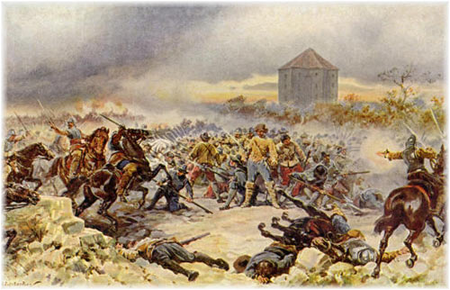
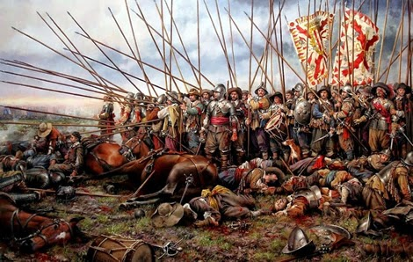
Battle of White Mountain, 1620
Battle of Rocroi, 1943

Slide 5
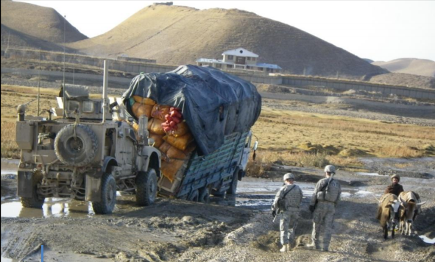
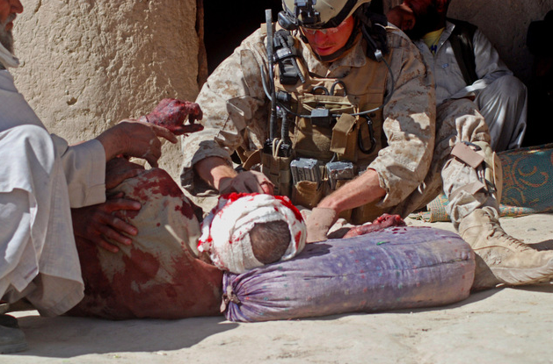
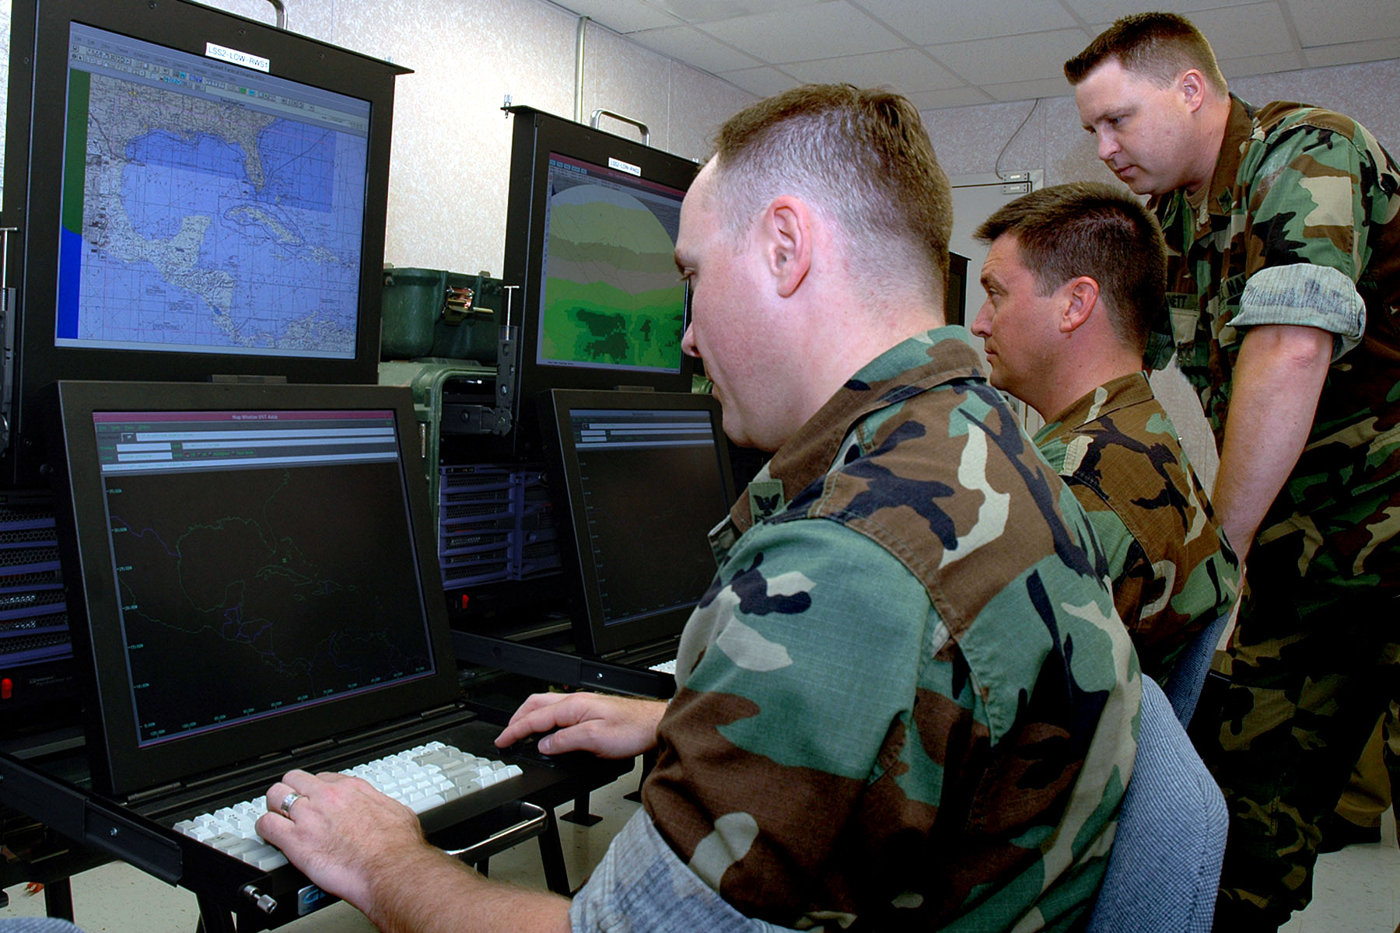
Consider what one sees of the war while doing different military jobs
Pilot’s point of view
Army infantry
Army infantry
Marine corpsman
Intelligence officer

Slide 6
Where do reporters go for their stories?

Slide 7
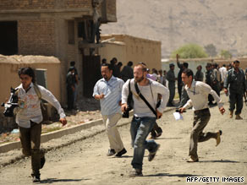
Others document the war close up
Nour Kelze, 25 photo journalist
Journalists in Afghanistan running from gunfire aimed at the Afghan National Police in the background

Slide 8
Other Factors that Influence the historia we construct about war:
If we are writing about war, we bring to that task our training as historians, literary scholars, art historians, reporters, philosophers. We ask certain sets of questions specific to our disciplines and write with certain generic conventions in mind.
And we bring to any writing we do our own interests, attitudes, and prejudice. Do we consider the war just or unjust? Which side of the conflict are we on.

Slide 9
The Takeaways
Every account, every story about a war or about a single event in war is an interpretation.
Every interpretation is a simplification.
There is no single truth about a war but there are many honest ways of describing it.

Slide 10
Story 1 – the Long View

Slide 11
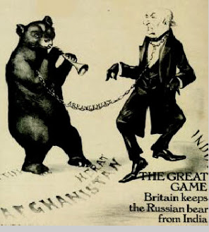
The Great Game

Slide 12
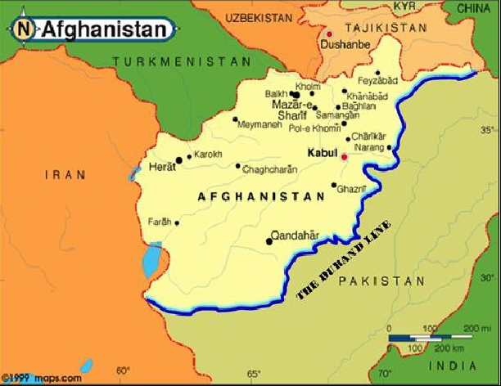
1839 – 1st Anglo-Afghan war
1878 – 2nd British invasion
1893 – Durand line

Slide 13
Ethnic Map of Afghanistan and Pakistan

Slide 14
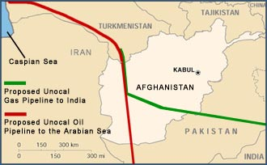
Story 2: The 20th C Economic Account
Soviets wanted to build a pipeline to link energy markets of the west with Asia
Iran wanted to build the same pipeline but from Iran across Afghanistan
The Americans were eager to do the same thing.

Slide 15
Afghanistan’s major export

Slide 16
What does this say about Afghanistan today?

Slide 17
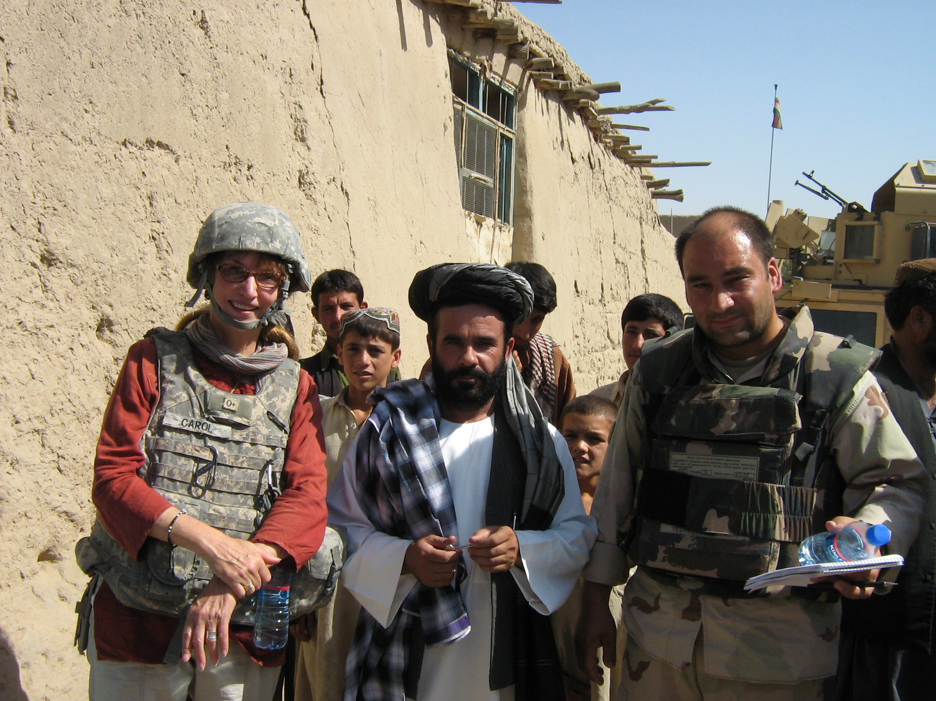

Slide 19
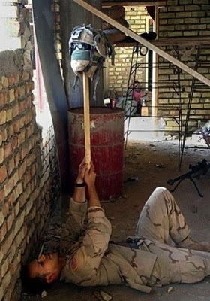
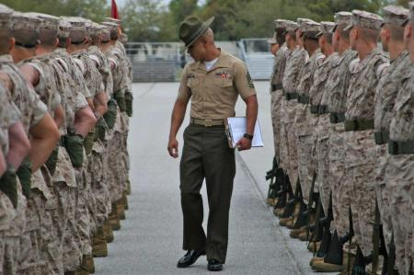
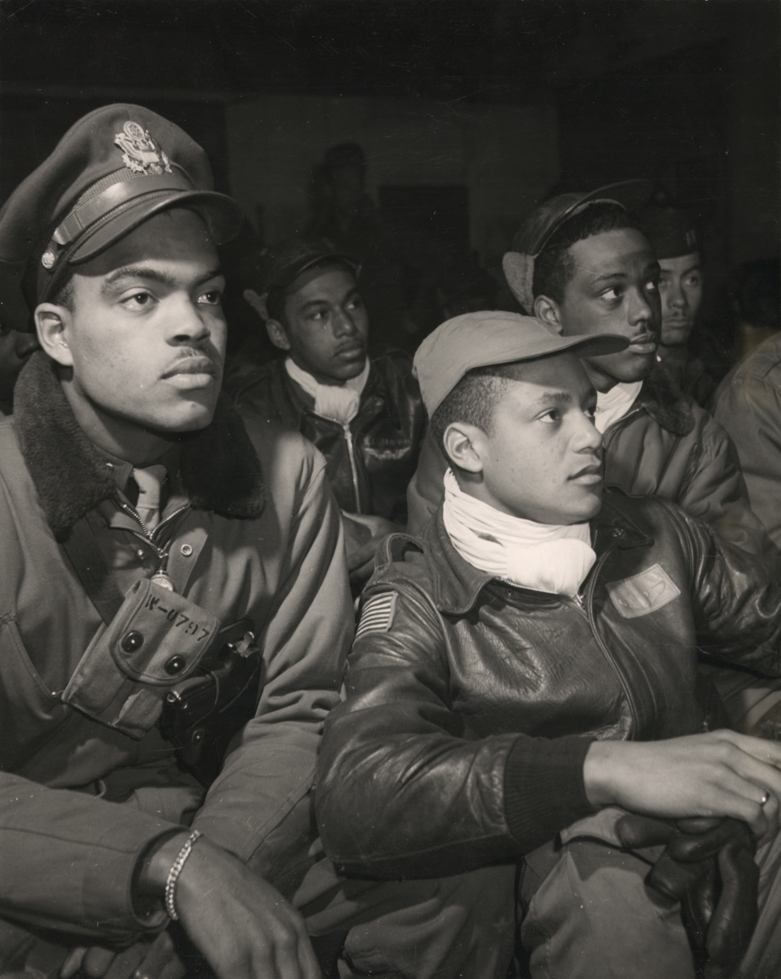
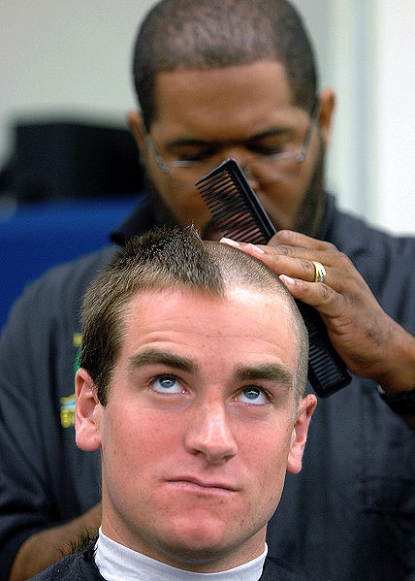
Military Culture

Slide 20
Transformation of the Citizen into the Soldier
Basic training, I will argue, is a highly ritualized education designed to transform identity.
The process of that transformation has historically pitted hyper-masculinity against civilian femininity, a problem that has hampered full gender integration.
Becoming a member of the Corps requires that one master its culture.

Slide 21
Culture
a way of life informed by those who came before us, by the beliefs we hold, and the activities we perform.
Culture is manifest in the rituals we observe, the jokes we tell, the slang we speak, the clothes we wear, the food we eat, the music we listen to and perform, the work we do, and the ways in which we interact with others who share our work place.

Slide 22
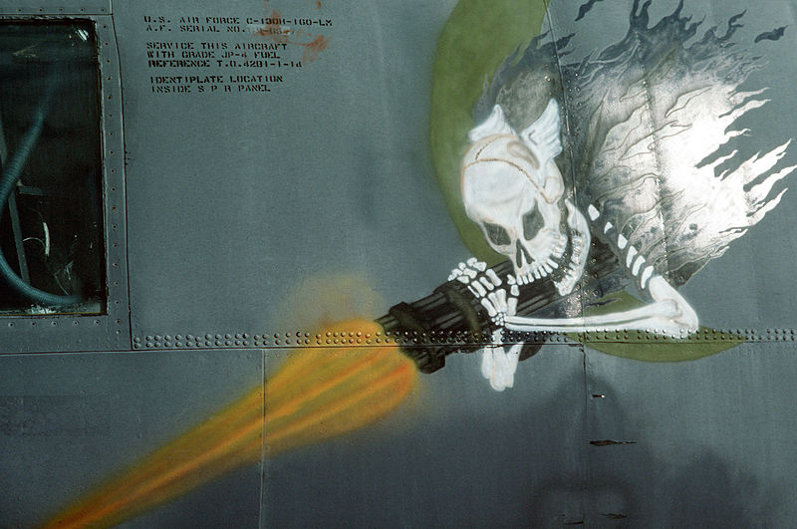
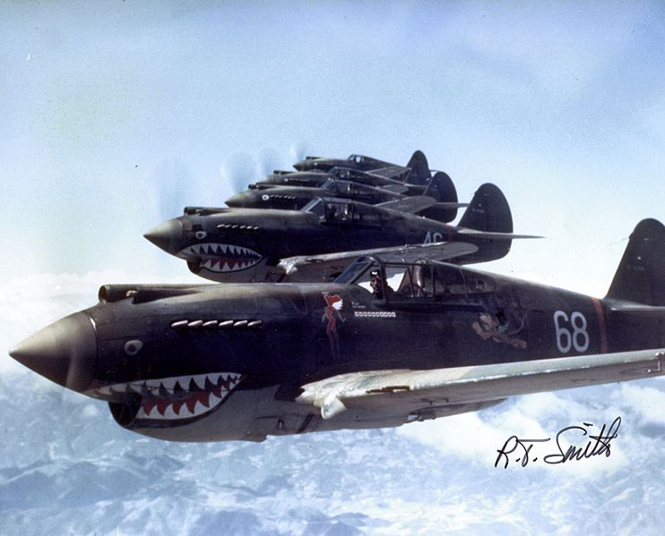
Nose art

Slide 23
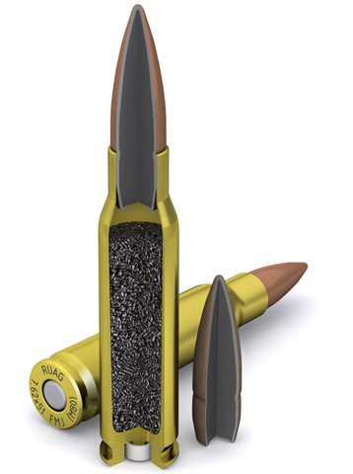
What to look for in the film?
Kubrick is famous for his long takes.
Where is he placing these long takes and why?
He’s also known for his deep focus shots in which the background, middle ground and fore ground are all in focus.
Places where you see the real verging on the absurd
Why is the film called “Full Metal Jacket” and not “Short-timers?”

Slide 24
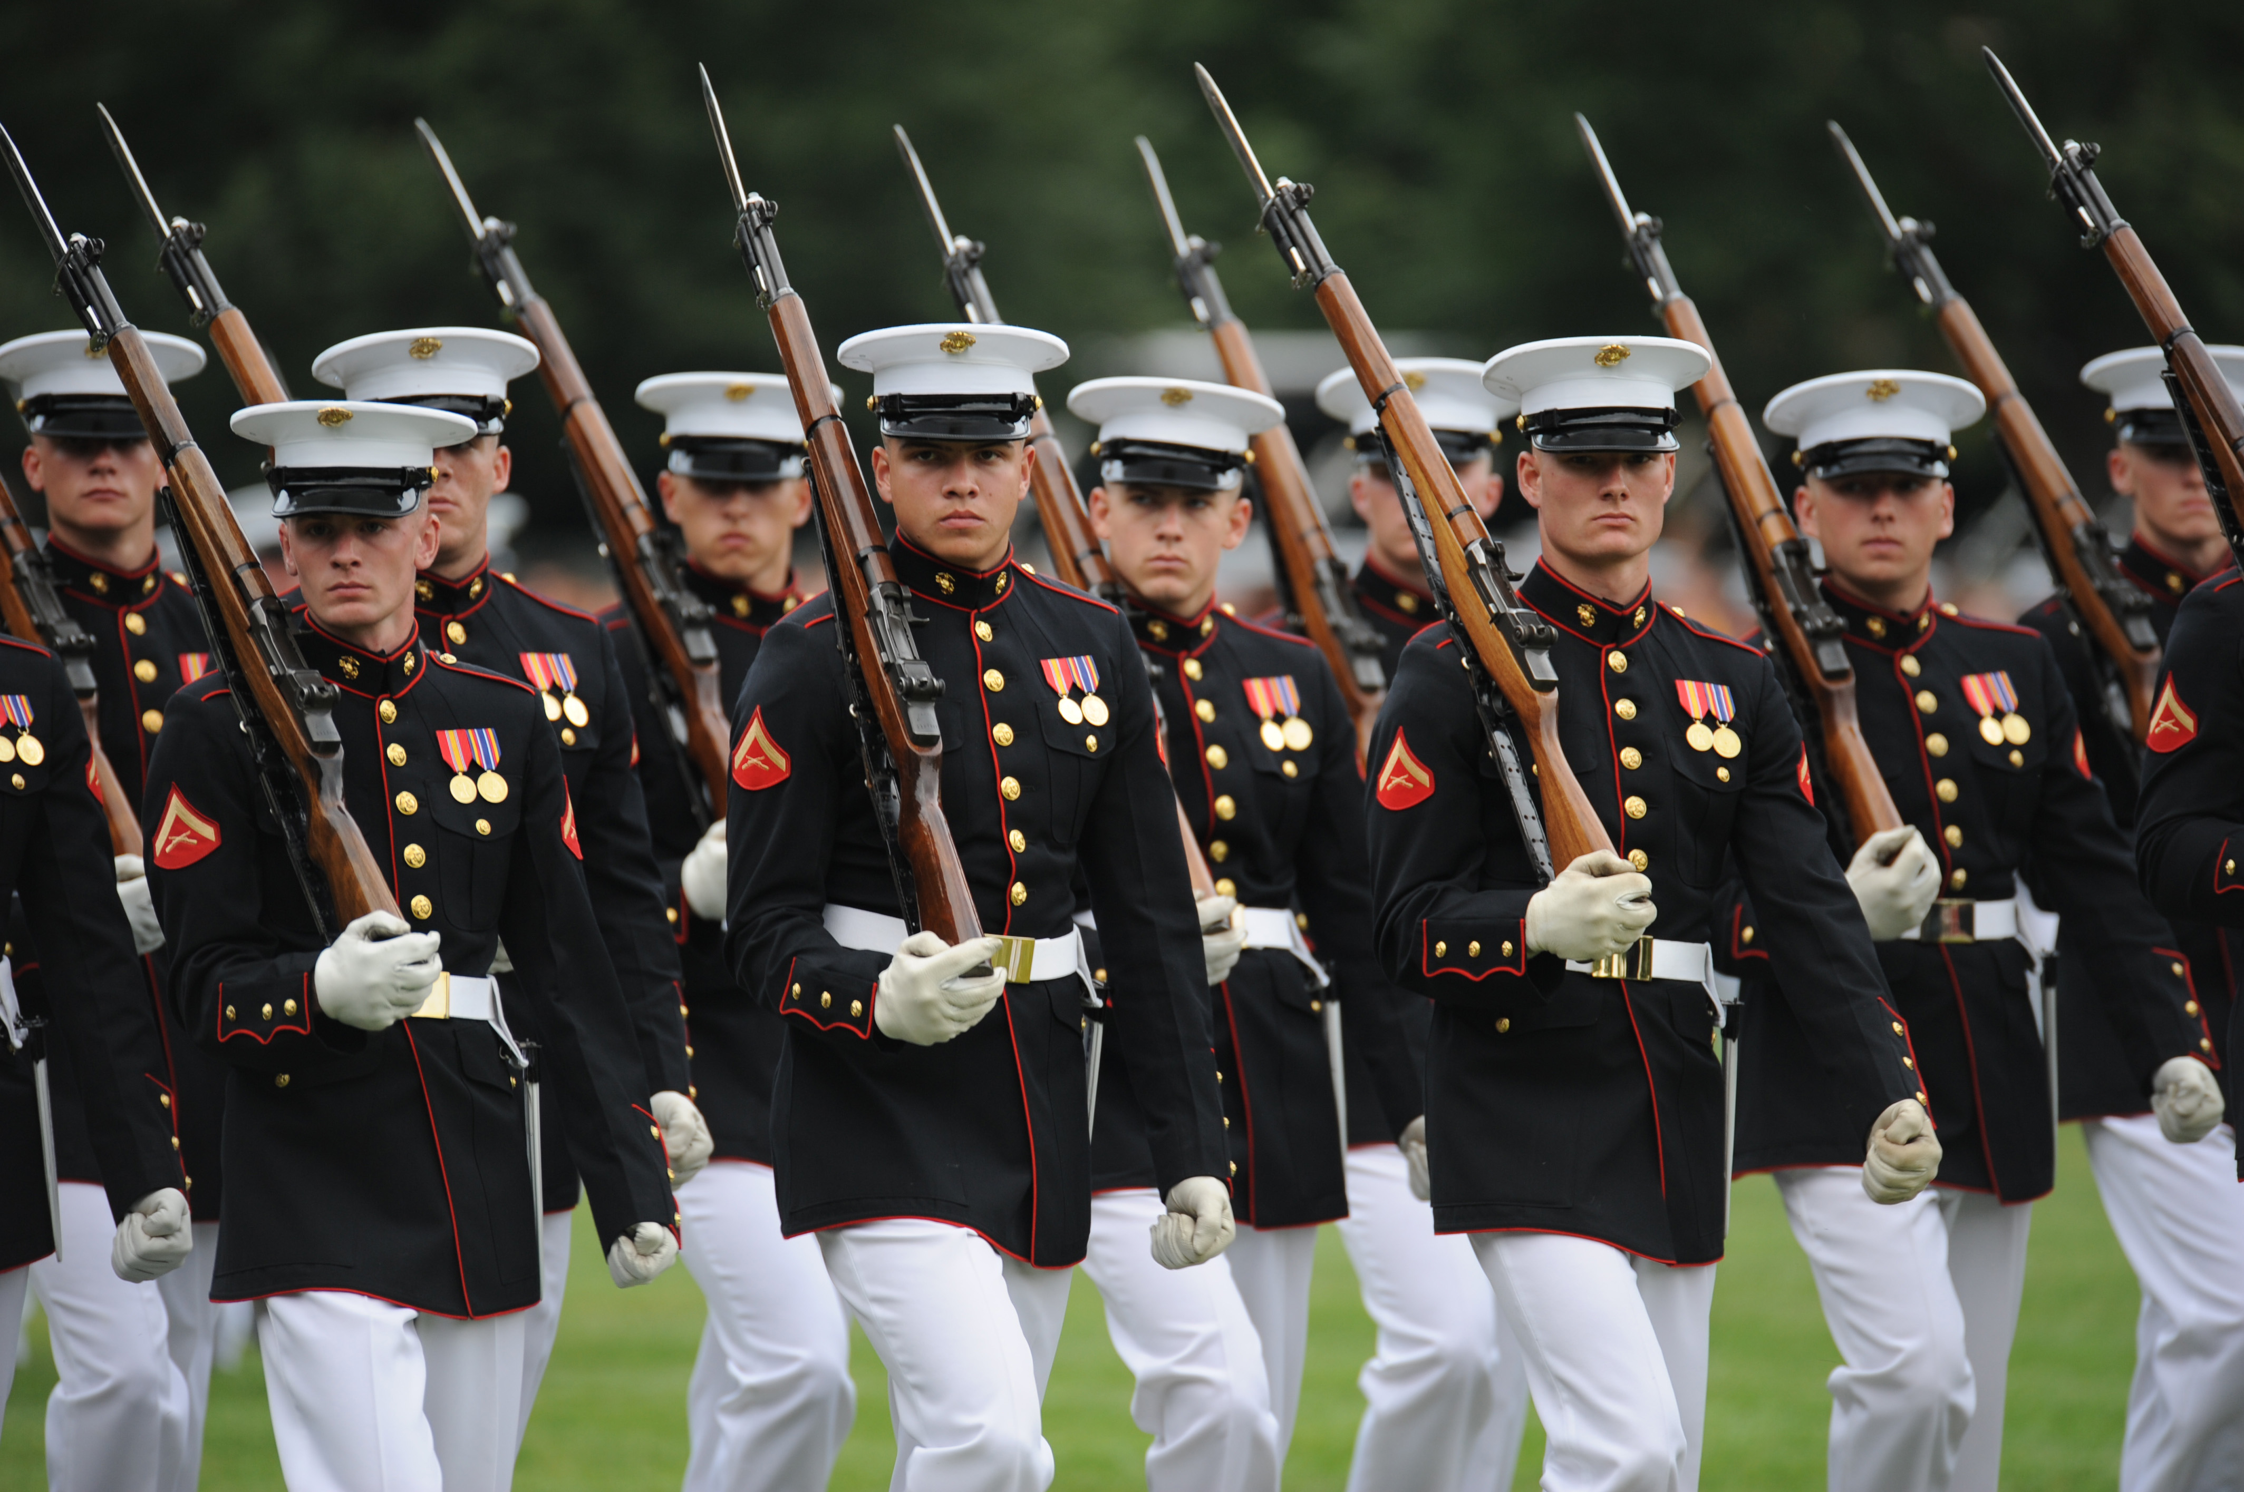

Slide 25
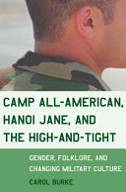
High-and-tight

Slide 26
Proper grooming standards
“Males will keep their face clean-shaven when in uniform or in civilian clothes on duty. Mustaches are permitted; if worn, males will keep mustaches neatly trimmed, tapered, and tidy. Mustaches will not present a chopped off or bushy appearance, and no portion of the mustache will cover the upper lip line or will extend sideways beyond a vertical line drawn upward from the corners of the mouth.” (Army Reg 670-1 http://www.apd.army.mil/jw2/xmldemo/r670_1/head.asp

Slide 27
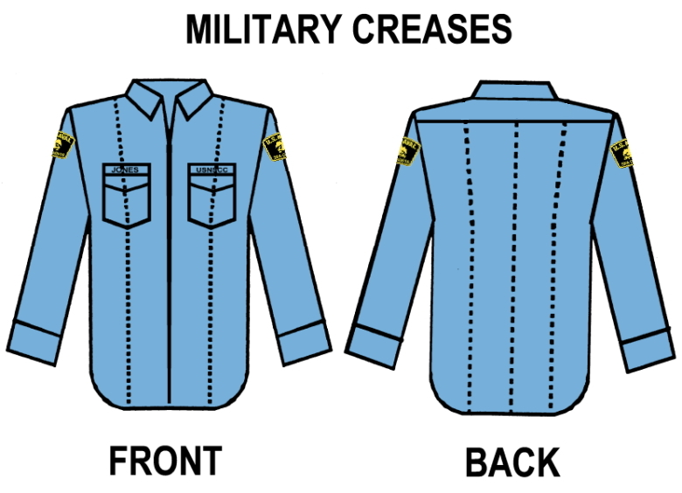

Slide 28
SPEECH

Slide 31
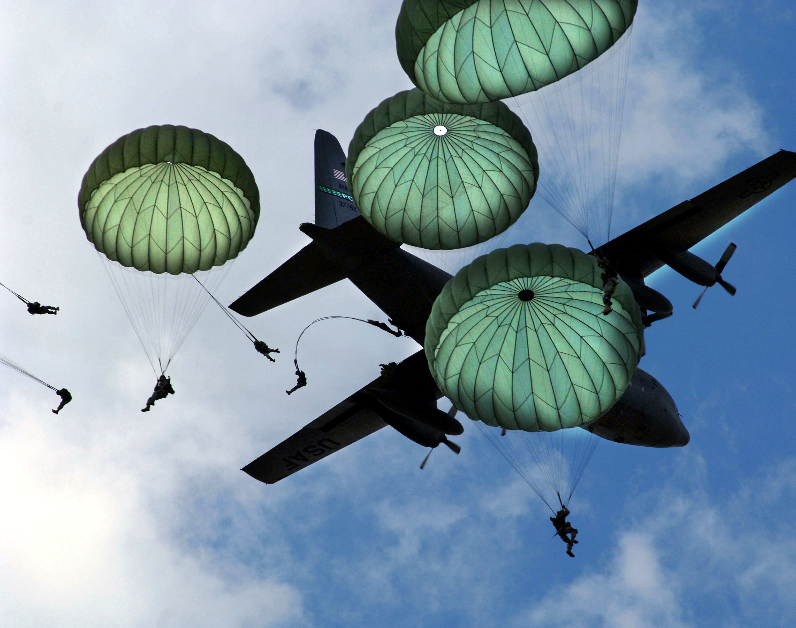
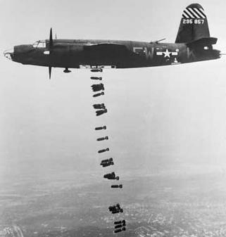
The Madhouse
Hanging out the laundry
Laying eggs

Slide 32
The Function of Military Folk Speech
Distinguish members of the corps from civilians
Lessen the tedium with humor
Release anxiety and tension
Safely complain
Express frustration with hierarchy
Indoctrination (also called “bastardization”)
By referring only to themselves in 3rd person, recruits shift their identity from an individual one to a collective one

Slide 33
Leonard Lawrence (aka Pyle)

Slide 34
“Gomer Pyle USMC” (1964-69)
Starring Jim Nabors as Gomer and Frank Sutton as his Gunnery Sgt.

Slide 35
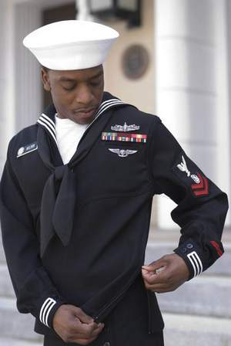

Slide 36
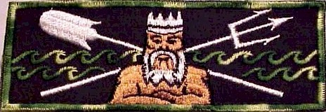
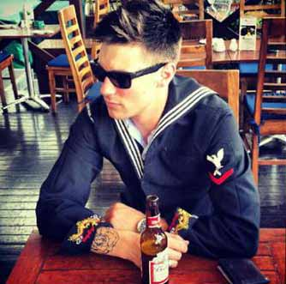
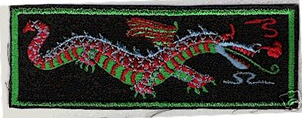
Liberty Cuffs

Slide 37
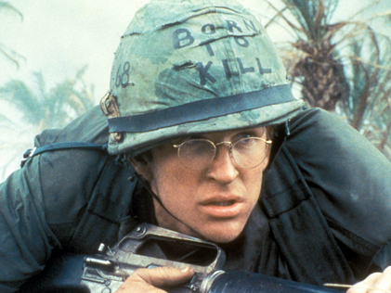

Slide 38
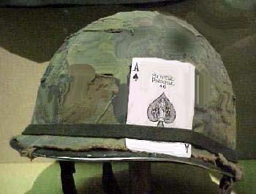
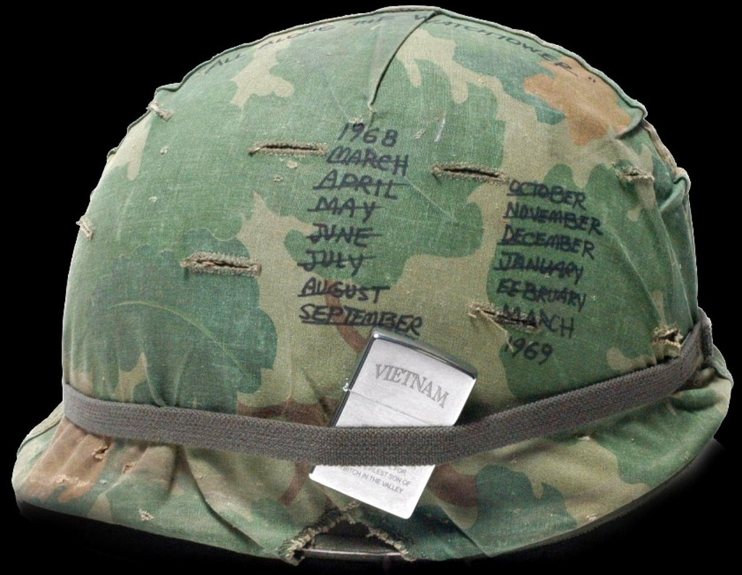

Slide 39
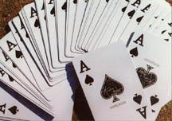
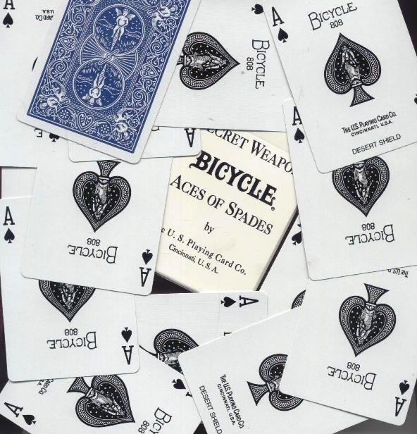
“the death card”

Slide 40
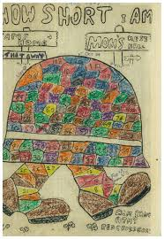
Short-timer Calendars

Slide 43
The short timer

Slide 44
Short timers
Gustav Hasford (1947-1993)
Kubrick based his film on Hasford’s Short Timers, published in 1979
Enlisted in the Marine Corps, and like Joker, was sent to Vietnam as a combat correspondent.
Of that job, he writes: “We appeared to be journalists, but we were really simply promoting the war and promoting the Marine Corps.” He goes on, “In war, truth is the first casualty….History may be written with blood and iron but it’s printed with ink.” (35)

Slide 45
Vietnam War Facts
1956 – 64 “Advisory Period of the War”
1965 – 1975
2.7 million Americans served in Vietnam (25% were draftees—in WWII it was 65%)
3.5 million Americans served in the greater S E Asian theater (Vietnam, Cambodia, Laos and Thailand)
1968 (Jan – Feb) Tet Offensive
58,202 American soldiers killed in the war
3-5 million Vietnamese killed in the war
6,727,000 tons of ordnance dropped on Indochina (compare with WWII – 1,633,000 tons)
3,500,000 acres sprayed with 19,000,000 gallons of defoliants
140,000 Vietnamese evacuated in April 1975
(http://www.va.gov/opa/publications/factsheets/fs_americas_wars.pdf)

Slide 46
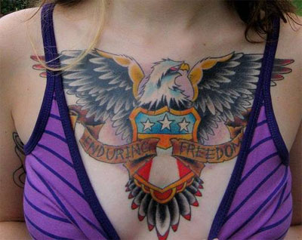
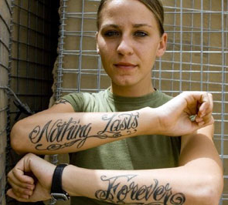
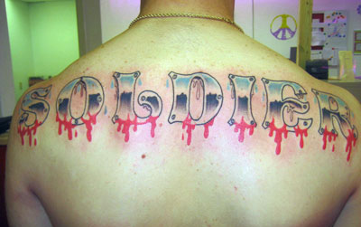
Military Tattoos

Slide 47
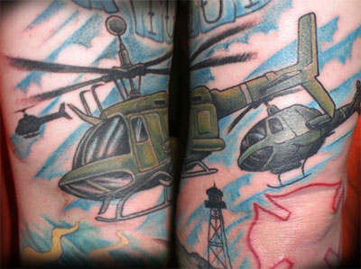
Brotherhood Tattoos

Slide 48
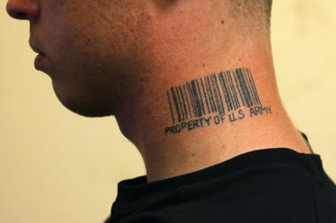
Ironic Tattoos
infidel

Slide 49
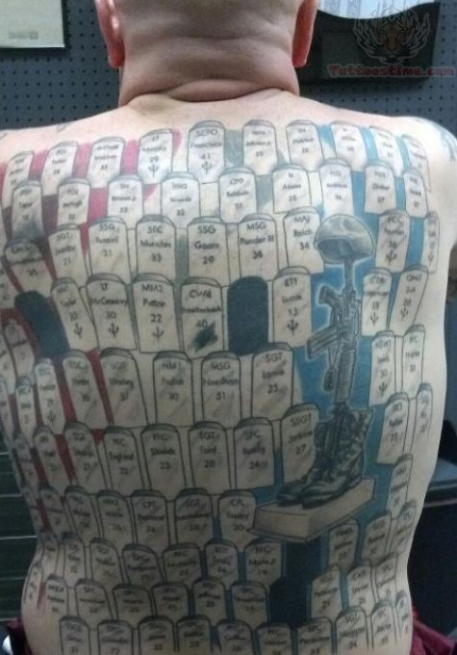
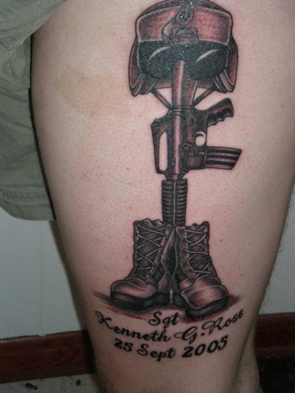
Memorial Tattoos

Slide 50
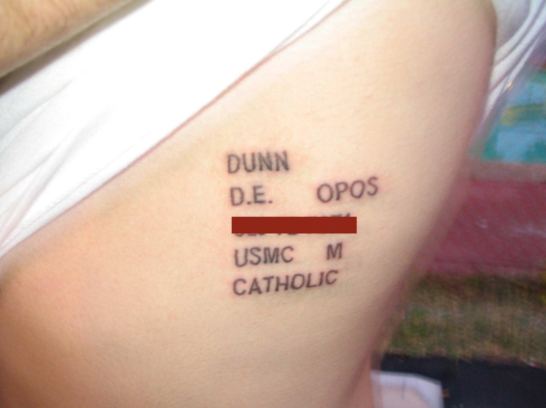
Meat Tags

Slide 51
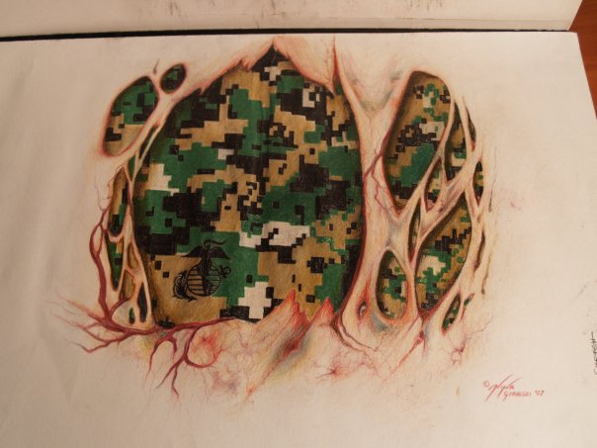
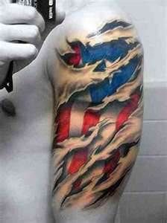
Flesh Shreds

Slide 52
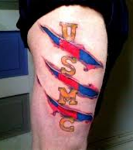
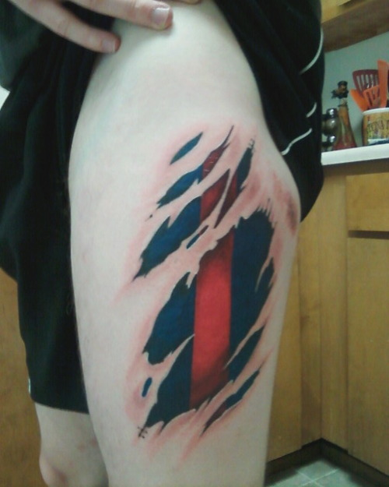
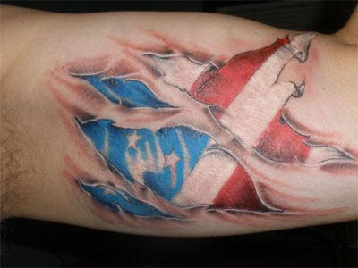
Flesh Shreds

