Slide 1
Witnesses to War IV
Witnessing:
Kluger’s memoir
Nanking (Film)
--witness testimony
--staged reading of primary documents
City of Life and Death
--Chinese and Japanese perspectives on the same events
-----------------------------------------------------------
A more mediated form of witnessing: Horrors of War Bubble Gum Cards
News and historical information
Lurid illustrations
Brief texts explaining the significance of the illustration
To know the HORRORS OF WAR is to want PEACE

Slide 2
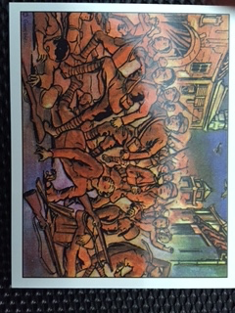
From Spectatorship to Voyeurism
Voyeurism=pleasurable observation of sordid or sensational subjects
288 cards 1938 Gum, Inc. Philadelphia, PA

Slide 3
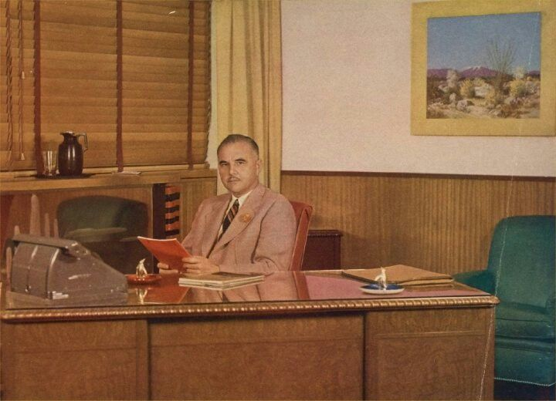
J. Warren Bowman of Gum, Inc. collborated with George Moll on cards

Slide 4
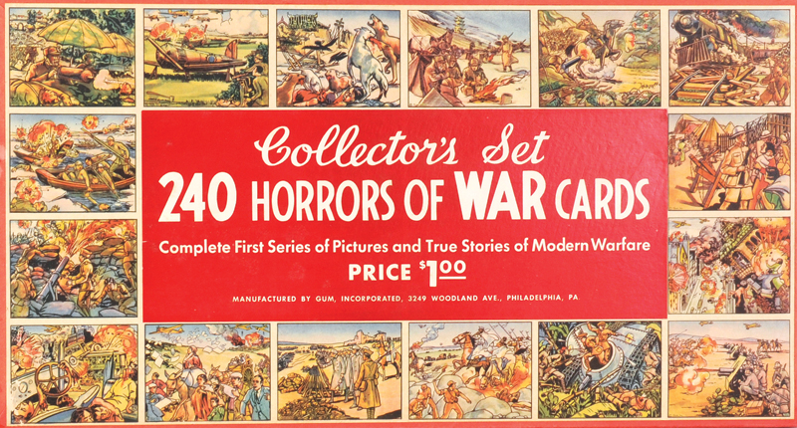
From Gum Inc. promotional material:
Much can be accomplished in the way of forming an attitude against war and for
Peace by showing children of an impressionable age what war really means. No child can
Look at these pictures of its destruction without getting the idea that war is wrong. With
A whole generation growing up with an anti-war fixation attributable to these cards,
It should go a long way toward bringing about a state of Patriotic Peace throughout
The United States and eventually throughout the World. (Collectors Set)

Slide 5
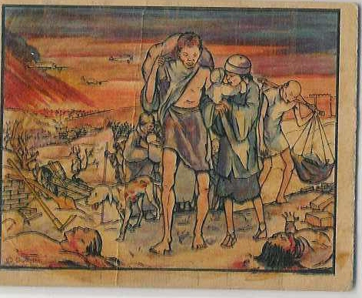

Slide 6
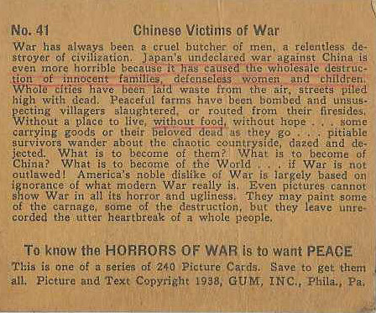

Slide 7
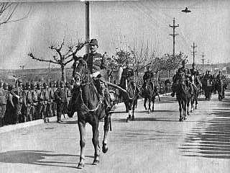
General Iwane Matsui enters Nanking, December 17, 1937

Slide 8
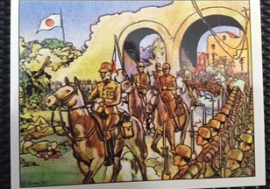
Horrors of War depiction of the same scene

Slide 9
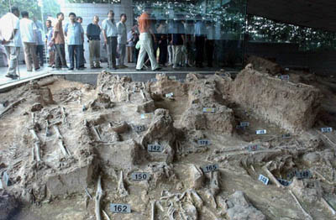
Nanjing Memorial Massacre Museum
Displays the horrors of war

Slide 10
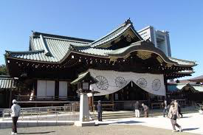
Yasukuni Shrine

