Slide 1
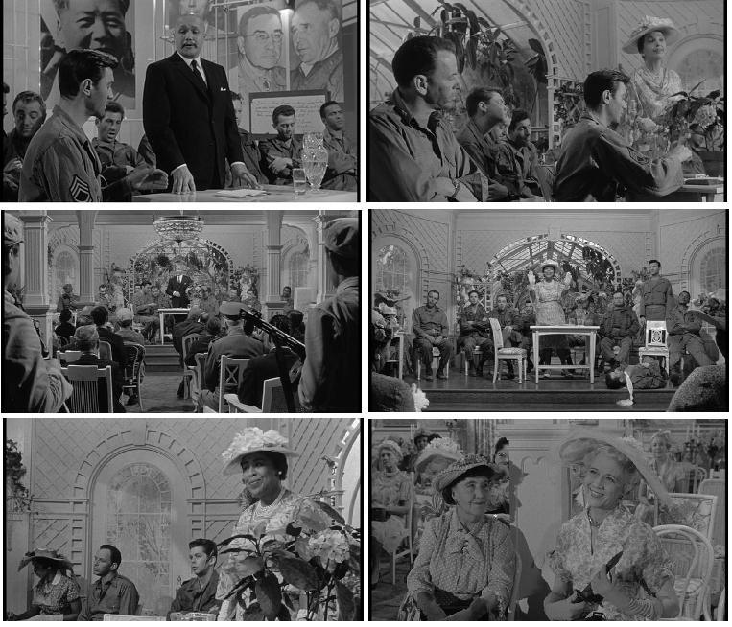
Welcome to the unconscious…
Sequence takes place as Marco sleeps; we are in his dreaming mind...
https://m.youtube.com/watch?v=LBDhoUZgsDo

Slide 2
Transpositions
Marco’s sequence: an integrated platoon sits on stage; male and female Soviets and Chinese become white women dressed formally. The Garden Party lecture is genteel; Yen Lo’s lecture has a different tone, and sets out to overturn an “old wives tale.”
Allen Melvin’s sequence: the same platoon sits on stage; male and female Soviets and Chinese become black women
The dreams rewrite racial and national difference (latent content) as sexual and gender difference (manifest content).
Which form of difference is this movie most afraid of? Is the film’s fear of the Soviets and Chinese primary or secondary?

Slide 3
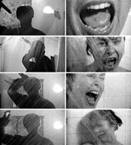
The O.E.D. defines montage as “the process or technique of selecting, editing, and piecing together separate sections of films to form a continuous whole; a sequence or picture resulting from such a process.”
Montage
That “continuous whole” can feel more or less continuous; a montage can produce a seamless continuity, or a jarring juxtaposition of the unlike.

Slide 4
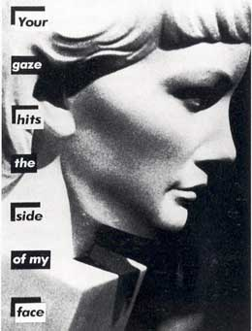
The Male Gaze
Laura Mulvey argues that film allows male subjects to exert their mastery over female objects. “The male gaze projects its fantasy upon the female figure” who becomes simultaneously idealized and immobilized. Women are to be looked at and put on display. The camera is an extension of the male gaze.
http://csmt.uchicago.edu/glossary2004/gaze.htm
Barbara Kruger

Slide 5
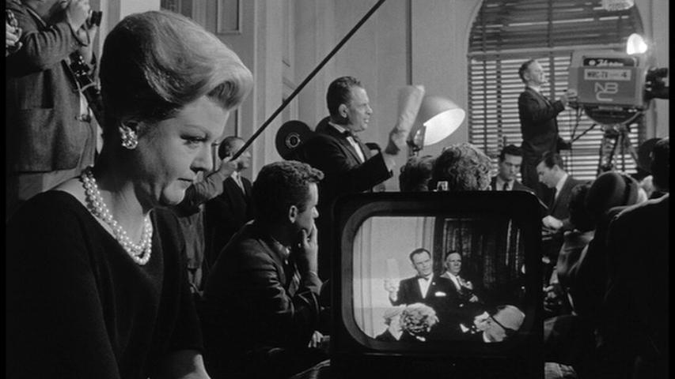
But in the Garden Party sequence, the men are on a stage. They are being watched by a female audience. They are objects, not subjects.
Whose agency does the camera express?
What kind of a villain is Eleanor Shaw? Whose fear does she express?

Slide 6
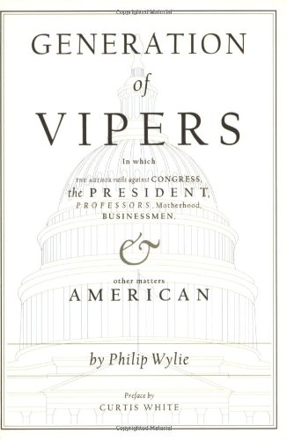
“Momism”
Written by Philip Wylie and published in 1942, Generation of Vipers was a bestseller.
In 1950, the American Library Association named it one of the most influential books of the first half of the century.
According to Wylie, America was “a matriarchy in fact if not in declaration,” in which oppressive mothers raised boys who would turn out to be bad soldiers.
“I give you mom. I give you the destroying mother.”

Slide 7
“Mom, in Wylie’s depiction, was a self-righteous, hypocritical, sexually repressed, middle-aged woman. Having lost the household functions of preindustrial women, according to Wylie, mom got men to worship her and spend money on her instead.”
“‘She is a middle-aged puffin with an eye like a hawk,’ Philip Wylie wrote of mom; he might have been describing [Angela] Lansbury. [Lawrence] Harvey hates his mother, but he is in her power. Her incestuous love for him, which repels Harvey but which he cannot escape, is the source of the party’s hold on his unconscious . . . . As if to confirm Wylie’s claim that moms will not let their sons go, Harvey is programmed to kill his own fiancée.”
Michael Rogin, Ronald Reagan, The Movie, 242, 252

Slide 8
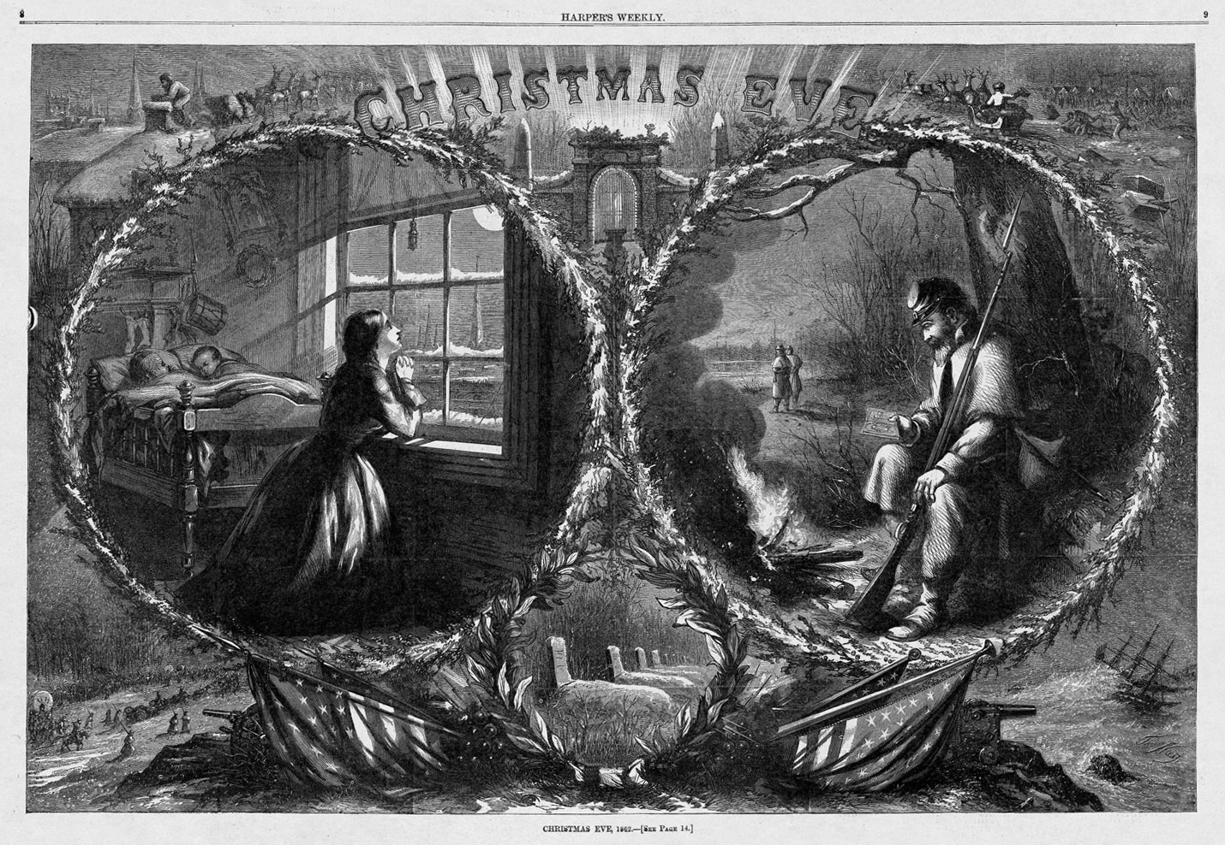
Recall Prof. Fahs on “Sentimental Domesticity”

Slide 9
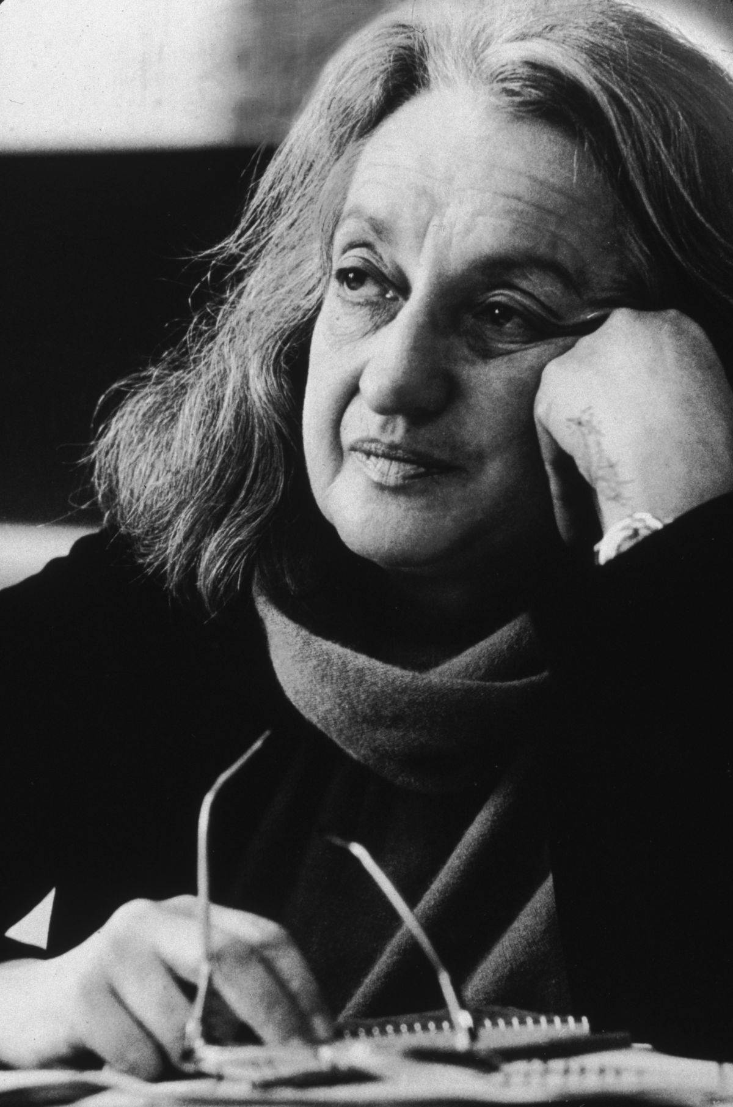
“The problem lay buried, unspoken, for many years in the minds of American women. It was a strange stirring, a sense of dissatisfaction, a yearning that women suffered in the middle of the twentieth century in the United States. Each suburban wife struggled with it alone. As she made the beds, shopped for groceries, matched slipcover material, ate peanut butter sandwiches with her children, chauffeured Cub Scouts and Brownies, lay beside her husband at night -she was afraid to ask even of herself the silent question- ‘Is this all?’” ―Betty Friedan, The Feminine Mystique (1963)
Betty Friedan, 1921-2006

Slide 10
What have we said so far?
The Manchurian Candidate amplifies misogynist fears about controlling mothers and dependant sons. Those fears fly in the face of the realities facing women in the 1950s.
The film mobilizes misogynist fears by wedding them to “Orientalist” fears (the nation is menaced by domineering mothers and a “Yellow Peril”)
We also asked: which set of fears is primary? Is one set “latent” and the other “manifest”?
(Phillip Wylie was an ardent anti-communist. Dominating mothers meant weak soldiers, unable to fight against the Soviet Union.)

Slide 11
Recall Prof. Lazo on “Orientalism”
“Orientalism can be discussed and analyzed as the corporate institution for dealing with the Orient – dealing with it by making statements about it, authorizing views of it, describing it, by teaching it, settling it, ruling over it: in short, Orientalism as a Western style for dominating, restructuring, and having authority over the Orient.” (3)
West as modern, rational, democratic, and ultimately superior (masculine?)
Orient as exotic and exaggerated: camels, belly dancers, sheiks, desert (feminine?)

Slide 12
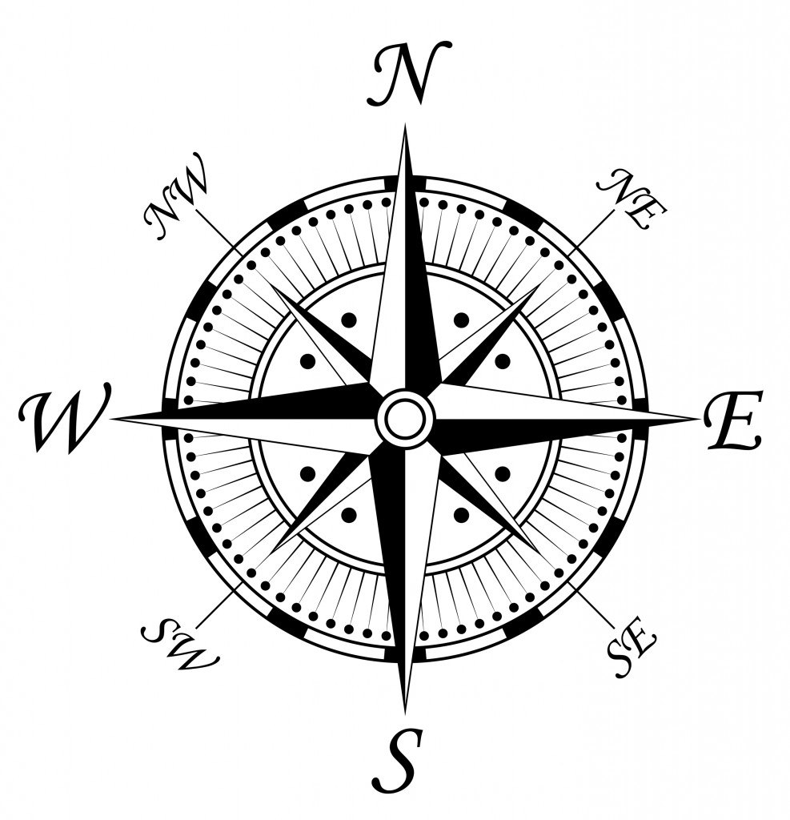
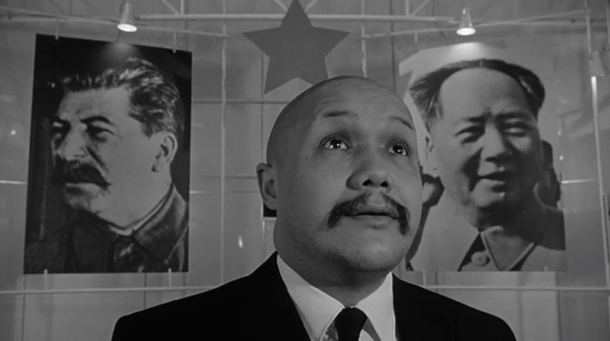
But keep in mind:
“The Orient” is not a stable entity, and “Orientalism” is not a stable phenomenon. “The Orient” is not a single region or set of countries. “Orientalism” is an ongoing process of orientation, of establishing and policing relationships.

Slide 13
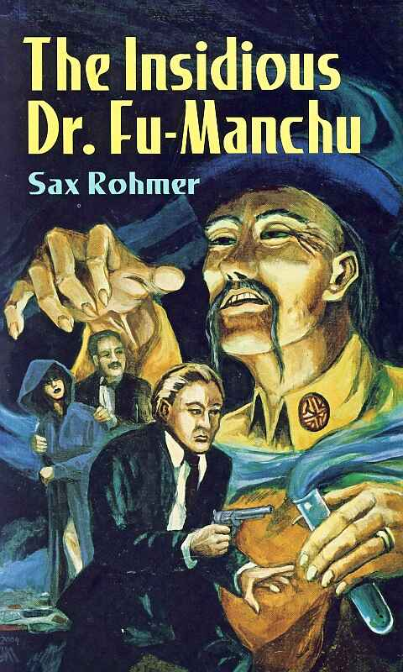
Marco describes Yen Lo as “A Chinese cat smiling like Fu Manchu”
Recall Richard Hofstadter on the Paranoid Style: “The enemy is clearly delineated: he is a perfect model of malice, a kind of amoral superman — sinister, ubiquitous, powerful, cruel, sensual, luxury-loving.”

Slide 14
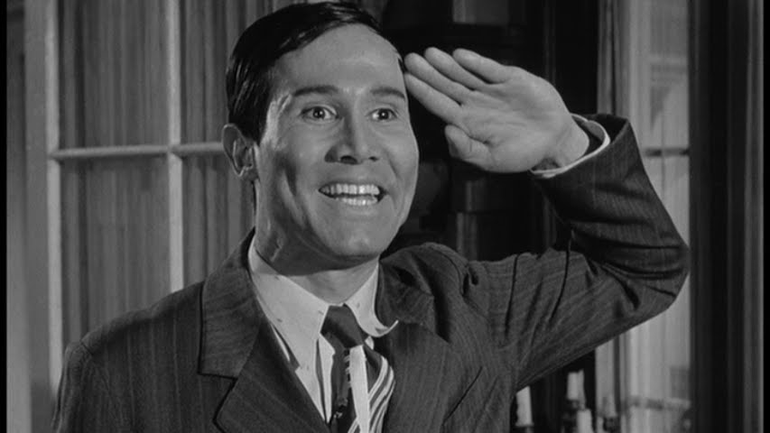

Slide 15
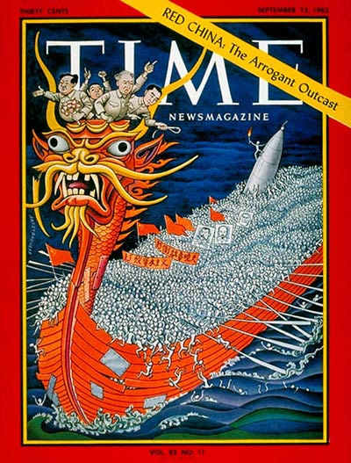

Slide 16
After “the loss of China,” the U.S. government “focused its coercive energies . . . on Chinese Americans as potential spies and subversives. Chinese family organizations sometimes ran afoul of the FBI for maintaining ties to similar organizations in communist China, while the Immigration and Naturalization Service used deceptive tactics to deport Chinese who it thought might be sympathetic to the mainland government. In 1956 federal agents swept through Chinatowns on the East and West coasts in an effort to track down suspected communists who it feared had entered the country illegally. Domestic containment policies revived latent ‘yellow peril’ fears of a combined Chinese threat from both within and outside the nation.”
Christina Klein, Cold War Orientalism (University of California Press, 2005), 34

Slide 17
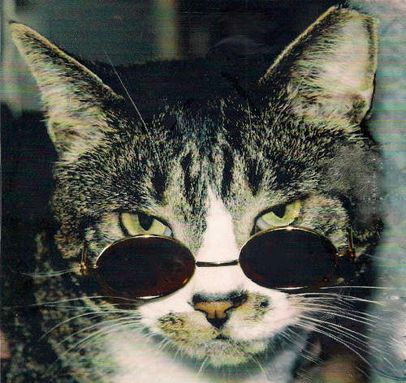
But why does Marco call Yen Lo a “cat”?
“Cats” are often typed as feminine and sensual; this makes sense in terms of what we know of Orientalism…
But the term is often associated with the jazz underground of the 1950s and 1960s—as in, “he’s a real cool cat.”
Could it be that Yen Lo is an object of desire as well as anxiety? Do we always know where anxiety stops and desire begins?
Are fantasies of racial difference ever simply “negative”?

Slide 18
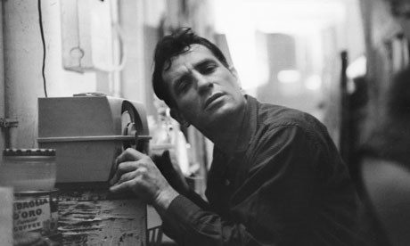
Are the words below “positive” or “negative”?
In Kerouac’s On the Road (1957), Sal Paradise wanders through “the Denver colored section, wishing I were a Negro, feeling that the best the white world had offered was not enough ecstasy for me, not enough life, joy, kicks, darkness, music, not enough night. . . . wishing I could exchange worlds with the happy, true-hearted, ecstatic Negroes of America.”
He adds, “I wished I were a Denver Mexican, or even a poor overworked Jap, anything but what I was so drearily, a ‘white man’ disillusioned” (180).

Slide 19
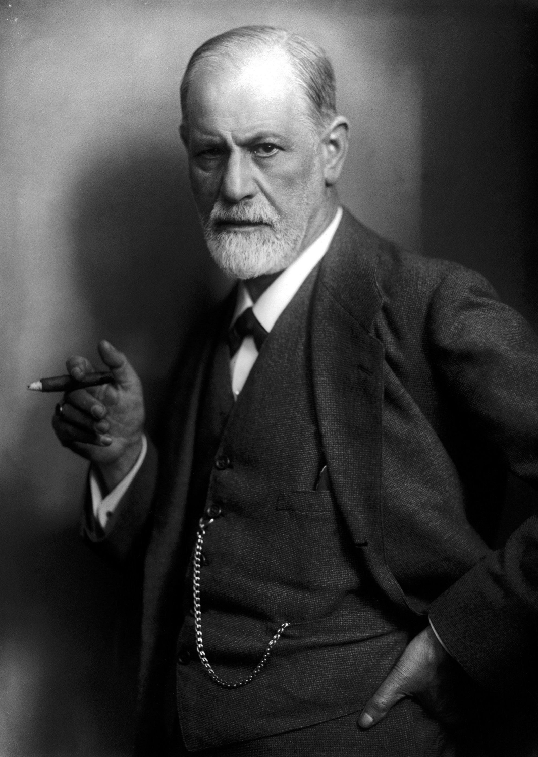
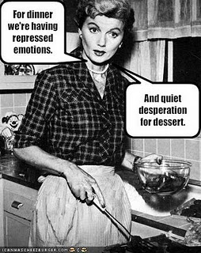
Yen Lo: “at the core of [Raymond’s] defects is his concealed tendency to timidity, sexual and social, both of which are closely linked” (41).
Yen Lo reaches into Raymond’s mind and “wipes off” his “consciousness of guilt, that rough lip-print of original sin” (88).
Raymond leaves for Korea repressed and returns as “a man who could get exactly what he wanted sensually” (5).

Slide 20
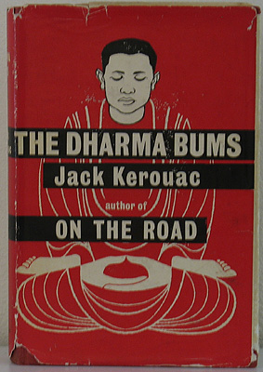
Kerouac’s Dharma Bums is published in 1958, one year before The Manchurian Candidate
Dharma Bums describes the adventures of “Ray” Smith, who begins the novel “afraid to take my clothes off” (29).
Ray learns the art of “Zen Free Love Lunacy” from a poet who looks like one of “the old giggling sages of China” (11).
Ray embraces the poet’s Chinese “theories about women and lovemaking” (27). He realizes that “this is what I always liked about the Oriental religion” (31).

Slide 21
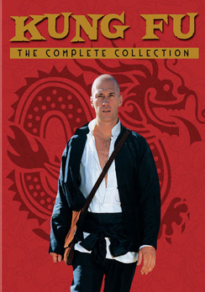
Sinophilia
Along with Allan Watts, who popularized Zen Buddhism for American readers, Gary Snyder and Beat poets like Kenneth Rexroth embraced Chinese spirituality and culture.
The television show Kung Fu participated in a similar cultural fascination.
The idea for the ABC television series Kung Fu (1972-1975) was stolen from Bruce Lee

Slide 22
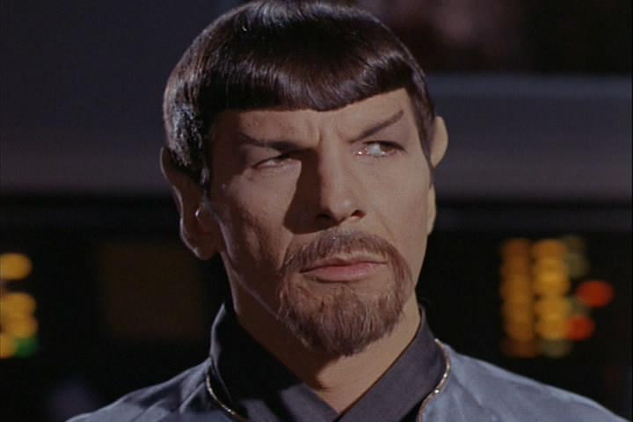
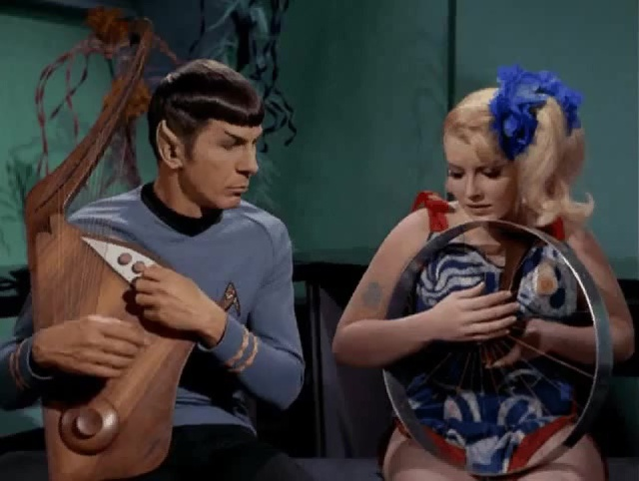
A disapproving assessment: “Caine [the protagonist of Kung Fu] has sprung up from that worship of the occult, the different, the alien that showed itself in the earlier teenybopper adoration of Spock (the half-other-world-half-human creature of Star Trek), and in the current fascination with things Chinese.” Benjamin Stein, The National Review, 1974

Slide 23
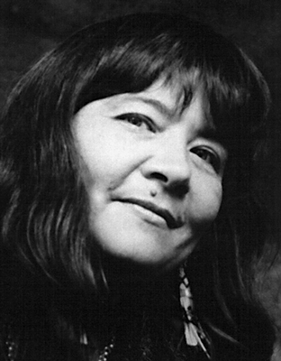
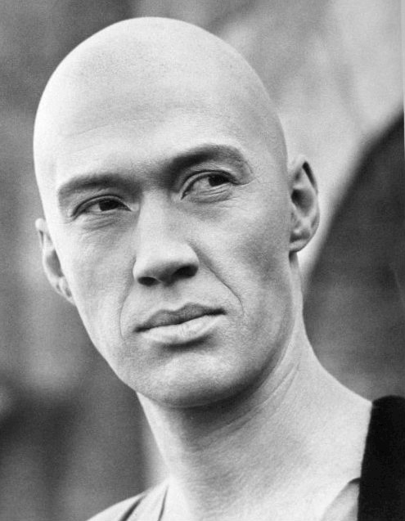
Who is truly “Native”?
(Eleanor Shaw considers herself a “Nativist”)
“You sure act like an Injun,” a cowboy says to Kwai Chang Caine in Kung Fu.
“Thirty thousand years ago
Indians came riding across the ocean
carried by giant sea turtles.”
Leslie Marmon Silko,
“Prayer to the Pacific” (1981)

Slide 24
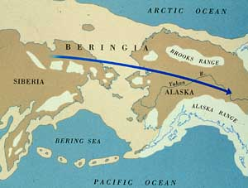
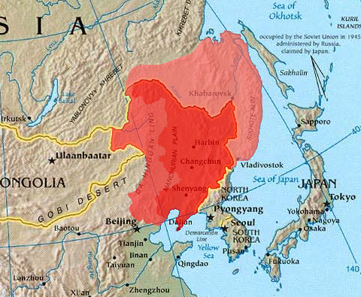
Who is the Manchurian Candidate? (And who are the real foreigners?)
Condon writes that Ben Marco has “the aboriginal look”--because some of his forebears were Native American. This means Marco appears partly Asian. Marco “looked like an Aztec crossed with an Eskimo, which was a fairly common western American type, because the Aztec troops had drifted down from Siberia” (26).
Siberia and Manchuria neighbor one another

Slide 25
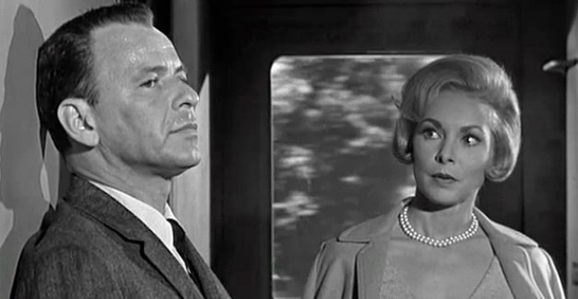
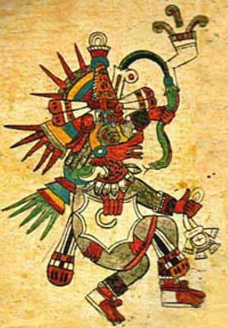
Marco meets Eugénie Rose on the train and notices that her brooch is fashioned to look like the Aztec god Quetzalcoatl. Moments later, she declares herself “one of the original Chinese workmen who laid track” (159) for the rail on which they ride.
Marco thinks her nose “Semitic”; she makes him think, also, of “Moslems” and the “huanacauri rock of Incan puberty” (157). She has, he thinks, “Tuareg eyes” (197).

