Slide 1
Dirty Wars
Professor Rodrigo Lazo
Department of English
Office hours: 2-3 p.m. Wednesday
Humanities Gateway 3114
rlazo@uci.edu

Slide 2
Debates over Torture in the
United States After 9/11
II. J.M. Coetzee’s Waiting for the
Barbarians (literary interpretation)
III. Argentina’s Dirty War

Slide 3
War as an occasion for debate and the articulation of values
Civil war preceded by raging debates over slavery and the process of abolition.
Publications, images, cartoons, public meetings, petitions and other forms of engagement over government action or inaction in mid-19th century.
In the fall quarter :
“Just war” theory
Jus in bello:
Principles in relation to military conduct

Slide 4
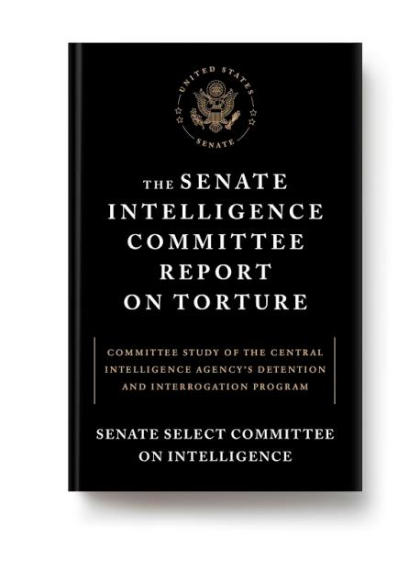
http://www.nytimes.com/interactive/2014/12/09/world/cia-torture-report-document.html

Slide 5
TORTURE = ?
A word that governmental entities try to avoid using to describe certain actions?
Word has a legal definition as well as a more fluid general usage.
How is the word used in relation to entertainment?
Can “torture” capture the action or experience it wants to name?

Slide 6
Euphemisms for “torture”
Enhanced interrogation technique
Moderate physical pressure
Coercive interrogation
Special methods of questioning
Novel interrogation methods
Refined interrogation
Waterboarding (Water Cure)

Slide 7
Oxford English Dictionary Definition
The infliction of severe bodily pain, as punishment or a means of persuasion; spec. judicial torture, inflicted by a judicial or quasi-judicial authority, for the purpose of forcing an accused or suspected person to confess, or an unwilling witness to give evidence or information (OED)
http://www.oed.com/view/Entry/203700?r skey=5h8eoK&result=1&isAdvanced=false#eid

Slide 8
UN Convention Against Torture
For the purposes of this Convention, the term "torture" means any act by which severe pain or suffering, whether physical or mental, is intentionally inflicted on a person for such purposes as obtaining from him or a third person information or a confession, punishing him for an act he or a third person has committed or is suspected of having committed, or intimidating or coercing him or a third person, or for any reason based on discrimination of any kind, when such pain or suffering is inflicted by or at the instigation of or with the consent or acquiescence of a public official or other person acting in an official capacity. It does not include pain or suffering arising only from, inherent in or incidental to lawful sanctions.

Slide 9
24 – Justifying torture?

Slide 10
Scarry/Dershowitz -- Positions
Absolute
Limited Legal Permissibility
Limited moral Acceptability
Torture is never acceptable (Scarry)
Permitted in certain cases (Dershowitz)
Acceptable but illegal, and thus no warrants

Slide 11
Ethical Approaches
Absolutist - Prohibition in all cases
(Deontological)
Situational – Depends on the situation.
Best interest.
(Consequentialist)

Slide 12
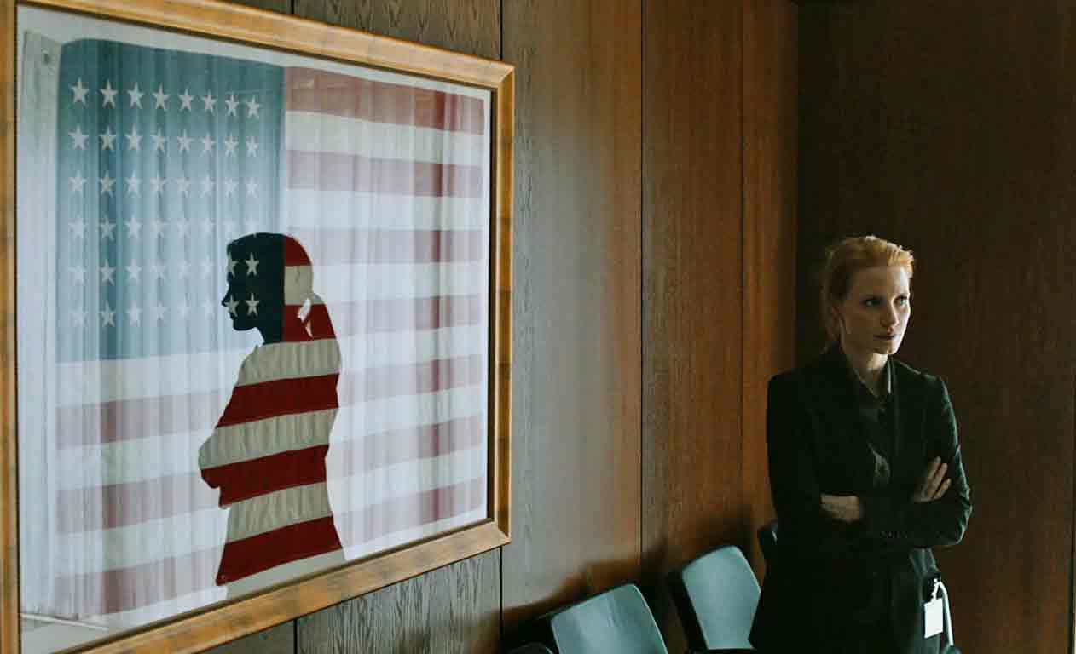
Zero Dark Thirty (2012)

Slide 13
Senate Committee’s Conclusions
#1 - “The CIA’s use of its enhanced interrogation techniques was not an effective means of acquiring intelligence or gaining cooperation from detainees.” (p. 3)
#2 – “The CIA’s justification for the use of its enhanced interrogation techniques rested on inaccurate claims of their effectiveness.” (4)

Slide 14
Grand Theft Auto 5

Slide 15
Torture-tainment
The combination of entertainment (in various media) and torture, either in its legal definition or a more general sense of inflicting pain. Often torture-tainment is deployed to drive a plot such as the placing of a protagonist in a dangerous situation. It can be used to create horror and/or repulsion. Sometimes it is linked to commentary on social or political conditions. Appears increasingly in shows after 2005.

Slide 16
Wars in the 2000s
September 11, 2001 – Attack on the World Trade Center in New York
October 7, 2001 – US and British forces begin attacking Afghanistan. US troops are still there today.
March 20, 2003 – US invades Iraq. US military personnel withdraw December 2011.

Slide 17
VP Dick Cheney – Sept. 16, 2001
"We also have to work, though, sort of the dark side, if you will. We've got to spend time in the shadows in the intelligence world. A lot of what needs to be done here will have to be done quietly, without any discussion, using sources and methods that are available to our intelligence agencies, if we're going to be successful.”
http://georgewbush-whitehouse.archives.gov/vicepresident/news-speeches/speeches/vp20010916.html

Slide 18
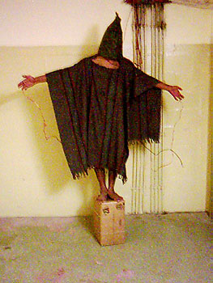
Abu Ghraib Revelations 2004

Slide 19
Would I approve waterboarding?

