Slide 1
Maenadism out of Control
Divinity, Society, Nature

Slide 2
Miracles 2 and 3
An earthquake: ‘Look there, how the palace of Pentheus totters. Look, the palace is collapsing! Dionysus is within. Adore him!’ (586-588)
Dionysus escapes from jail: C. ‘How did you escape that godless man?’ D. ‘With ease. No effort was required.’ C. ‘But the manacles on your wrists?’ D. ‘There I, in turn, humiliated him, outrage for outrage. He seemed to think that he was chaining me but never once so much as touched my hands. He fed on his desires.’ (613-617)

Slide 3
How Many Dionysuses Are There?
‘Inside the stable he intended as my jail, instead of me, he found a bull
and tried to rope its knees and hooves. He was panting desperately, biting
his lips with his teeth, his whole body drenched with sweat, while I sat
nearby, quietly watching. But at that moment Bacchus came, shook the
palace and touched his mother’s grave with tongues of fire. […] Then,
afraid I might escape, he [Pentheus] suddenly stopped short, drew his
sword and rushed to the palace. There, it seems, Bromius had made a
shape, a phantom which resembled me, within the court. Bursting in,
Pentheus thrust and stabbed at that thing of gleaming air as though he
thought it me.’ (618-632)

Slide 4
Maenads at Rest
‘There they lay in the deep sleep of exhaustion,
some resting on boughs of fir, others sleeping
where they fell, here and there among the oak
leaves—but all modestly and soberly, not, as you
think, drunk with wine, nor wandering, led astray
by the music of the flute, to hunt their Aphrodite
through the woods.’ (683-688)

Slide 5
Maenads and Animals at Peace
‘First they let their hair loose, down over their shoulders,
and those whose straps had slipped fastened their skins of
fawn with writhing snakes that licked their cheeks. Breasts
swollen with milk, new mothers who had left their babies
behind at home nestled gazelles and young wolves in their
arms, suckling them.’ (695-701)
‘“O Iacchus! Son of Zeus!” “O Bromius!” they cried until
the beasts … seemed wild with divinity. And when they
ran, everything ran with them.’ (725-727)

Slide 6
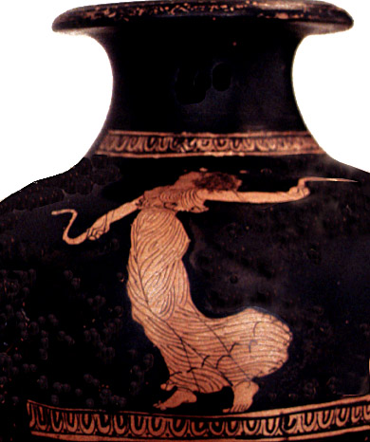
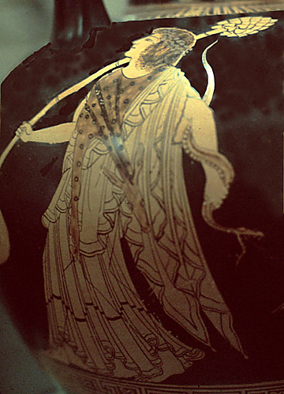
Maenads and Snakes

Slide 7
Maenads and Liquids
‘One woman struck her thyrsus against a rock and a
fountain of cool water came bubbling up. Another
Drove her fennel in the ground, and where it struck the
Earth, at the touch of god, a spring of wine poured out.
Those who wanted milk scratched at the soil with bare
Fingers and the white milk came welling up. Pure honey
spurted, streaming, from their wands.’ (702-711)

Slide 8
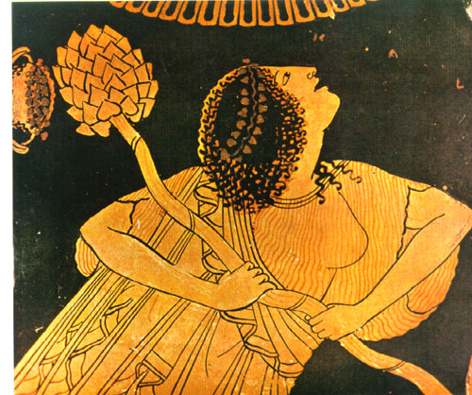
Maenad

Slide 9
Maenads in Action
‘Then, carried up by their own speed, they flew like birds, across the
spreading fields …. Like invaders they swooped on Hysiae and on
Erythrae in the foothills of Cithaeron. Everything in sight they
pillaged and destroyed. They snatched the children from their
homes.’ (747-754)
‘Then the villagers, furious at what the women did, took to arms.
and there, sire, was something terrible to see. For the men’s spears
were pointed and sharp, and yet drew no blood, whereas the wands
the women threw inflicted wounds. And then the men ran, routed
by women.’ (758-763)

Slide 10
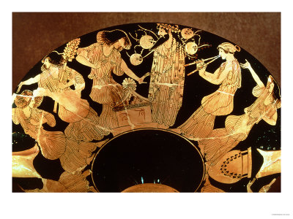
Maenads and Dionysus

Slide 11
Maenads against Animals
‘And then you could have seen a single woman
with bare hands tear a fat calf, still bellowing with
fright, in two, while others clawed the heifers to
pieces. There were ribs and cloven hooves
scattered everywhere, and scraps smeared with
blood hung from the fir trees. And bulls, their
raging fury gathered in their horns, lowered their
heads to charge, then fell, stumbling to the earth,
pulled down by hordes of women and stripped of
flesh and skin more quickly, sire, than you could blink your
royal eyes.’ (736-747)

Slide 12
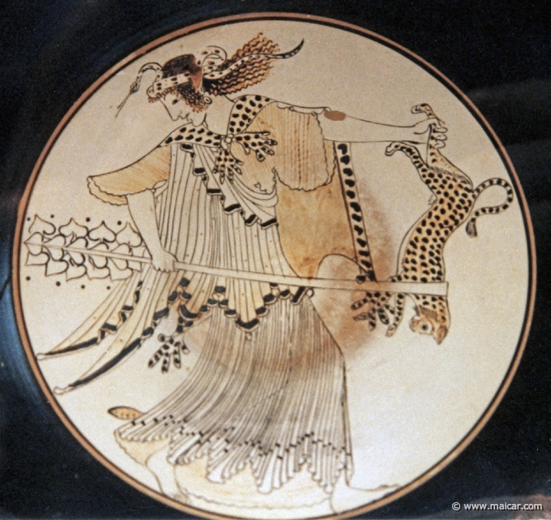
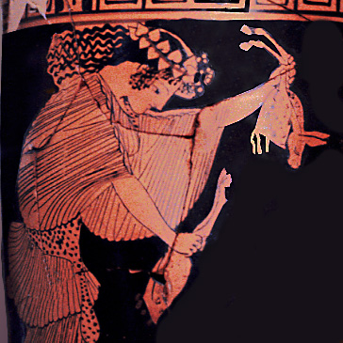
Sparagmos on Animals

Slide 13
A City Divided: Men against Women
‘Like a blazing fire this Bacchic violence spreads. It
comes too close. We are disgraced, humiliated in
the eyes of Hellas. … You there. Go down
quickly to the Electran gates and order out all
heavy-armored infantry; call up the fastest troops
among our cavalry, the mobile squadrons and the
archers. We march against the Bacchae! Affairs are
out of hand when we tamely endure such conduct in
our women.’ (776-785)

Slide 14
Luring the Prey: Sight as Bait
D: ‘Wait! Would you like to see their revels on the mountain?’
P: ‘I would pay a great sum to see that sight.’
D: ‘Why are you so passionately curious?’ [lit.: ‘Why have you fallen so much in love with this?’]
P: ‘Of course I’d be sorry to see them drunk.’
D: ‘But for all your sorrow, you’d like very much to see them?’
P: ‘Yes, very much. I could crouch beneath the fir trees, out of sight.’ (811-816)

Slide 15
Becoming the Other: Pentheus as a Maenad (I)
D: ‘First you must dress in women’s clothes.’
P: ‘What? You want me, a man to wear a woman’s dress. But why?’
D: ‘If they knew you were a man, they would kill you instant! […] I shall go inside with you and help you dress.’
P: ‘Dress? In a woman’s dress, you mean? I would die of shame.’
D: ‘Very well. Then you no longer hanker to see the Maenads?’
P: ‘What is this costume I must wear?’

Slide 16
Becoming the Other: Pentheus as a Maenad (II)
D: ‘On your head I shall set a wig with long curls.’
P: ‘And then?’
D: ‘Next, robes to your feet and a net for your hair.’
P: ‘Yes? Go on.’
D: ‘Then a thyrsus for your hand and a skin of dappled fawn.’
P: ‘I could not bear it. I cannot bring myself to dress in women’s clothes.’
D: ‘Then you must fight the Bacchae. That means bloodshed.’
P: ‘Right. First we must go and reconnoiter.’ (830-6)

Slide 17
A Plea for Insanity
‘Women, our prey now thrashes in the net we threw. He
shall see the Bacchae and pay the price with death.
Dionysus, now action rests with you. And you are near.
Punish this man. But first distract his wits; for sane of
mind this man would never wear a woman’s dress; but
obsess his soul and he will not refuse. After those threats
with which he was so fierce, I want him made the
laughingstock of Thebes, paraded through the streets, a
woman.’ (846-854)

