Slide 1
Spreading Death
God, Humans, and Animals

Slide 2
Seeing Things Aright
P. ‘I seem to see two suns blazing in the heavens.
And now two Thebes, two cities […] and you,
you are a bull who walks before me there. […] But
now I see a bull.’
D. ‘It is the god you see. Though hostile formerly,
He now declares a truce and goes with us. You see
what you could not when you were blind.’ (918-24)

Slide 3
Directing Pentheus
D: ‘But look: one of your curls has come loose
from under the snood where I tucked it.’ P: ‘It
must have worked loose when I was dancing for
joy and shaking my head.’ D: ‘Then let me be your
maid and tuck it back. Hold still.’ P: ‘Arrange it. I
am in your hands completely.’ […] P: ‘But to be a
real Bacchante, should I hold the wand in my right
hand? Or this way?’ D: ‘No. In your right hand. And
raise it as you raise your right foot.’ (927-40)

Slide 4
A Contest with Dionysus: God against Man
P: ‘Then lead me through the very heart of Thebes since I alone
of all this city dare to go.’ D: ‘You and you alone will suffer for
your city. A great ordeal awaits you. But you are worthy of your
fate.’ […] D: ‘You will be carried home … cradled in your
mother’s arms.’ […] P. ‘I go to my reward.’ D: ‘You are an
extraordinary young man, and you go to an extraordinary
experience. You shall win a glory towering to heaven and
usurping god’s. Agave and you daughters of Cadmus, reach out
your hands! I bring this young man to a great ordeal. The victor?
Bromius.’ (963-975)

Slide 5
Mother disowns Son
‘Run to the mountain, fleet hounds of madness! Run, run to the
revels of Cadmus’ daughters! Sting them against the man in
women’s clothes, the madman who spies on the Maenads, who
peers from behind the rocks, who spies from a vantage!
His mother shall see him first. She will cry to the Maenads:
“Who is this spy who has come to the mountains to peer at the
mountain-revels of the women of Thebes? What bore him,
Bacchae? This man was born of no woman. Some lioness gave
him birth, some one of the Libyan gorgons!”’ (978-990)

Slide 6
Dionysus: Animal and a Smiling Terror
‘O Dionysus, reveal yourself a bull! Be manifest,
a snake with darting heads, a lion breathing fire!
Bacchus, come! Come with your smile!
Cast your noose about this man who hunts
your Bacchae! Bring him down, trampled
underfoot by the murderous herd of your
Maenads!’ (1016-1021)

Slide 7
Seeing, Not Seeing, Being Seen, and Hearing
‘There in a grassy glen we halted, unmoving, silent, without a word, so we
might see but not be seen.’ (1046-7)
‘But Pentheus, unhappy man, could not quite see the companies of
women. “Stranger,” he said, “from where I stand, I cannot see these
counterfeited Maenads.”’ (1057-60)
‘And now the Maenads saw him more clearly than he saw them. But
barely had they seen, when the stranger vanished and there came a great
voice out of heaven … crying: “Women, I bring you the man who has
mocked at you and me and at our holy mysteries. Take vengeance upon
him.”’ (1074-7)

Slide 8
The Beast gets Caught
‘Then Agave cried out: “Maenads, make a circle
about the trunk and grip it with your hands.
unless we take this climbing beast, he will reveal
the secrets of the god.” With that, thousands of
hands tore the fir tree from the earth, and down,
down from his high perch fell Pentheus, tumbling
to the ground, sobbing and screaming as he fell,
for he knew his end was near.’ (1106-12)

Slide 9
‘No, no Mother!’
‘His own mother, like a priestess with her victim,
fell upon him first. But snatching off his wig and
snood so she would recognize his face, he
touched her cheeks, screaming, “No, no,
Mother! I am Pentheus, your own son, the child
you bore to Echion! Pity me, spare me, Mother!
I have done a wrong, but do not kill your own
son for my offence.”’ (1113-21)

Slide 10
Sparagmos
‘But she was foaming at the mouth, and her crazed eyes rolling
with frenzy. She was mad, stark mad, possessed by Bacchus.
Ignoring his cries of pity, she seized his left arm at the wrist;
then, planting her foot upon his chest, she pulled, wrenching
away the arm at the shoulder. […] Ino, meanwhile, on the other
side was scratching off his flesh. […] One tore off an arm,
another a foot still warm in its shoe. His ribs were clawed clean
of flesh and every hand was smeared with blood as they played
ball with scraps of Pentheus’ body.’ (1123-37)

Slide 11
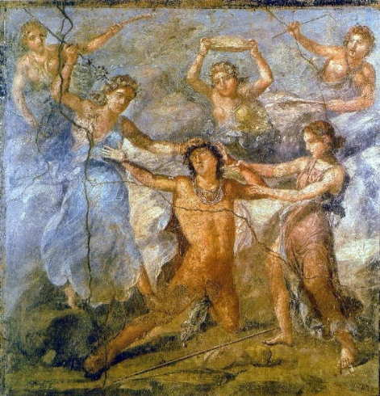
Pentheus Dismembered (1)

Slide 12
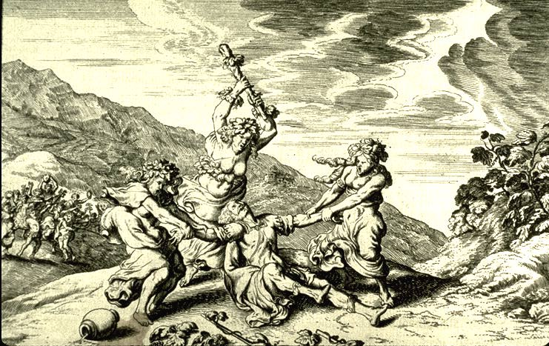
Pentheus Dismembered (2)

Slide 13
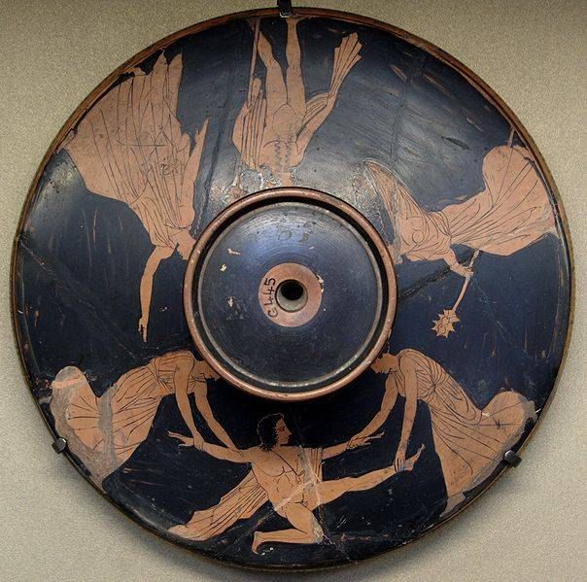
Pentheus Dismembered (3)

Slide 14
Agave, the Sorrowful Victor
M: ‘Leaving her sisters at the Maenad dances, she is
coming here, gloating over her grisly prize. She calls
upon Bacchus: he is her “fellow huntsman,” “comrade
of the chase, crowned with victory.” But all the
victory she carries home is her own grief.’ (1143-8)
C: ‘You are proud?’ A: ‘Proud and happy. I have won
the trophy of the chase, a great prize, manifest to all.’ (1196-9)
A: ‘Here in my hands I hold the quarry of my chase, a
trophy for our house. Take it, father, take it. Glory in my kill
And invite your friends to share the feast of triumph.’ (1239-1242)

Slide 15
‘I cannot look’
‘This is a grief so great it knows no size. I cannot
look. This is the awful murder your hands have
done. This, this is the noble victim you have
slaughtered to the gods. And to share a feast like
this you now invite all Thebes and me? O gods,
how terribly I pity you and then myself.’ (1243-7)

Slide 16
Distributing Punishments
‘Upon you, Agave, and on your sisters I pronounce this doom: you
shall leave this city in expiation of the murder you have done. You are
unclean, and it would be a sacrilege that murderers should remain at
peace beside the graves [of those whom they have killed].’ (1124-8)
‘You, Cadmus, shall be changed to a serpent, and your wife, Harmonia,
shall undergo your doom, a serpent too. With her it is your fate to go
on a journey […] Yet in the end the god Ares shall save Harmonia
and you and bring you both to live among the blest.’ (1330-9)

Slide 17
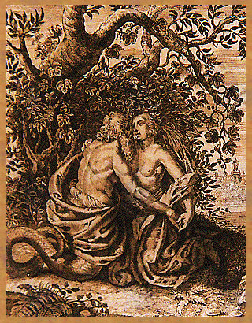
Cadmus and Harmonia

