Slide 1
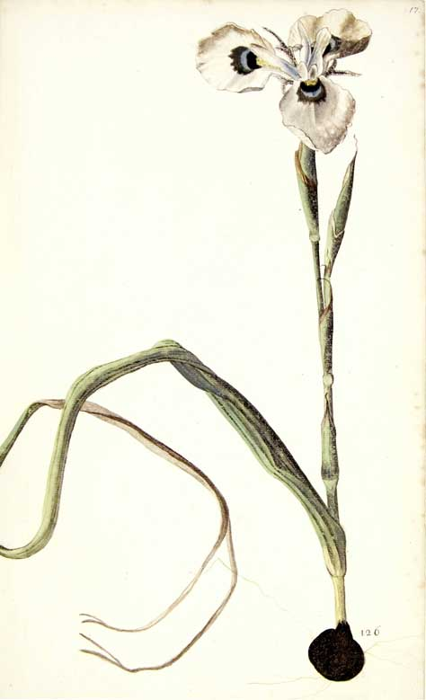
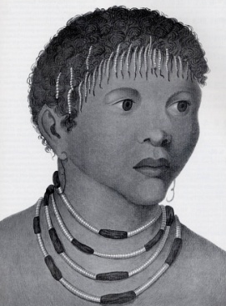
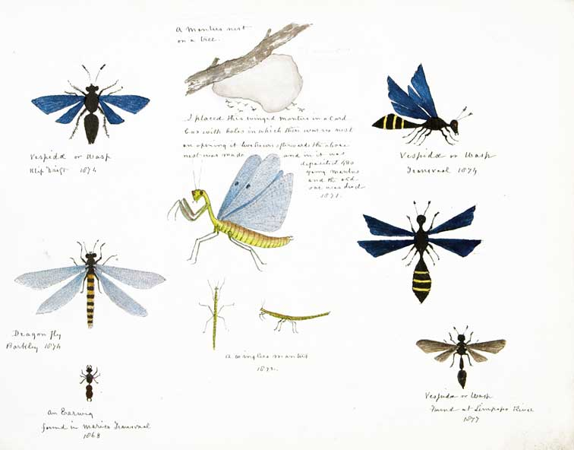
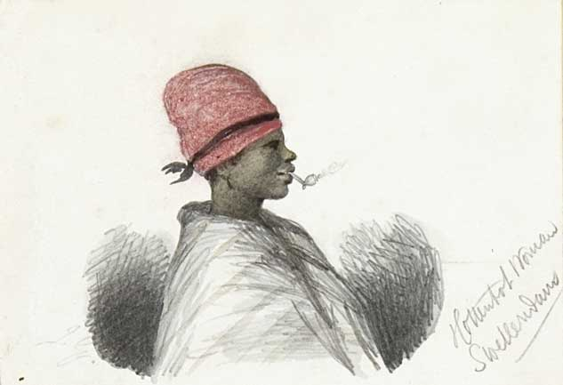
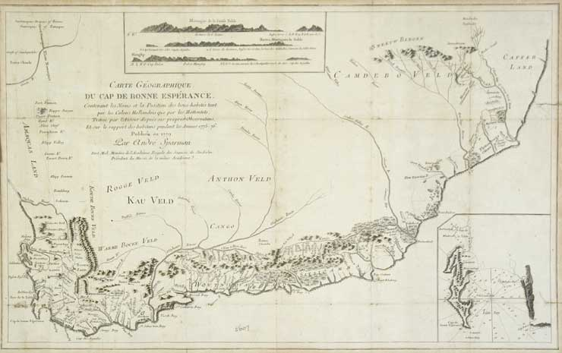
Colonial Contexts of Knowledge Acquisition

Slide 2
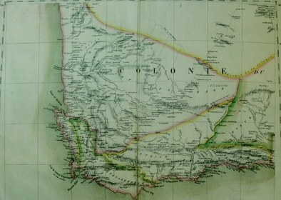
Today’s Lecture
Research Methods
Historical Content
Change over time
Reading/interpreting sources
Specific comparisons
Scale
“unit of analysis”
Mutual development of colonialism and science
Compare the projects of Kolb, Sparrman, and Bleek

Slide 3
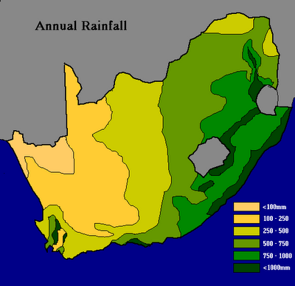
Cape Colony: Territorial Expansion
Colonie du Cap de Bonne Espérance CA: M 1/326, c. 1820

Slide 4
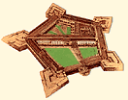
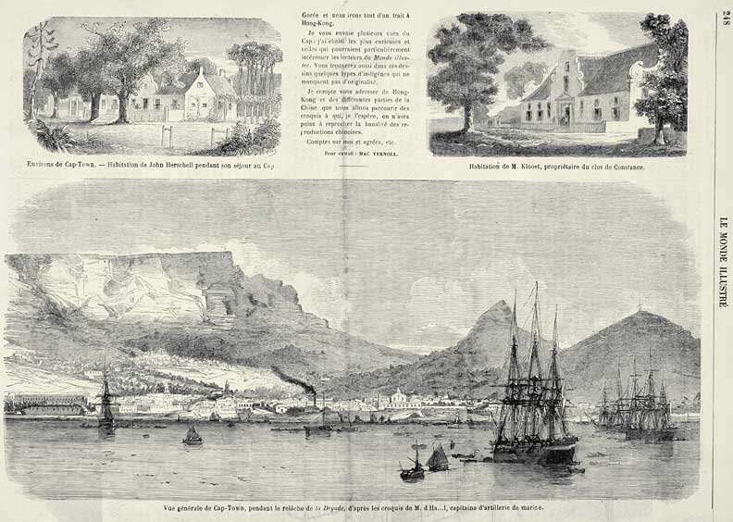
Considerations of Power

Slide 5
History of Science
Briefly,
In Europe
Ole Worm (1588-1654), a doctor and professor of natural philosophy in Copenhagen, used his collection to teach students.
Museum Wormianum; seu, Historia rerum rariorum, tam naturalium, quam artificialium, tam domesticarum, quam exoticarum . . . Leiden: ex officina Elseviriorum, 1655 Smithsonian Institution Library

Slide 6
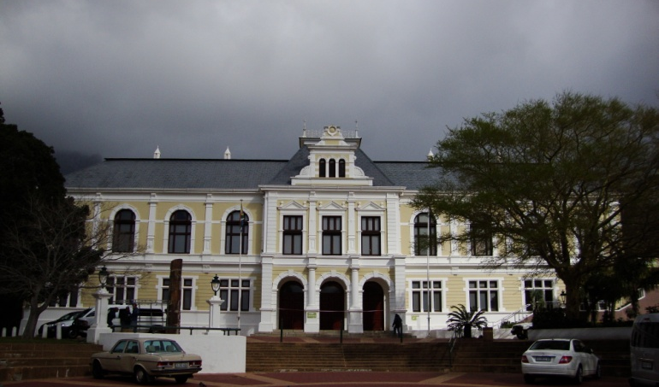
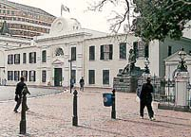
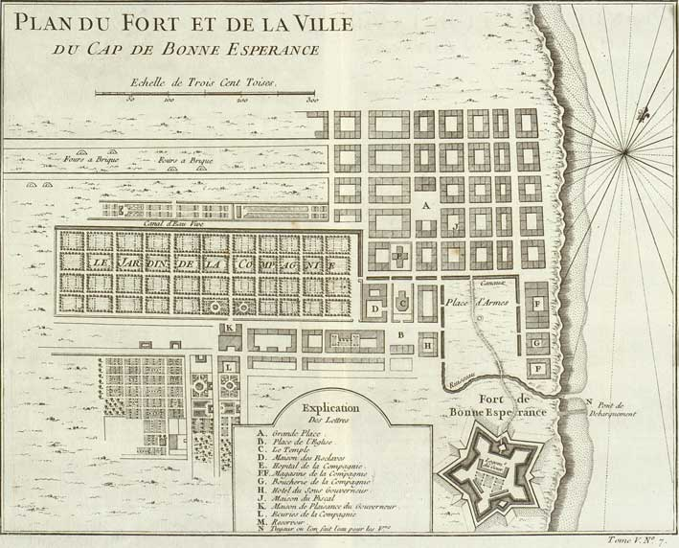
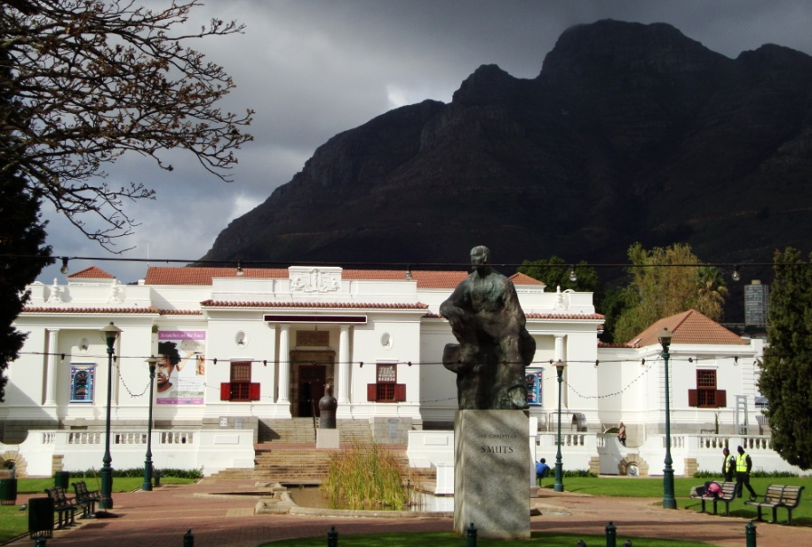
South African Museum
Slave Lodge
South African National Gallery

Slide 7
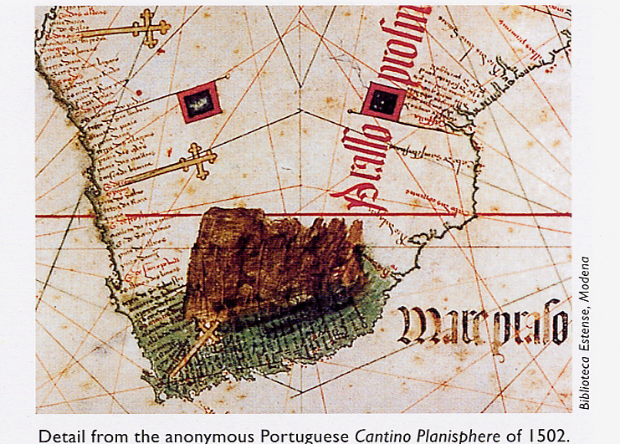
Portuguese Exploration
Portuguese navigators reach the Azores, 1427
Vasco Da Gama, 1498
Bartolomeu Dias, 1488

Slide 8
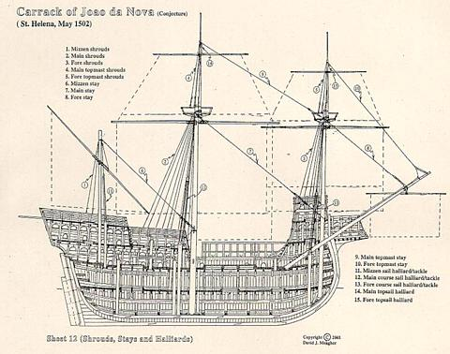
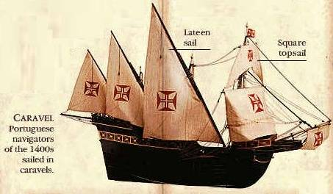
Maritime Science and Technology

Slide 9
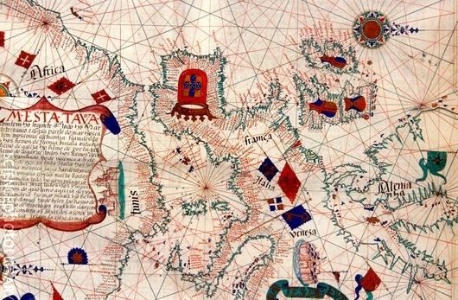
Navigation
Portuguese sea chart, 16th century
Caption: This map is from a 1563 atlas by the Portuguese cartographer Lazaro Luis, at the Sciences Academy of Lisbon.

Slide 10
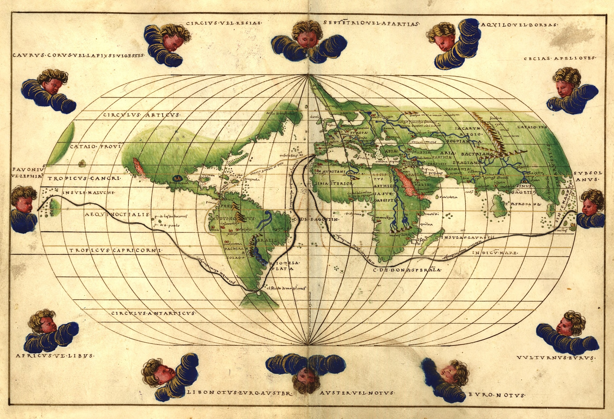
European Expansion
Ferdinand Magellan expedition, circumnavigation 1519-1522
Battista Agnese, World Map from Portolan Atlas, 1544

Slide 11
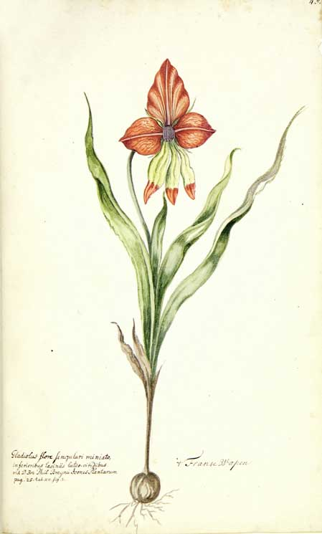
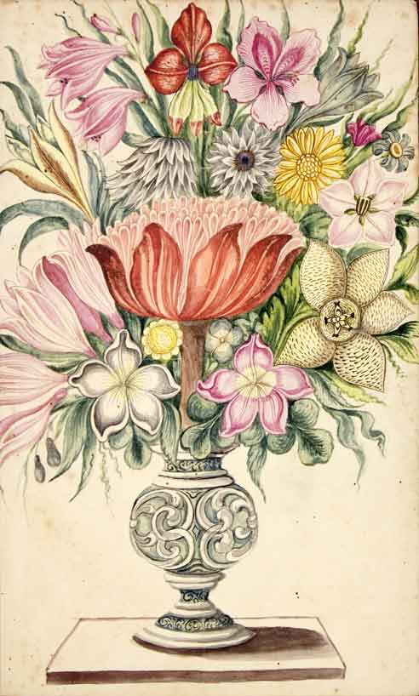
Colonial Exchanges

Slide 12
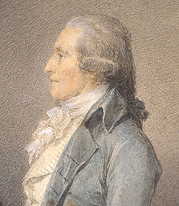
Anders Sparrman (1748-1820)

Slide 13
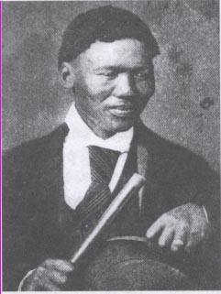
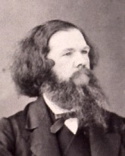
Cross-cultural collaborations
Wilhelm Bleek (1827-1875)
Lucy Lloyd (1834-1914)
|xam
||kabbo

