Slide 1
Bacchae and Protagoras
Humans, Animals, and Gods

Slide 2
Catching Dionysus
‘We captured the quarry you sent us out to catch.
But our prey here was tame: refused to run
Or hide, held out his hands as willing as you
Please, completely unafraid. His ruddy cheeks were
Flushed as though with wine, and he stood there
Smiling, making no objection when we roped his
Hands and marched him here. It made me feel
Ashamed. “Listen, stranger,” I said, “I am not to
Blame. We act under orders from Pentheus. He
Ordered your arrest.”’ (435-443)

Slide 3
Miracle 1
‘As for those women you clapped in chains and
Sent to the dungeon, they’re gone, clean away,
Went skipping off to the fields crying on their god
Bromius. The chains on their legs snapped apart
By themselves. Untouched by any human hand,
The doors swung open, opening of their own
Accord.’ (444-449)

Slide 4
Dionysus’ Conversational Tactics
He relays basic facts about himself: his origin and divine status.
He is evasive: Dionysus’ rites cannot be revealed to those who are not initiated; the god assumes whatever form he wishes.
He conveys information about his religion: foreigners believe in him; his rites are held mostly by night because ‘the darkness is well-suited to devotion.’ (486)
He warns: ‘You, [Pentheus], will regret your stupid blasphemies.’ (489) ‘I give you sober warning, fools: place no chains on me.’ (503)

Slide 5
Pentheus’ Response
Curiosity: ‘your answers are designed to make me curious.’ (474)
Threats: ‘you shall regret these clever answers.’ (488)
Xenophobia and repressed sexuality.
Punishment of Dionysus:
‘First of all, I shall cut off your girlish curls.’ (492)
‘Second, you will surrender your wand.’ (494)
‘Last, I shall place you under guard and confine you in
The palace.’ (496)
Punishment of the women: ‘I shall have them sold as slaves or put to work at my looms. That will silence their drums.’ (513-4)

Slide 6
Knowing vs. Being ignorant
D: ‘He is here now and sees what I endure.’/P:
‘Where is he? I cannot see him.’/D: ‘With me:
Your blasphemies have made you blind.’ (499-501)
D: ‘You do not know the limits of your strength.
You do not know what you do. You do not know
Who you are.’/P: ‘I am Pentheus, the son of
Echion and Agave.’/ D: ‘Pentheus: you shall repent
That name.’ (505-507)

Slide 7
Pentheus the Beast
‘With fury, with fury, he rages, Pentheus, son of
Echion, born of the breed of Earth, spawned by
The dragon, whelped by the Earth! Inhuman, a
Rabid beast, a giant, in wildness raging, storming,
Defying the children of heaven.’ (539-544)
‘Descend from Olympus, lord! Come, whirl your
Wand of gold and quell with death this beast of blood
Whose violence abuses man and god
outrageously.’ (553-556)

Slide 8
Plato’s Protagoras (320c-322d)
Of Gods and Men

Slide 9
Epimetheus’ Hindsight
To some creatures—the ‘unreasoning animals’—he
gave strength without quickness; the weaker ones
he made quick; some he armed, others he left
unarmed but devised for them some other means
for preserving themselves; to the small ones he
gave wings or an underground habitat. Next, he
supplied them with defenses against mutual
destruction and protected them against the weather.
He clothed, shod, and gave them nourishment; to
some he gave the capacity for few births, to others the
capacity for multiple births.
To humans: nothing

Slide 10
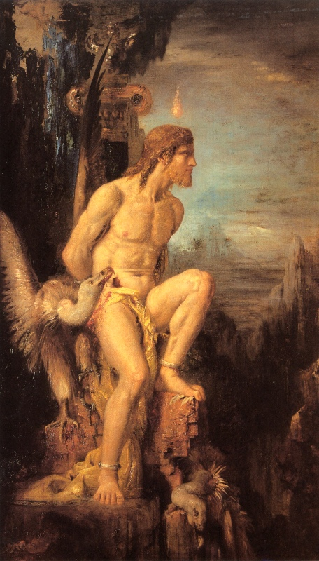
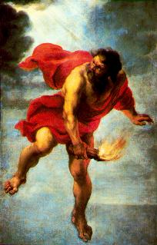
Prometheus the Thief

Slide 11
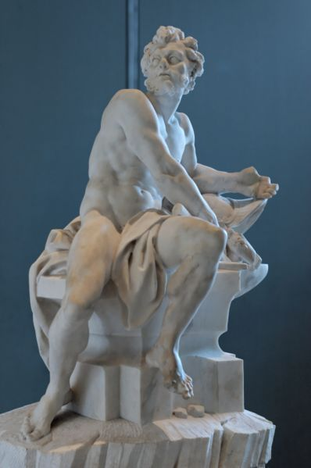
Hephaestus

Slide 12
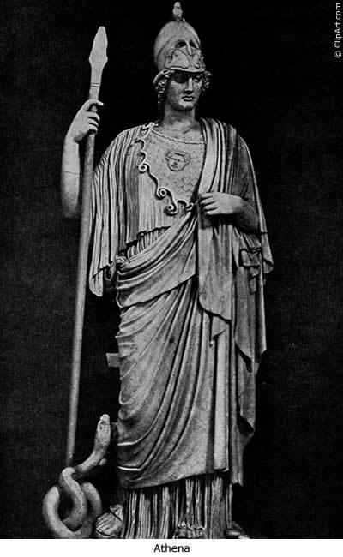
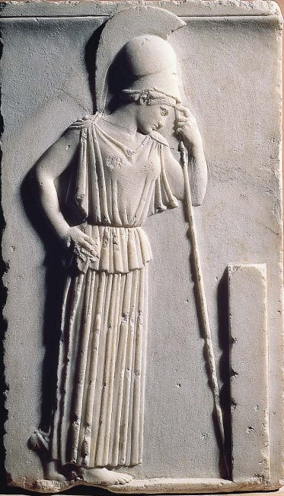
Athena

Slide 13
What can humans do?
They articulate words.
They invent houses, clothes, shoes, blankets.
They are nourished by food from the earth.
They alone among the animals worship the gods ‘because they have a share of the divine dispensation,’ a ‘kind of kinship with the gods.’

Slide 14
What can humans not do?
At first they live isolated from one another and are destroyed by strong animals. They ‘lack the art of politics of which the art of war is a part.’
Then they try to band together but wrong each other ‘because they do not possess the art of politics.’

Slide 15
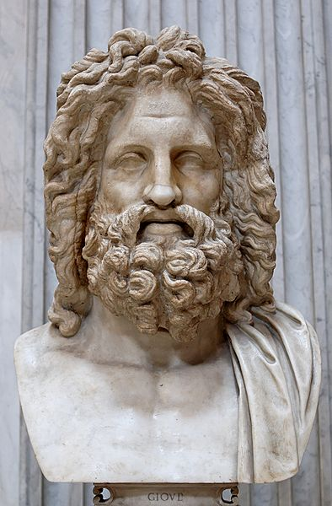
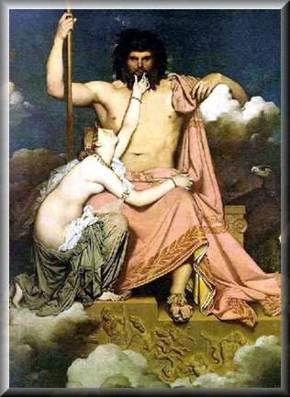
Zeus

Slide 16
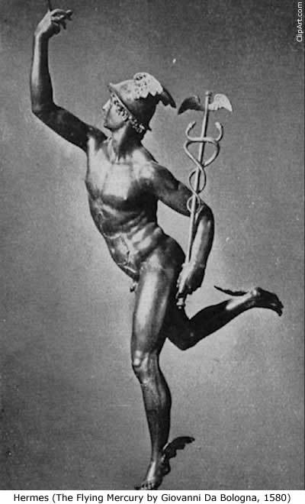
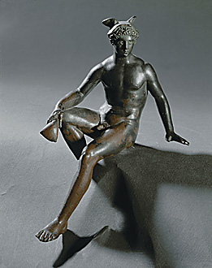
Hermes

Slide 17
Zeus’ Gifts to Humans
Justice and Shame: they bring order within cities and forge bonds of friendship.
These gifts are distributed to all ‘for cities would never come to be if only a few possessed these.’
The penalty for those who cannot partake of justice and shame is death.

