Slide 1
Humanities Core Course
Fall 2015: Section 3
Georges Van Den Abbeele
Forms of Representing War
(Epic, Lyric, Novel , Painting, Theatre, Cinema)
Fiction as basis for reasoning
Ways to Think the Fact of War
(Political Philosophy, Ethics, Strategy, Leadership
Use and Abuse of Power)
Reasoning as basis for action

Slide 2
Humanities Core Course
Fall 2015: Section 3
Fiction as basis for (inductive) reasoning:
Examples from which to infer general principles
(Deductive) reasoning as basis for action:
Abstract principles to be verified by internal logical consistency as well as against specific examples (principle of non-contradiction)

Slide 3
Syllogism
Example One:
Premise A: All humans are mortal
Premise B: Machiavelli is human
Conclusion: Machiavelli is mortal

Slide 4
Syllogism
Example One:
Premise A: All humans are mortal
Premise B: Machiavelli is human
Conclusion: Machiavelli is mortal
CORRECT

Slide 5
Syllogism
Example One:
Premise A: All humans are mortal
Premise B: Machiavelli is human
Conclusion: Machiavelli is mortal CORRECT
Example Two:
Premise A: All Florentines are rich
Premise B: Machiavelli is Florentine
Conclusion: Machiavelli is rich

Slide 6
Syllogism
Example One:
Premise A: All humans are mortal
Premise B: Machiavelli is human
Conclusion: Machiavelli is mortal CORRECT
Example Two:
Premise A: All Florentines are rich
Premise B: Machiavelli is Florentine
Conclusion: Machiavelli is rich INCORRECT
WHY?

Slide 7
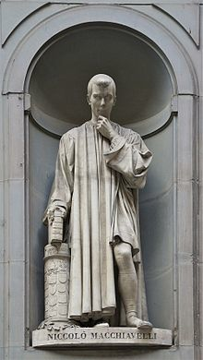
Niccolò Machiavelli
1469-1527
The Mandragola, 1518
The Art of War, 1520
Discourses on Livy, 1531
Florentine Histories, 1532
The Prince, 1532

Slide 8
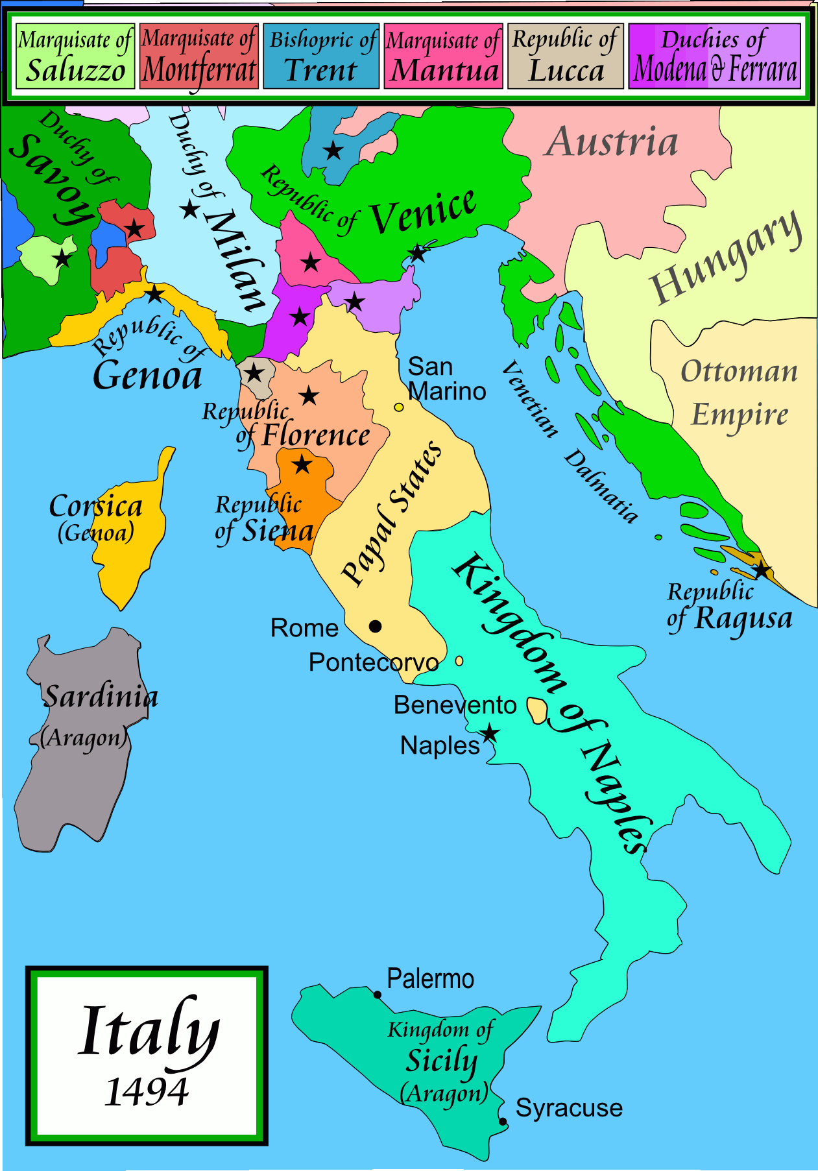
Renaissance Italy:
A World of Contradiction
On the one hand…
cultural, artistic, and scientific innovation:
Leonardo da Vinci
Michelangelo
Ficino
Raphael
Botticelli
Castiglione
Ariosto
Tasso
Alberti
Vasari
Cellini
Galileo
Bruno

Slide 9
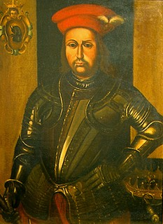
Renaissance Italy:
A World of Contradiction
On the other hand…
political turmoil, conflict, internal strife, external invasions:
French invasion, 1494
French Invasion, 1499
French Invasion, 1525
Spanish, Holy Roman Empire, Invasion & Sack of Rome, 1527
Plus: Condottiere (mercenary warlords) like Braccio Fortebraccio

Slide 10
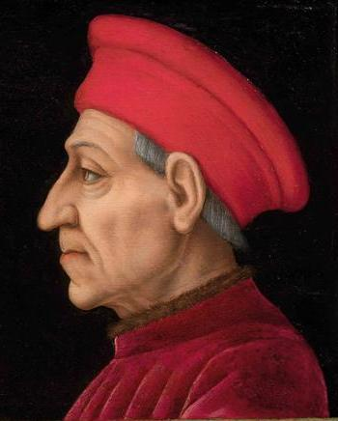
Florence: From Republic to ?
1115 – 1434
  Independent republic
1434 – 1494
  De’ Medici domination, from bankers to rulers
    Cosimo
    Piero
    Lorenzo il Magnifico

Slide 11
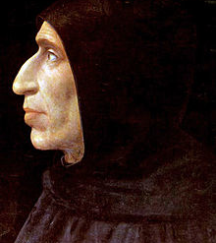
Florence: From Republic to ?
1494 – 1498
  Girolamo Savonarola
    “unarmed prophet”
    Bonfire of the vanities
    Excommunicated &
      Executed for heresy
1498 – 1512
  Florentine Republic
  Machiavelli
    Office of the Chancery
    Head of Militia

Slide 12
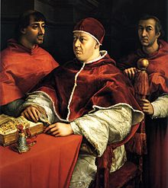
Florence: From Republic to Principality
1512 – 1527
  Return of Medici rule
  M tortured, imprisoned, then internal exile
    Writes Il Principe
1527 – 1530
  Republic restored
  Machiavelli dies, 1527
1530 – 1737
  Return of Medicis, become hereditary rulers (Dukes)
  Popes Leo X, Clement VII

Slide 13
The Prince
(Il Principe)
= the leader
“Of Principalities”

Slide 14
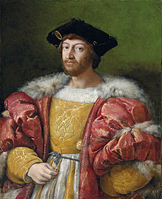
Dedicated to Lorenzo di Piero de’ Medici (grandson of Il Magnifico)
Why?
Genre: “Mirror of Princes”, to educate young leaders
What is M’s point of view?
Evil Advice for rulers?
Dispassionate analysis of power?
Cynical advocate or republican critic?

Slide 15
Argumentative Structure
General Assertion
Logical discussion of implied premises and presuppositions, as well as potential consequences and qualifications (deductive reasoning)
Specific historical examples adduced to test validity of assertion
Examples as tools to deepen and complicate analysis of political situation in question

Slide 16
  “I say therefore that in states that are hereditary and accustomed to the lineage of their prince there are many fewer difficulties in maintaining them than in new ones, for it suffices only not to break with the orders of one’s ancestors and then to govern according to circumstances. So that if a prince is of ordinary industry he will always maintain himself in his state, unless an extraordinary and excessive force deprives him of it. . . .
  “We have in Italy, among our examples, the duke of Ferrara, who survived the attacks of the Venetians in 1484 and those of pope Julius in 1510 for no other reason than that he had grown old in that dominion. For the prince by birth has fewer reasons and less need to offend, from which it proceeds that he is more loved; and, if extraordinary vices do not make him hated, it is reasonable that his own subjects naturally should wish him well. And in the antiquity and continuity of his dominion, the memories of revolutions and the reasons for them are extinguished.” (p. 42)

Slide 17
On the other hand . . .
“But the difficulties are in the new principality. . . . Its troubles arise in the first place from a natural difficulty that exists in all new principalities, which is that men willingly change their lord if they believe they will be better off, and this belief makes them take up arms against him. In this, however, they deceive themselves, because they then see by experience that they have become worse off.” (p. 43)

Slide 18
And more . . .
(note the change in perspective)
“This follows from another natural and ordinary necessity that stipulates that one always has to offend those of whom one becomes a new prince, both with men-at-arms and with the infinite other injuries that a new acquisition brings with it. The result is that you have as enemies all those you have offended in occupying that principality, and you cannot maintain as friends those who have put you there, because you cannot satisfy them in that way that they had earlier supposed and because you cannot use strong medicines against them, since you are obligated to them.” (p. 43)

Slide 19
Example
“ For these reasons Louis XII, king of France, quickly occupied Milan and quickly lost it. And to take it from Louis the first time all that was needed were Ludovico’s own forces, because those people who had opened the gates to the king, when they found themselves deceived in their opinion and in the future good they had presupposed, could no longer endure the annoyances of the new prince.” (p. 43)

Slide 20
Virtù vs Fortuna
“Dominions that are thus acquired are either accustomed to living under a prince or used to being free, and they are acquired either with the arms of others or with one’s own, either by fortune or by virtue.” (p. 41)
Virtue or virtù, from Latin, virtus, or the quality of being a vir, man or male in the gendered sense, as opposed to the generic human, homo. Virtue, in the Roman Imperial world, thus meant valor, courage, character, strength, pride, attributes very different from the Christian idea of virtue as moral goodness.

Slide 21
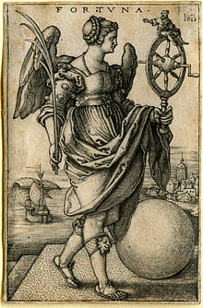

Fortuna or “Lady Luck” a gendered and misogynist stereotype
“Fortune is a lady” (p. 119)

Slide 22
Virtù vs. Fortuna
“Nonetheless, so that our free will may not be elimiinated, I judge that it may be true that fortune is the arbiter of half our actions, but that she indeed allows us to govern the other half of them, or almost that much.” (p. 117)
The antidote to being at the mercy of fortune and happenstance is virtù and prudentia (again less “prudence” than practical judgment and decision making).
For Machiavelli, and contrary to our contemporary understanding of these terms, virtue can be utterly ruthless and prudence completely “impetuous.” These are his terms for human agency. Within the limits of the unpredictability of fortune, virtue for a ruler is whatever it takes to acquire and maintain power, regardless of the means.

Slide 23
Virtù vs. Fortuna
According to Machiavelli, the best way to understand the “virtue” of leadership is to study and imitate the actions of great leaders:
“For, since men always walk in paths beaten by others, and they proceed by means of imitation in their actions, and since one cannot completely hold to the paths of others, nor arrive at the virtue of those whom you imitate, a prudent man should always enter by paths beaten by great men and imitate those who have been the most excellent, so that if his virtue does not arrive there, at least it gives off some scent of it. And he should do as the prudent archers do when the place they wish to strike appears to them too far off. Since the archers know just how far the virtue of their bow reaches, they place their aim much higher than the intended place, not in order to reach a place so high with their arrow, but to be able, with the help of so high an aim, to achieve their goal.” (p. 55)

Slide 24
Virtù vs. Fortuna
On the other hand,
On the other hand . . . !!!
These explicitly gendered terms of the struggle between (male) virtue and (female) fortune, and the advice to imitate the great men of the past also lead to some of Machiavelli’s most shocking and cynical conclusions:
“it is better to be impetuous than cautious, for fortune is a lady, and it is necessary, if one wants to hold her down, to beat her and to dash her. And one sees that she lets herself be won more by these men, than by those who proceed coldly. For this reason, as a lady, she is always the friend of the young, because they are less cautious, more ferocious, and they command her with more audacity” (p. 119)

Slide 25
Virtù vs. Fortuna
To what extent are we to understand power politics on the model of domestic or sexual violence?
Is the cult of “strong leadership” necessarily embedded in a culture of specifically male privilege, unapologetic rape and entitled exploitation of others?
Are these false syllogisms?
Jaded advice to the powerful?
Or a brutally honest portrayal about how rulers really do think about whom and how they rule?
And does “fortune” really favor the “impetuous” and the “ferocious”?
To help us answer these questions, next time, we will look critically at the examples Machiavelli himself gives us of successful and unsuccessful princes, as well as examples of leaders who claim to follow upon Machiavelli’s words.

