Slide 1
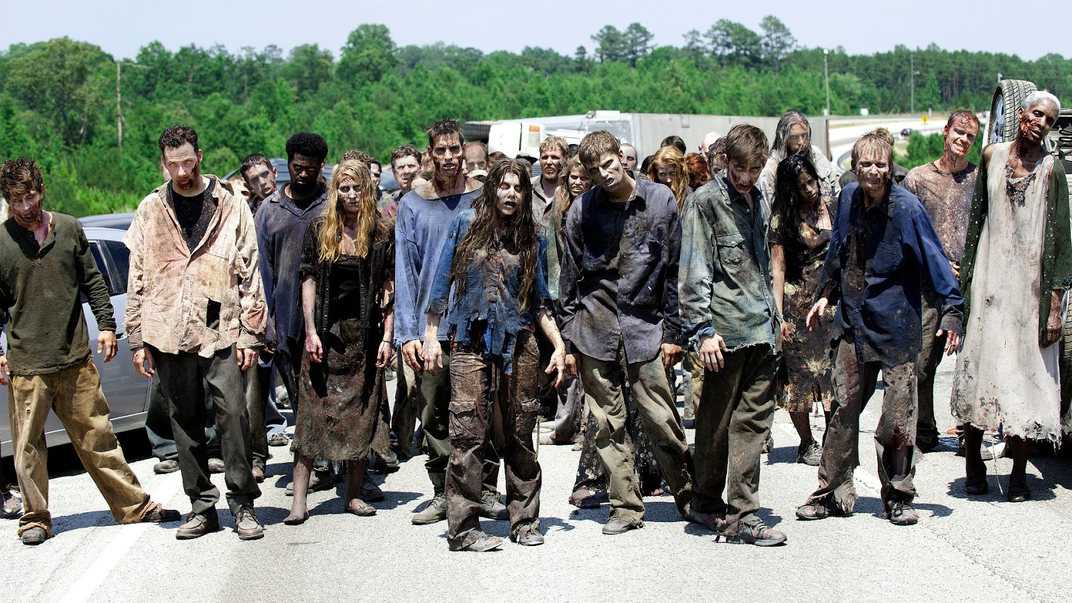
Zombies and World War Z

Slide 2
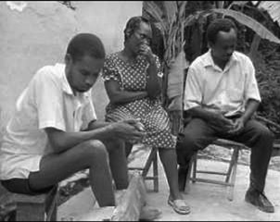
Wilfred Doricent 1988 Haiti

Slide 3
Zombie as signifier
They do their real cultural work in the figurative mode
--something that has outlived its purpose
--going through the motions
--the utterly abject, lowest of the low: perfect villains/enemies along with Nazis
--huddled masses of the poor or the outcast
--an ever-present danger that threatens to overwhelm us
--consumption/consumer society/capitalism
--mathematical/quantitative/proliferating danger
--epidemiological
Many more contexts in which zombies signify

Slide 4
WHAT IS A ZOMBIE?
"An all-purpose form for mediating a wide range of concerns"
Chera Kee, “They are not Men...They are Dead Bodies!: From Cannibal to Zombie
and Back Again,” Better Off Dead: The Evolution of the Zombie as Post-Human
(eds. Deborah Christie and Sarah Juliet Lauro), Fordham UP, September 2011:
9-23, 9.
TWO STRANDS OF THE ZOMBIE NARRATIVE:
“Coming Home:” Evolving toward or returning to humanity
Feral flesh eaters: Unchanging, operating on pure instinct

Slide 5
WHAT IS A ZOMBIE?
"An all-purpose form for mediating a wide range of concerns"
Chera Kee, “They are not Men...They are Dead Bodies!: From Cannibal to Zombie
and Back Again,” Better Off Dead: The Evolution of the Zombie as Post-Human
(eds. Deborah Christie and Sarah Juliet Lauro), Fordham UP, September 2011:
9-23, 9.
TWO STRANDS OF THE ZOMBIE NARRATIVE:
“Coming Home:” Evolving toward or returning to humanity
Feral flesh eaters: Unchanging, operating on pure instinct

Slide 6
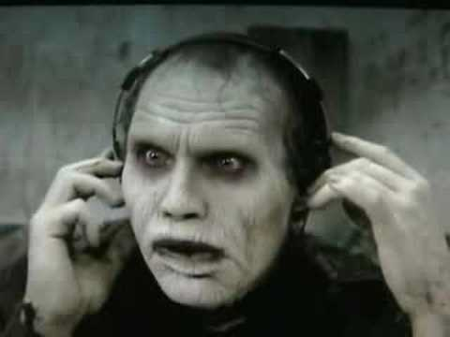
Bub Day of the Dead dir. George Romero 1985

Slide 7


Slide 8


Slide 9
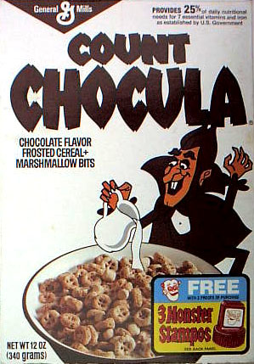
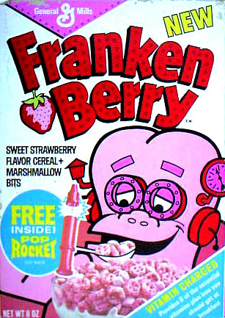

Slide 10
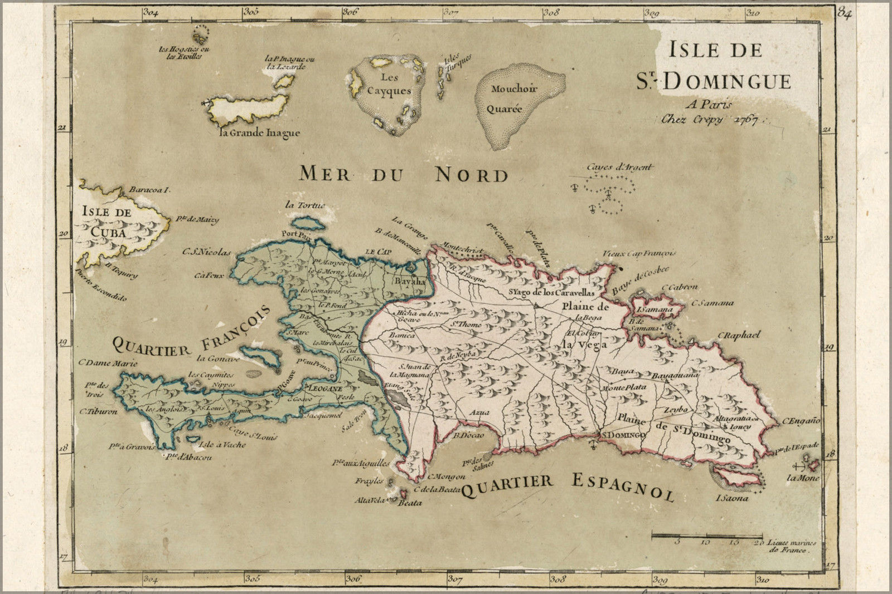

Slide 11
Columbus lands in 1492
--1493: 1300 Spaniards arrive to set up plantations
--Native Arawaks forced to work but they are not immune to European diseases and
most die. Pop. 250,000 dwindles to 17,000 in fewer than 20 years
--1503: Slave trade begins, most of them from the Congo
--French and Dutch pirates control parts of the western island and in 1765, France
declares western part of the island a French colony. Saint-Domingue (Haiti)
--Harsh working conditions for slaves but very lucrative for France—its most profitable
colony.
--Congolese spirit religion merges with the French/Spanish Catholicism imposed on the
Slaves. Ki-Kongo word for Spirit=nzambi
Meanwhile, back at the Metropole…
--French Revolution of 1789
--Declaration of the Rights of Man and Citizen: Rights of Man are universal
“Men are born and remain free and equal in rights”
Haitian Revolution 1791-1804

Slide 12
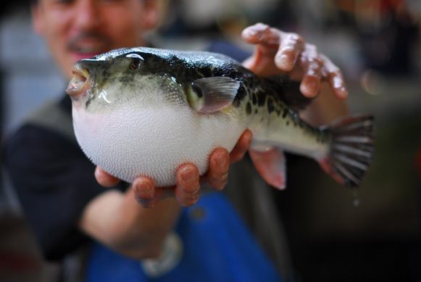
Tetradotoxin a neurotoxin from the puffer fish
Fugu poisoning

Slide 13
1915-34 US Occupation of Haiti 1916-18 forced labor
W.B. Seabrook The Magic Island 1929
Most US readers knew Haiti only through Seabrook’s exoticizing work
with its chapter on a zombie encounter
White Zombie 1932 dir. Victor Halperin starring Bela Lugosi
I Walked with a Zombie 1943 dir. Jacques Tourneur
Zombies on Broadway (comedy) 1945 dir. Gordon Douglas

Slide 14
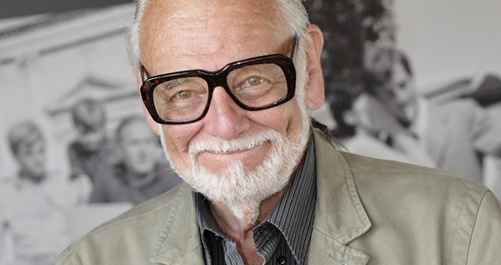
GEORGE ROMERO 1940-
Night of the Living Dead 1968
Dawn of the Dead 1978
Day of the Dead 1985

