Slide 1
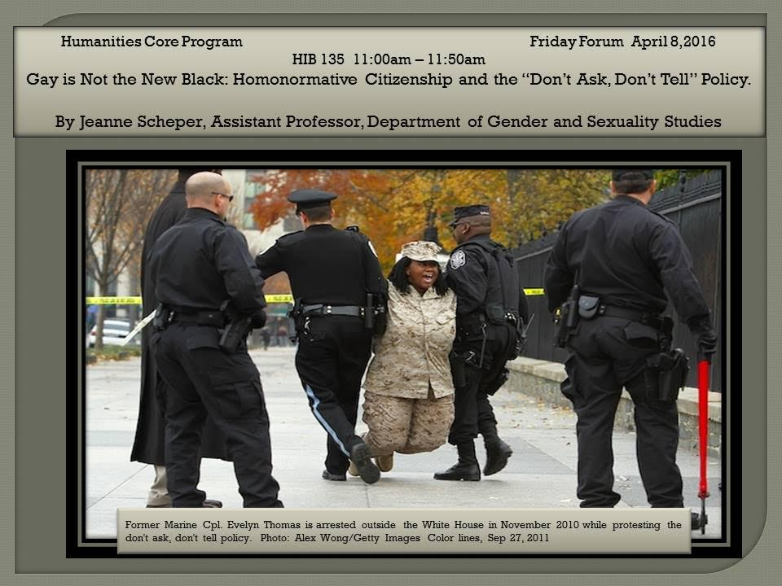
FRIDAY FORUM April 8 11:00 HIB 135
Jeanne Scheper, Department of Gender & Sexuality Studies
Gay is not the New Black: Homonormative Citizenship and the “Don’t Ask, Don’t Tell” Policy

Slide 2
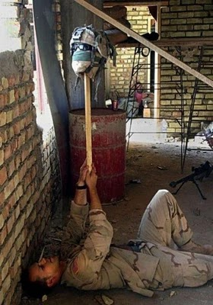
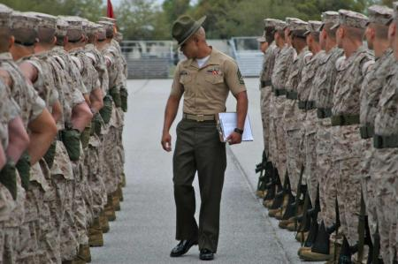
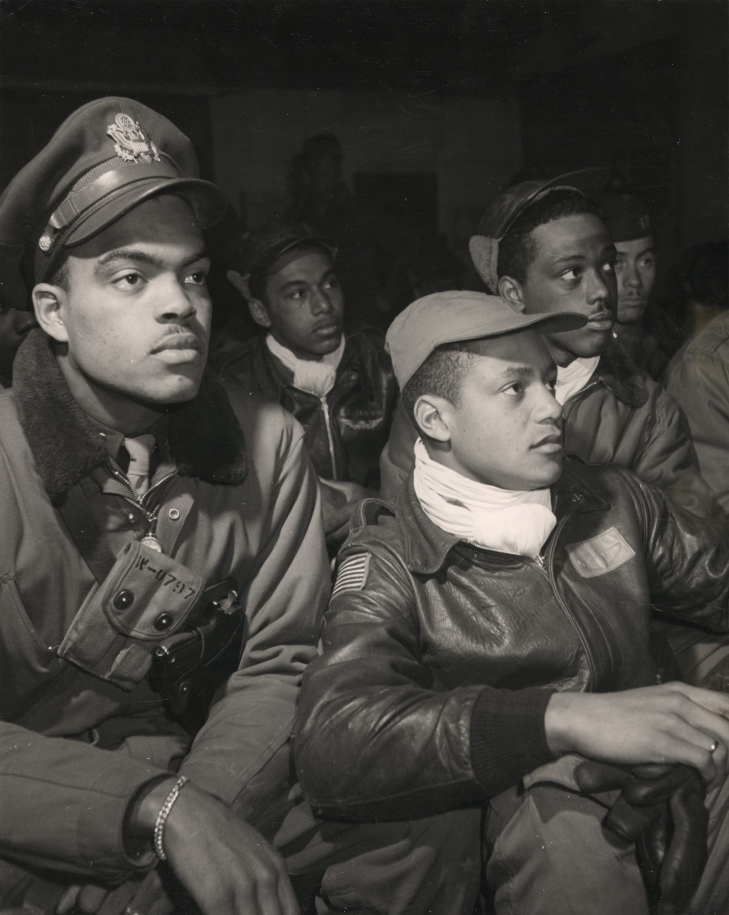
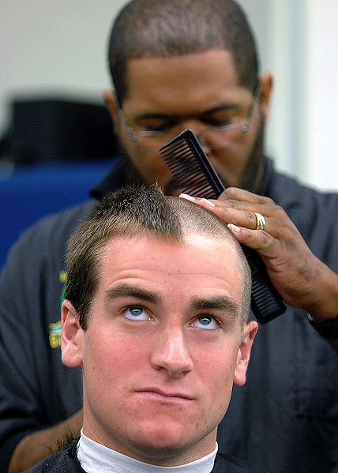
Military Culture
Basic Training

Slide 3
Disclaimer
Soldiers and Marines are not known for their polite speech, and some members of this community (and the actors who depict them) relate speech that is highly offensive, sometimes sexist, racist, and even scatological.
I may quote something that disgusts, not to shock you but to illustrate the kinds of texts one encounters when looking closely at a culture that few but its members see.
My job as a scholar is to move beyond the discomfort and to think about what function/s these examples of military culture might serve.
I caution you that Invisible War is an Academy Award nominated film that presents victims of military sexual assault who recount the difficulties they have faced in the aftermath of such violence. If you find it overwhelming, please speak with your section leader, with me, or with someone at our Counseling Center.

Slide 4
Today
Basic training is a highly ritualized military rite of passage designed to transform identity, one that will allow its members to execute violence on command in the name of the state.
A process that ha historically pitted byper-masculinity against civilian femininity.
Becoming a member of the corps requires that one master its culture.

Slide 5
Culture
a way of life informed by those who came before us, by the beliefs we hold, and the activities we perform.
Culture is manifest in the rituals we observe, the jokes we tell, the slang we speak, the clothes we wear, the food we eat, the music we listen to and perform, the work we do, and the ways in which we interact with others who share our work place.

Slide 6
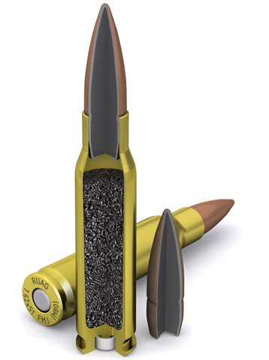
What to look for in Full Metal Jacket?
Kubrick is famous for his long takes.
Where is he placing these long takes and why?
He’s also known for his deep focus shots in which the background, middle ground and fore ground are all in focus.
Places where you see the real verging on the absurd
Why is the film called “Full Metal Jacket” and not “Short-timers?”

Slide 7
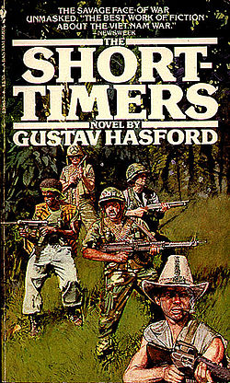
Short timers
Gustav Hasford (1947-1993)
Kubrick based his film on Hasford’s Short Timers, published in 1979
Enlisted in the Marine Corps, and like Joker, was sent to Vietnam as a combat correspondent.
Of that job, he writes: “We appeared to be journalists, but we were really simply promoting the war and promoting the Marine Corps.” He goes on, “In war, truth is the first casualty….History may be written with blood and iron but it’s printed with ink.” (35)

Slide 8
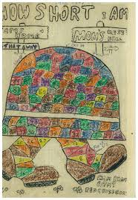
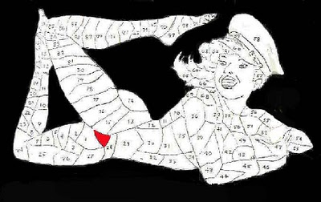
Short-timer Calendars

Slide 9
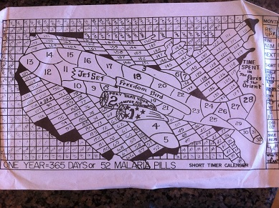

Slide 10
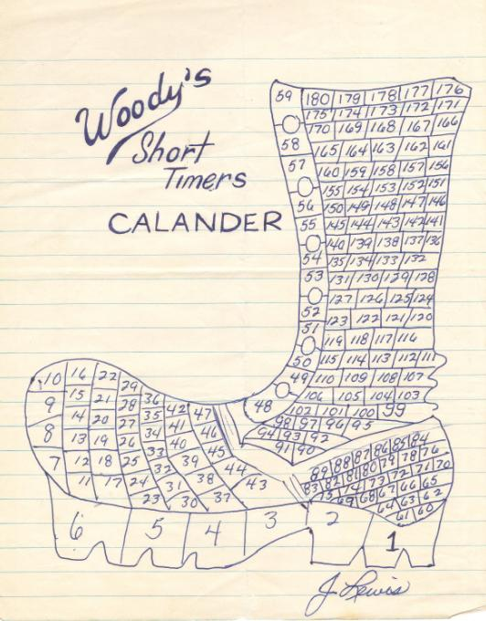

Slide 11
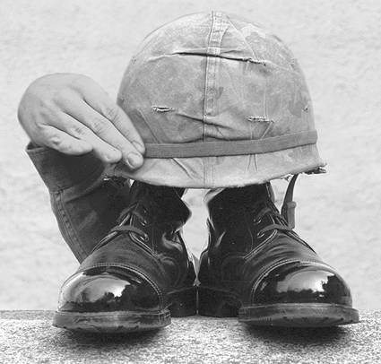
The short timer

Slide 12
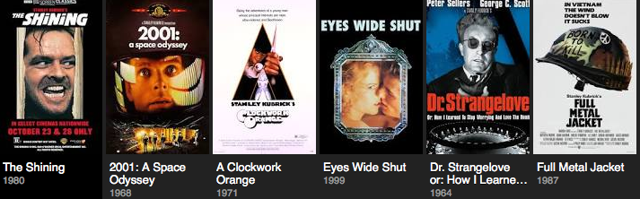
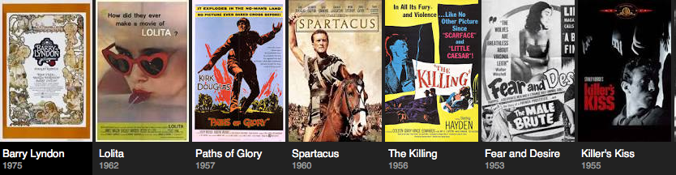
Stanley Kubrick 1928 - 1999

Slide 13
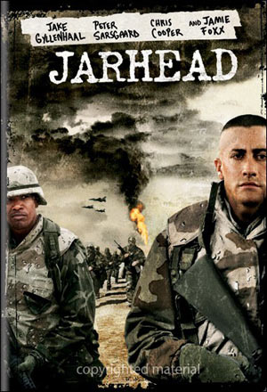
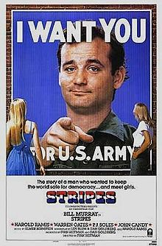
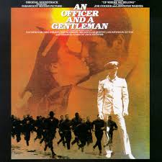
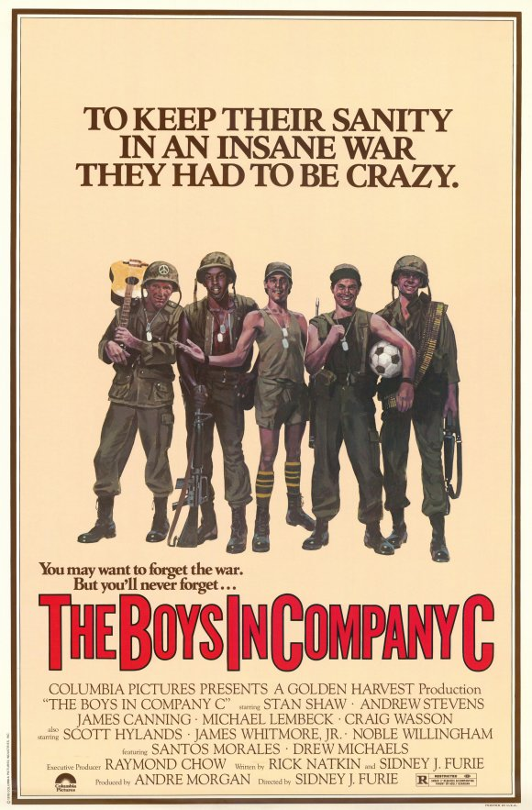
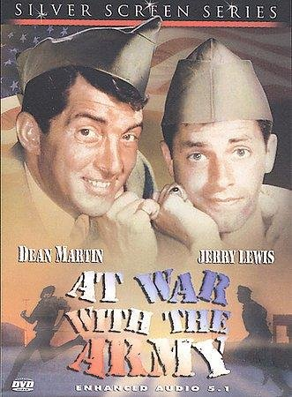

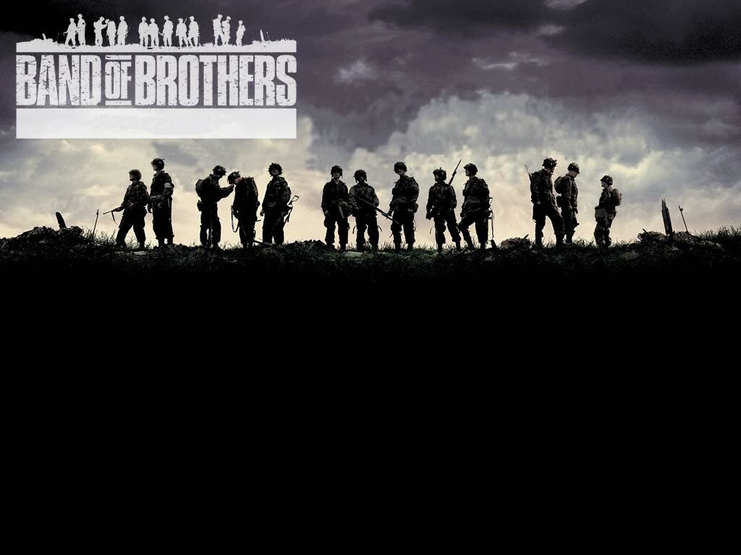
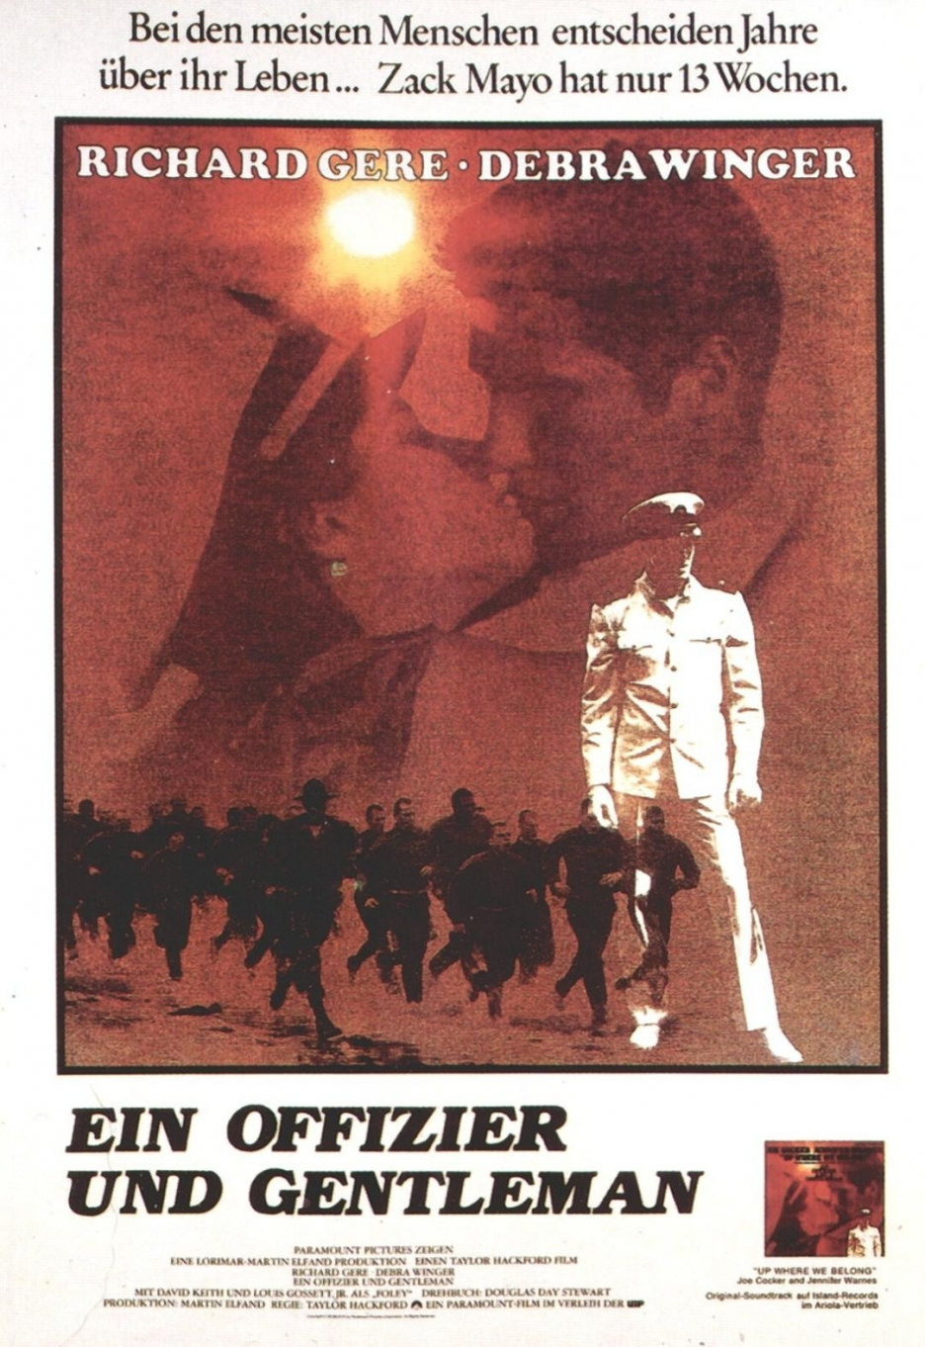
Basic
Training

Slide 14
Erving Goffman, Presentation of Self in Everyday Life
“When an individual enters the presence of others, they commonly seek to acquire information about him or to bring into play information about him already possessed. They will be interested in his general socioeconomic status, his conception of self, his attitude toward them, his competence, his trustworthiness, etc. Although some of this information seems to be sought almost as an end in itself, there are usually quite practical reasons for acquiring it. Information about the individual helps to define the situation, enabling others to know in advance how best to act in order to call forth a desired response from him. (1)

Slide 15
Liminality
In his 1908 classic work, Rites de Passage, Arnold van Gennep defines liminality as the middle stage in initiation rituals. The initiate has not arrived at his new status, nor is he situated in his old state; he is between. (e.g. neither civilian nor Marine)
Liminality can be a state of confusion; what one thought one knew no longer pertains.
In The Ritual Process (1969), Victor Turner further refines the concept:
The neophyte in liminality must be a tabula rasa, a blank slate, on which is inscribed the knowledge and wisdom of the group, in those respects that pertain to the new status. The ordeals and humiliations…to which neophytes are submitted represent partly a destruction of the previous status and partly a tempering of their essence in order to prepare them to cope with their new responsibilities and restrain them in advance from abusing their new privileges. They have to be shown that in themselves they are clay or dust, mere matter, whose form is impressed upon them by society. (103)

Slide 16
According to a former commander of Paris Island, “Training was designed at Parris Island to break the umbilical cord between military and civilian life, designed to break him down to his fundamental self, take away all that he possesses and get him started out in a way that you want him to be. Issue him all new clothes, cut his hair, send his possessions home and tell him he doesn’t know a damn thing, that he’s the sorriest thing you’ve ever seen, but with my help you’re going to be worthwhile again.”

Slide 17
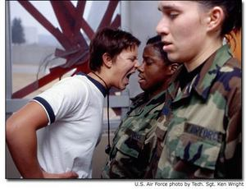
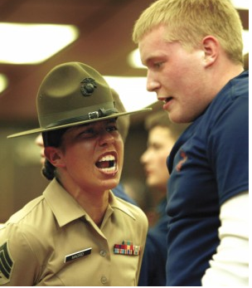
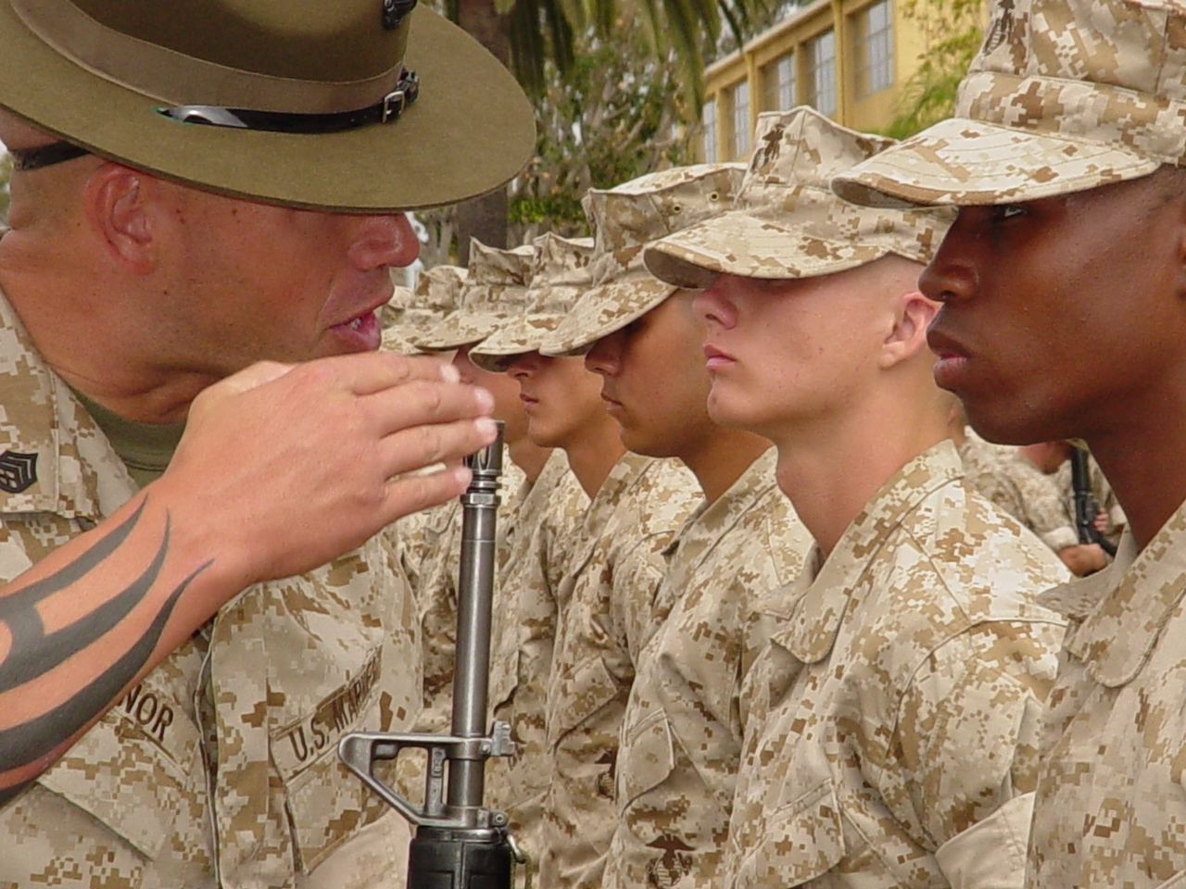
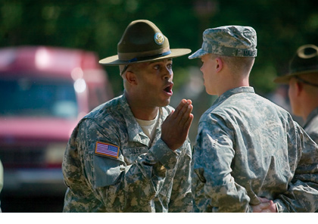

Slide 18
Lt.Col. Michael Becker explains, “The reason we do this [simulate confusion]…is to create uncertainty. From the recruit’s perspective, it appears to be chaos. War is chaos. And they see this drill instructor—this magnificent creature who brings order to chaos. They learn that if they follow orders, their life will be calmer….The recruits aren’t the enemy—don’t get me wrong. The enemy is their values—their un-Marinelike values.” (Ricks, Thomas. Making of the Corps. NY: Scribner, 1997. p

Slide 19
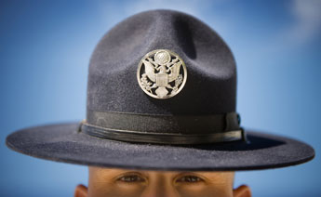

Slide 20
From Chaim Shatan’s “Bogus Manhood, Bogus Honor” Psychoanalytic Review 64.
“Recruits embrace their punisher and are renewed with a sense that they are part of something larger, the Corps, a union of not only all Marines but all former and future ones. Their true lineage is not a family line but a professional one, they enjoy fraternity with Chesty Puller.”

Slide 21
Deindividuation
Self-awareness is eclipsed by the powerful sense of belonging to a group.
One is no longer acting as a single moral agent solely responsible for one’s actions.
One may be willing to commit acts with others that would be unthinkable to do alone.
Dissociation can erase prohibitions that normally exist against aggression towards others.

Slide 22
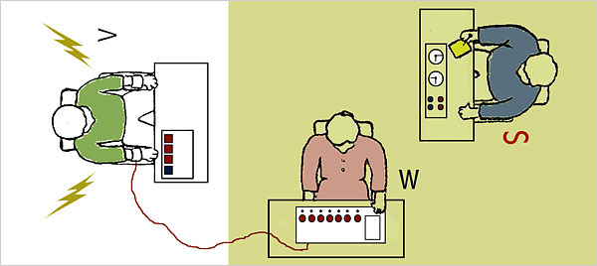
Experiments by Psychologist Stanley Milgrim in the 1960’s
Looked at obedience to authority
Experiment concerns the willingness to administer electric shock to another under the watchful eye of an authority figure
65% of the men in the study continued to administer shocks even after they heard screams

Slide 23
Related experiments have shown:
a) a moral disengagement that facilitates tolerance to inflict pain
b) a displacement of responsibility onto the victim
c) that those 35% who opt to stop when the victim yells to let him out tend to see themselves as the agents of the shocks, whereas those who are willing to continue see the authority figure as responsible for the pain inflicted.
d) those most willing tend to be fearful of a dangerous world & have a stricter moral code
e) one experiment revealed privates less likely to administer the high levels of shocks than LT Colonels

Slide 24
So, what are the methods Basic Training Employs?
Basic training transforms individuals into standard “government issue” soldiers by:
- prohibiting contact with the civilian world
- dressing everyone the same
- shaving their heads, or if women requiring exacting standards
- depriving them of sleep
-exhausting them physically
- prohibiting personal possessions
- measuring success not according to individual standards but by the success of the group
- infantilizing
- controlling every minute of their time
- simulating confusion
- prohibiting a recruit from referring to herself or himself in the first person:
  “Private Jones reporting for duty, Sir”
  “Midshipman Smith requests permission to ask a question sir.”
- keeping them in a liminal, deindividualized state
- forcing them to suppress anger and frustration
- bullying and humiliating

Slide 25
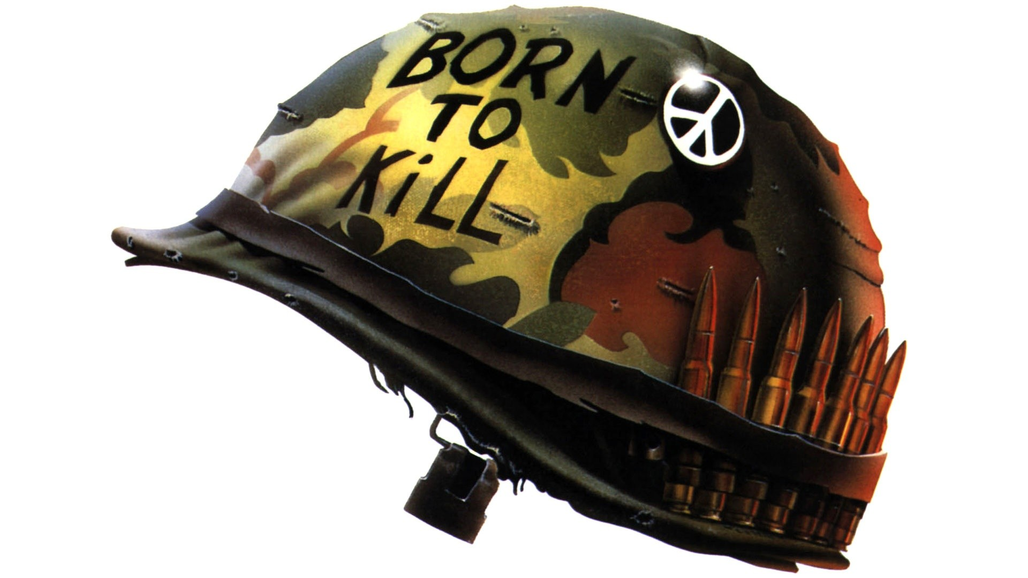
As you screen the film again, ask yourself:
--How do the two halves of the film relate?
--What songs frame the film?
--What does the film have to say about one’s rifle in the first and second halves?
--What advertisements do you see in the film? Why are they there?
--How are we to read Joker’s kill?
--Kubrick is a very careful director. Why does he add an 8th man to the group of 6 + Animal Mother who move to take out the sniper?

