Slide 1
Gail Hart
Professor of German
Department of European Languages and Studies
HIB 229
Office Hours Tuesday 1-3pm and many other times by appt.
gkhart@uci.edu
X46339

Slide 2
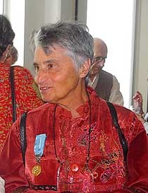
Witnesses to War Ruth Kluger: Still Alive
th Kluger: Stil

Slide 3
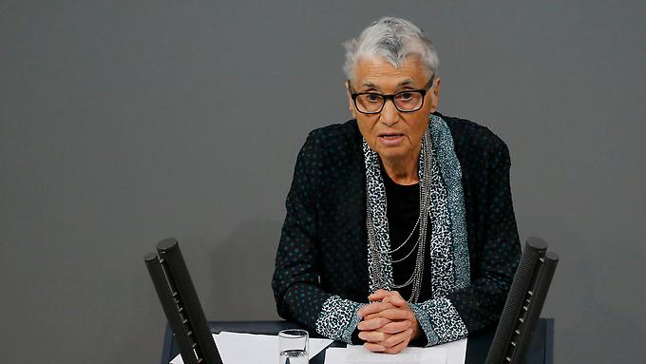
January 27, 2016 Address to German Parliament (Bundestag) on Forced Labor
Notes:
Address to the German Bundestag (Parliament) January 27, 2016

Slide 4
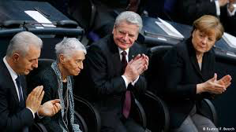
With Angela Merkel, Chancellor of Germany and Joachim Gauck,
President of Germany

Slide 5
History and Witness Accounts
History: Big Picture—descriptive/analytical narrative compiled from facts and factors, with an emphasis on general experience
Witness Accounts—personal experiences that reflect a facet or segment of the Big Picture
Louisa May Alcott, Frederick Douglass
Ruth Kluger, contributors to Film, Nanking.

Slide 6
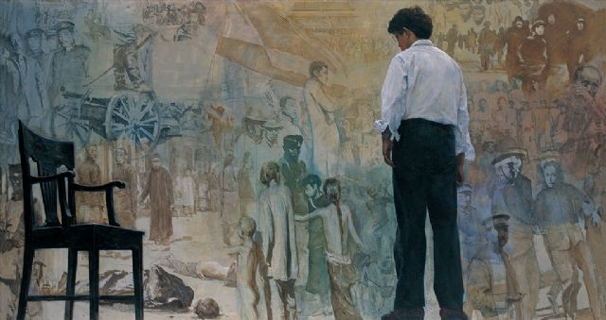
Thinking about History From My Space 1979 Chen Yifei (1946-2005)

Slide 7
Nanking (Film 2007)

Slide 8
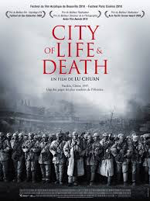
Lu Chuan City of Life and Death 2009

Slide 9
HOME Vienna as HOME
p. 24 “Oh, you are from Vienna…”
p. 41 “And yet being thrown out of our sandbox for no apparent reason
by the parents of other kids—that was the quintessential experience
of my generation…in Hitler’s Vienna.
p. 60 “But it is the city where I learned to speak, listen, and read, all the
basics for a human life. I remain its reluctant child.
p. 112 “I don’t hail from Auschwitz, I come from Vienna. Vienna is a part of me.”
Kluger’s ambivalence about Vienna.

Slide 10
Vienna

Slide 11
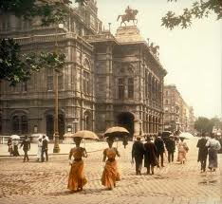
City of music, art, pastry, literature, and psychoanalysis
Vienna Court Opera:

Slide 12
Museum of Fine Arts

Slide 13
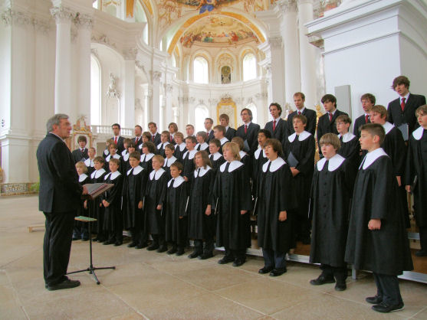
Vienna Boys’ Choir
1498-

Slide 14
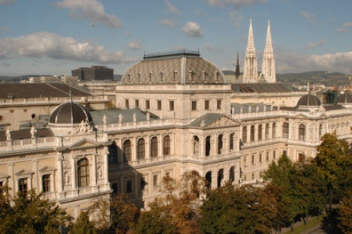
Oldest University in the German-Speaking World 1365 (UCI was 1965)

Slide 15
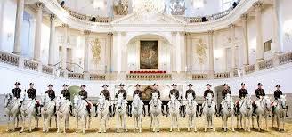
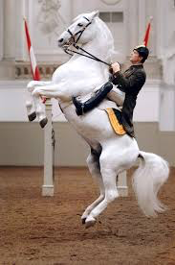
Spanish Riding School
1572-

Slide 16
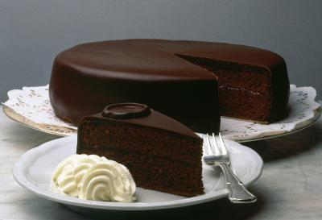
Sacher Torte
Vienna is known for cakes, pastries, and whipped cream

Slide 17
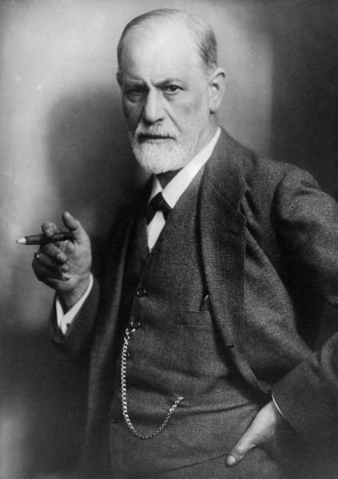
Sigmund Freud: 1856-1939 Reichsfluchtsteuer (exit tax)

Slide 18
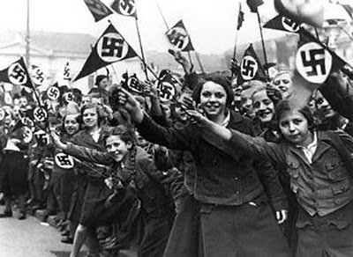
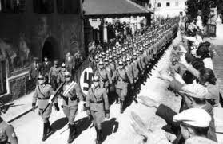
All of this history, entertainment, culture, and nourishment was withdrawn from the
Jewish population with the
Anschluss or Annexation to Germany on March 12, 1938

Slide 19
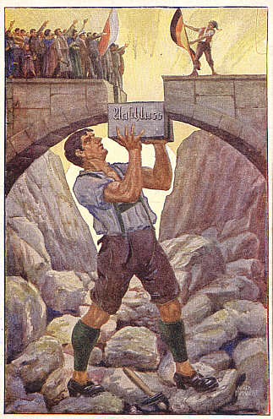
Anschluss

Slide 20
Kluger was 6 at the time of the Anschluss; now she is in her 80s.
The book you have is a translation, updating, modification of her 1992
autobiography, weiter leben: Eine Jugend
UCEAP:
THE ACCIDENT 1988

Slide 21
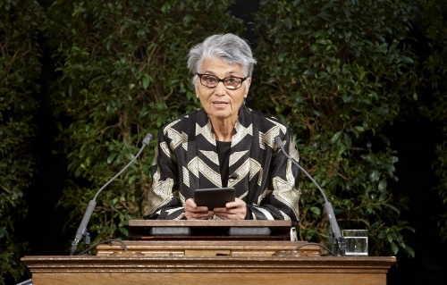
Kluger addresses the Austrian Parliament
Holocaust Remembrance Day 2011

Slide 22
Jonathan Yardley
Washington Post 9 December 2001
What an amazing book it is. The literature of the Holocaust is vast and
ever-growing, some of it of an uncommonly high order, but Still Alive moves
at once to the forefront.
The story it tells is by now numbingly familiar—a child is wrested out of
innocence into horror, adapts and copes, miraculously survives and some
grows into full productive adulthood—but the voice that tells it is new and
original.
Herself “more hard-boiled than I want others to be,” Kluger doggedly resists
self-deception, self-congratulation, and sentimentality….She views the
Holocaust and her own path through it with a clinical clarity that takes the
breath away.

Slide 23
Gabriele Anan NY Review of Books November 7, 2002
[Kluger] resents all views on the Holocaust that do not tally exactly with her own,
and gets indignant about everyone who criticizes her…
And of course nobody could expect to get it completely right unless they too had
survived the Holocaust. That makes it difficult to judge her book. It holds one’s
attention by the very nature of her story, and the story could hardly be better told,
in a forceful, colloquial style. All the same, Primo Levi told a similar story
without making one feel so hectored.
-----------------------------------
For discussion: One thing the book accomplishes is to make Kluger and her
experience intelligible to those who handle her as a representative of
the remote past, the Holocaust, human suffering, the war. She is trying to
integrate the victim into the conversation.

Slide 24
Some definitions for next time:
Monument: A statue or other structure that commemorates
A famous person or event. monere= to remind
Memorial: Often a synonym for monument but emphasizes the
mental exercise of memory. Of or belonging to memory.
Museum: Latin and Greek derivation= library, study, place of learning
Learning Center, Resource Center, Research Center
All of the above have been used to commemorate the Holocaust

