Slide 1
Zombies and War
Max Brooks: World War Z (2006)
The Zombie Survival Guide (2003)
Taking Zombies seriously
A zombie's digestive tract is completely dormant. The complex system that processes
food, extracts nutrition, and excretes waste does not factor into a zombie's
physiology. Autopsies conducted on neutralized undead have shown that their "food”
lies in its original, undigested state at all sections of the tract. This partially chewed,
slowly rotting matter will continue to accumulate, as the zombie devours more
victims, until it is forced through the anus or literally bursts through the stomach
or intestinal lining (ZSG 11-12)
SOMETIMES A ZOMBIE IS JUST A ZOMBIE

Slide 2
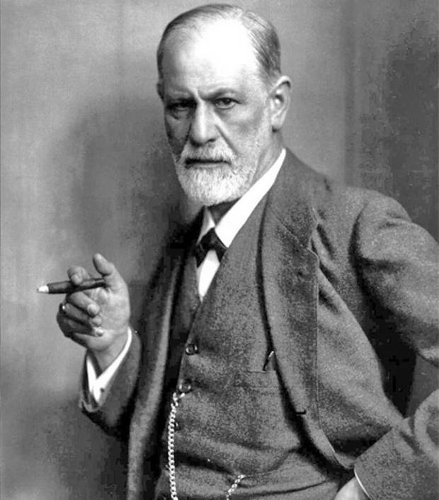
Sometime a cigar is just a cigar/sometimes a quotation is apocryphal

Slide 3
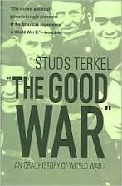
As Brooks’ zombies gain in detail and specification, their suggestive
resemblance to other figures and other contexts diminishes
Max Brooks 1972-
Wrote World War Z in the manner of Studs Terkel’s
“The Good War:” An Oral History of World War II

Slide 4
ORAL HISTORY vs. FILM
Film of World War Z 2013
Problems of transforming a series of print interviews into a BIG film:
Need for ACTION vs. the reflective nature of the interviews
Need for central role for the STAR vs. many voices (43) of the book
Difficulties of accommodating nuance within a SPECTACLE

Slide 5
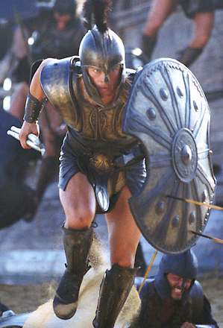
Troy 2004 World War Z 2013

Slide 7
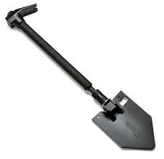
Zombie interventions in the human culture of war
WEAPONS: Reversion to hand-held weapons
The LOBO:

Slide 8
TACTICS:
SACRIFICE AND PRAGMATISM
Paul Redeker: “The heart should only exist to pump blood to the brain” (106).
“The first casualty of the conflict must be our own sentimentality” (107).
Also known as the South African Plan, the Chang Doctrine, and
the Prochnow Plan (Jürgen Prochnow played John Rabe in Nanking
and the submarine capt in Das Boot)

Slide 9
The Human Spirit and the “human factor”
“Patient Zero” China conceals the outbreak
US and Canada also suppress information
Travis D’ Ambrosia: Supreme Allied Commander in Europe
Breck Scott and Phalanx, vaccine for “African rabies
Israel institutes “voluntary quarantine” for “any foreign-born Jew,
Any foreigner of Israeli-born parents, any Palestinian living in the
formerly occupied territories, and any Palestinian whose family
had once lived within the borders of Israel” (p. 37).
Jürgen Warmbrunn
Saladin Kader
More geopolitics:
“Cuba won the zombie war” (p.228 [not assigned])

Slide 10
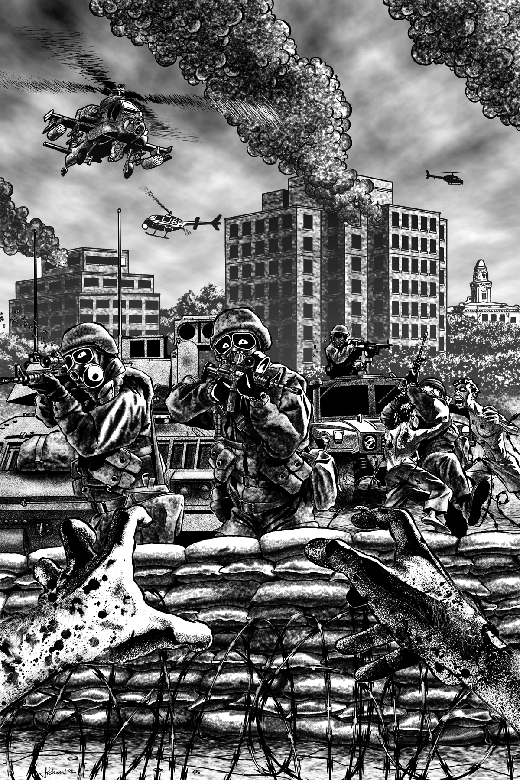
The Battle of Yonkers and Todd Wainio

