Slide 1
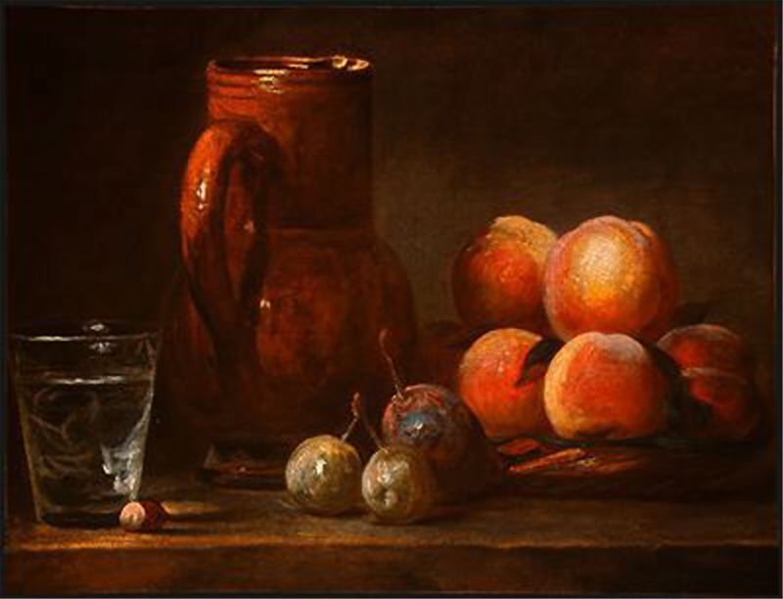
“There are several small paintings by Chardin…Nearly all represent fruit and the accessories of a meal. They are nature itself; the objects seem to come forward from the canvas and have a look of reality which deceives the eye…When I look at other artist’s paintings I feel I need to make myself a new pair of eyes; to see Chardin’s I only need to keep those which nature gave me and use them well….”
–Denis Diderot, 1763

Slide 2
Immediacy (“They are nature itself.”)
“While a medium is often depicted as a window onto a vision or an experience, immediacy is the absence of that window and is instead the presence of the viewer within the vision or experience itself. . . . By its very definition, ‘immediacy’ . . . connects two distinct entities, thus negating binary oppositions. The oppositions of artist/audience, time/space, cause/effect, artist/medium, action/stasis, real/abstract are all sent into far more confused and clouded relations once immediacy enters and the producer or observer attempts to connect the opposing elements.”
Ariana Weisel
http://lucian.uchicago.edu/blogs/mediatheory/keywords/immediacyimmediate/

Slide 3
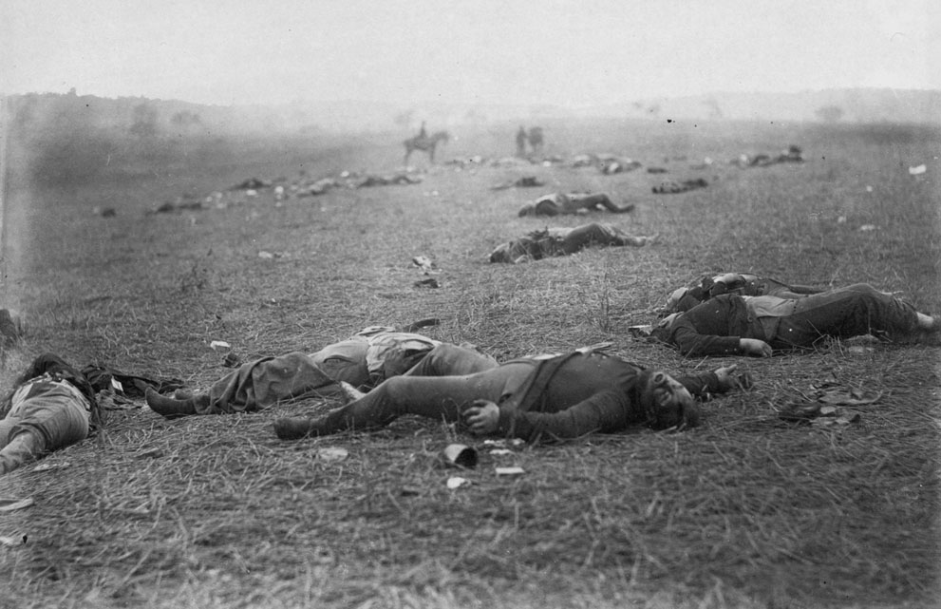

Slide 4
“The Vicarious War” and “The Real War”
“Mr. Brady has done something to bring home to us the terrible reality and earnestness of war. If he has not brought bodies and laid them in our dooryards and along the streets, he has done something very like it.”
NY Times, October 20, 1862

Slide 5
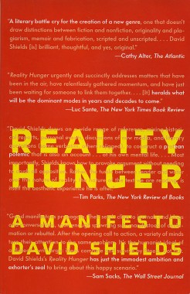
‘Every artistic movement from the beginning of time is an attempt to figure out a way to smuggle more of what the artist thinks is reality into the work of art. Zola: “Every proper artist is more or less a realist according to his own eyes.” Braque’s goal: “To get as close as I could to reality.”’
David Shields, Reality Hunger, 2010

Slide 6
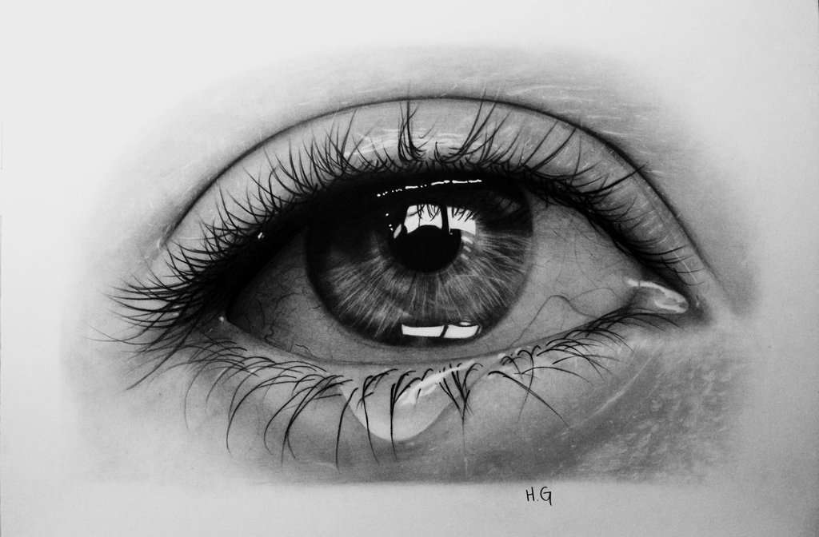
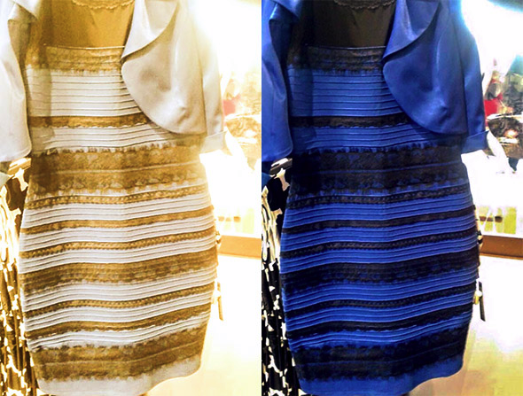
What are the limits of immediacy? (or “realism”)
The Oxford English Dictionary defines “mediation,” in part, as:
“Agency or action as an intermediary; the state or fact of serving as an intermediate agent, a means of action, or a medium of transmission; instrumentality.”
“The interposition of stages or processes between stimulus and result, or intention and realization.”

Slide 7
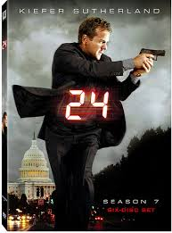
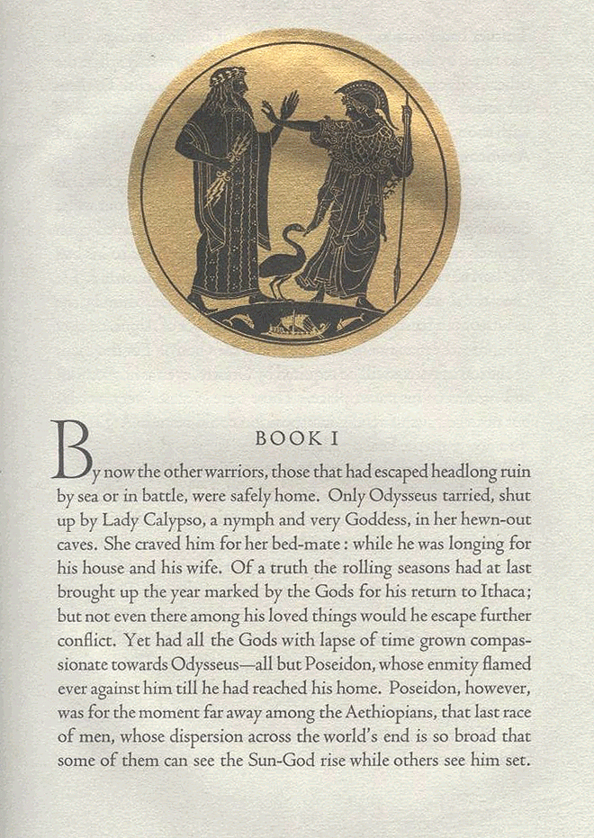
Do different mediums afford different kinds of immediacy? Do different genres and literary forms?
vs.
vs.
Is an epic poem a medium?
"24" is — was — nothing more or less than an epic poem, with Jack Bauer in the role of Odysseus or Beowulf.
The Los Angeles Times

Slide 8
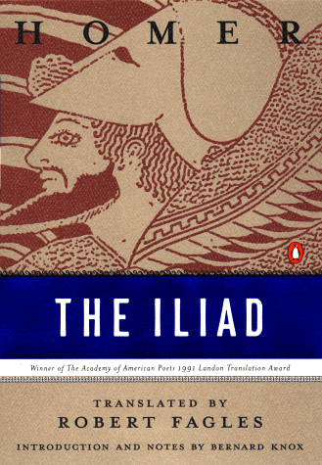
In what ways can lines of print (a medium) feel immediate? In what ways can epic poetry (a literary form) feel immediate?
“It is vividness as a feature of divine epiphany that is involved in poetry’s power to make the invisible past appear to its hearers. The first words of each poem effect this appearance by calling on the muses: because we are granted their perspective, when the great speeches are given we seem to be on the edge of the assembly and when the heroic actions are performed, we seem to be present as onlookers.”
Andrew Ford, Homer: the Poetry of the Past, 55.
“Rage--Goddess, sing…”

Slide 9
What about the novel? Critics distinguish between “immediate speech” and “free indirect speech”
In immediate speech, “The reader [is] installed in the thought of the main character from the first lines on, and it is the uninterrupted unfolding of that thought which, substituting completely for the customary form of narrative, apprises us of what the character does and what happens to him.”
James Joyce
“In free indirect speech, the narrator takes on the speech of the character, or, if one prefers, the character speaks through the voice of the narrator, and the two instances are then merged; in immediate speech, the narrator is obliterated, and the character substitutes for him” (174).
Gerard Genette, Narrative Discourse: An Essay in Method, 174.

Slide 10
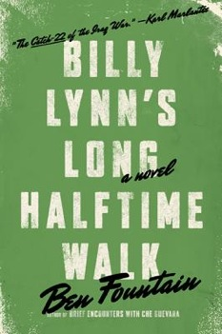
Immediate or Free Indirect Speech?
Where does the narrative place us with respect to the bodies and experiences of its characters?
(And in what way is the novel aware of that placement?)

Slide 11
Are the novel’s word cascades immediate?
terrRist
freedom
evil
nina leven
nina leven
troops
currj
support
Ben Fountain, Billy Lynn’s Long Halftime Walk (New York: HarperCollins, 2012), 2.

Slide 12
And Free Indirect?
“There’s something harsh in his fellow Americans, avid, ecstatic, a burning that comes of the deepest need. That’s his sense of it, they all need something from him, this pack of half-rich lawyers, dentists, soccer moms, and corporate VPs, they’re all gnashing for a piece of a barely grown grunt making $14,800 a year. For these adult, affluent people he is mere petty cash in their personal accounting, yet they lose it when then enter his personal space. They tremble. They breathe in fitful, stinky huffs. Their eyes skitz and quiver with the force of the moment, because here, finally, up close and personal, is the war made flesh…” (38-39).
How does the narrative mode contribute to the theme? What do we need from him? Don’t we want to know what it’s really like to fight in Iraq?

Slide 13
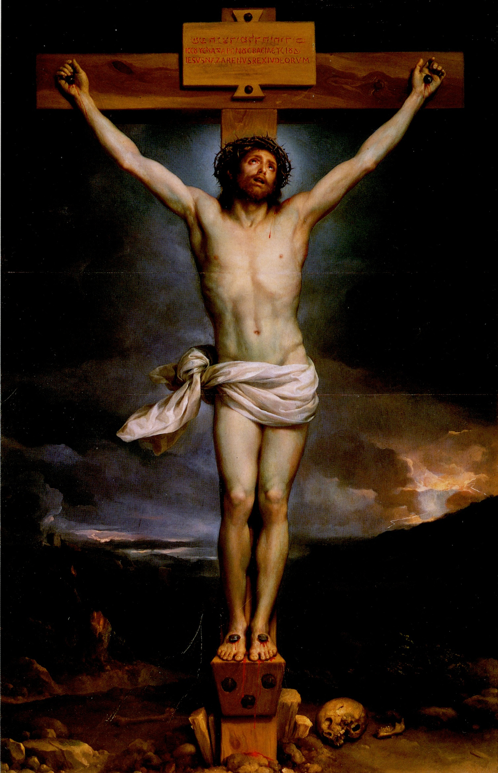
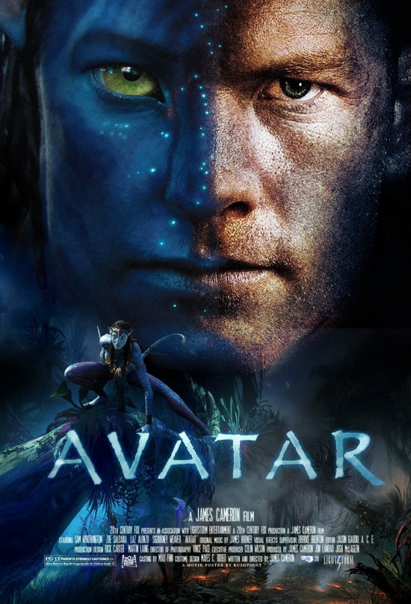
Surrogate Bodies and Vicarious Experience
“Americans fight the war daily in their strenuous inner lives. Billy knows because here at the contact point he feels the passion every day. Often it’s in their literal touch, a jolt arching across as they shake hands, a zap of pent-up warrior heat. For so many of them, this is the Moment: His ordeal becomes theirs, and vice versa, some sort of mystical transference takes place and it’s too much for most of them, judging from the way they choke up in the clutch” (39).
Is Fountain also describing the mystical transference between author and reader?

Slide 14
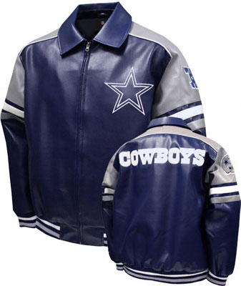
“Either we fight them over there or we fight them over here, that’s the way most Americans see it” (88).
Billy is a bridge between over there and over here for the Texans at the Super Bowl. He is also our avatar.
“Part of being a soldier is accepting that your body does not belong to you” (206)
‘“Dawg,” Mango says once they’re outside. “Six hundred seventy-nine dollars,” he says. “Billy,” he says, then, “Shit.” And that’s all they say about it.’ (31)

Slide 15
To whom or to what does Billy’s body belong?
He belongs to the US Army, in part. But to whom or to what does that army answer?
Recall a problem from The Manchurian Candidate: how to represent systemic agency?
“One of the Swedes opened his calfskin attaché case and showed Billy the gold stash he’d acquired in Baghdad, several pounds’ worth of chains and ropes and coins, of such purity that they glowed more orange than gold. . . . He was nineteen years old and had no idea that his war contained such things . . .” (5).

Slide 16
“So what do you believe in? Billy doesn’t so much wonder as feel the question thrust upon him. Ha ha, well, okay. Jesus? Sorta. Buddha? Hm. The Flag? Sure. How about . . . reality. Billy decides the war has made of him a rock solid convert to the Church of What It Is. . . .” (219-220).
“That same heaviness, the same torpor and melancholy, a kind of sickly-sweet emo funk that’s almost pleasurable, in the sense that it hints at something real. As if sorrow is the true reality? Without ever exactly putting his mind to it, he’s come to believe that loss is the standard trajectory” (11).

Slide 17
“. . . the Bravos speak from the high ground of experience. They are authentic. They are the Real. They have dealt much death and received much death and smelled it and held it and slopped through it in their boots, had it splattered on their clothes and tasted it in their mouths. That is their advantage, and given the masculine standard America has set for itself it is interesting how few actually qualify” (66).
Does “real” mean the same thing in the line below?
“MONEY MAKES US REAL” (266)

Slide 18
“She was really into me. It wasn’t about the money” (26).
“For these adult, affluent people, he is mere petty cash in their personal accounting.”
“As for the rest of Bravo, they might as well be so many shares of corporate stock that happen to talk and walk and drink a lot of beer” (34).
“Four. Hundred. Thousand. It was like God appearing in all his nuclear glory, omnipotent, all-consuming, incomprehensible” (95).
What kind of medium is money? What does it represent? How might it make Billy real?

Slide 19
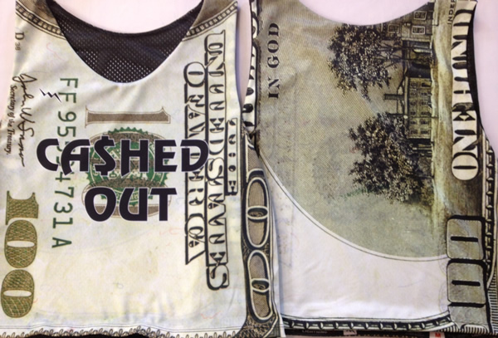
“Bravo’s talk these days is so much about money, moneymoneymoney like a bug on the brain or a hamster spinning its squeaky wheel, a conversation going nowhere at tremendous speed. . . . The way they obsess, it’s as if a big payday involved more than more buying power, as if x amount of dollars cooling in the bank could bring your ass safely through the war. He intuits the spiritual logic of it, but for him the equation works in reverse: The day the money comes through, the actual day his check clears, that will be the very day he gets smoked” (34).

Slide 20
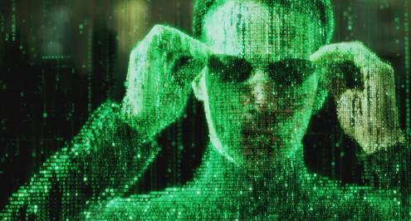
“Stadiums, for example. Airports. The interstate highway system. Wars. He wants to know how it is paid for, where do the billions come from? He imagines a shadowy, math-based parallel world that exists not just beside but amid the physical world, a transparent interlay of Matrix-style numbers through which flesh-and-blood humans move like fish through kelp. This is where the money lives, an integer-based realm of code and logic, geometric modules of cause and effect (121).

Slide 21
“The realm of markets, contracts, transactions, elegant vectors of fiber-optic agency whereby mind-boggling sums of mysterious wealth shoot around the world on beams of light. It seems the airiest thing there is yet the realest, but how you enter that world he has no idea except by passage through that other foreign country called college, and that ain’t happening. He will not return to the classroom, ever, the mere thought inflames a whole host of piss-offs and associated grudges that go all the way back to kindergarten, not to mention the sheer soul-sucking boredom of those years. If there is real knowledge to be had in the Texas public schools he never found it, and only lately has he started to feel the loss, the huge criminal act of his state-sanctioned ignorance as he struggles to understand the wider world. How it works, who gains, who loses, who decides. It is not a casual thing, this knowledge. In a way it might be everything” (121).

