Slide 1
Love,War, and Memory
Robert Duncan, Ned Fahs, and the Crisis of World War II

Slide 2
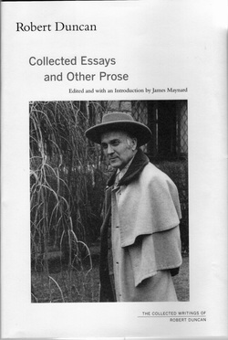

Slide 3
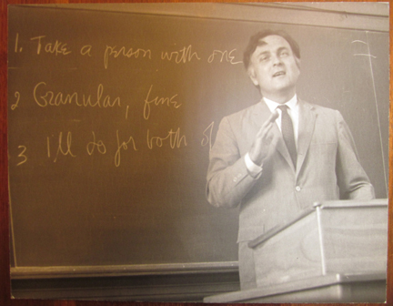

Slide 5
Poet Lisa Jarnot, author of The Ambassador from Venus

Slide 6
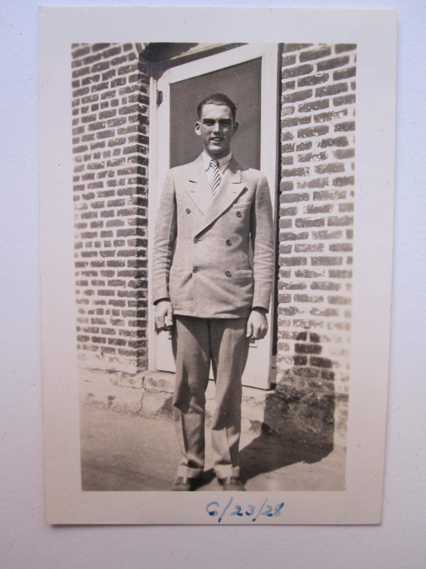
Ned Fahs at 17

Slide 7
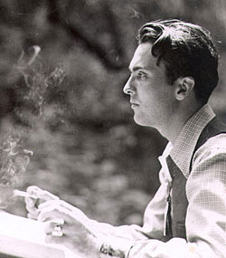

Slide 8
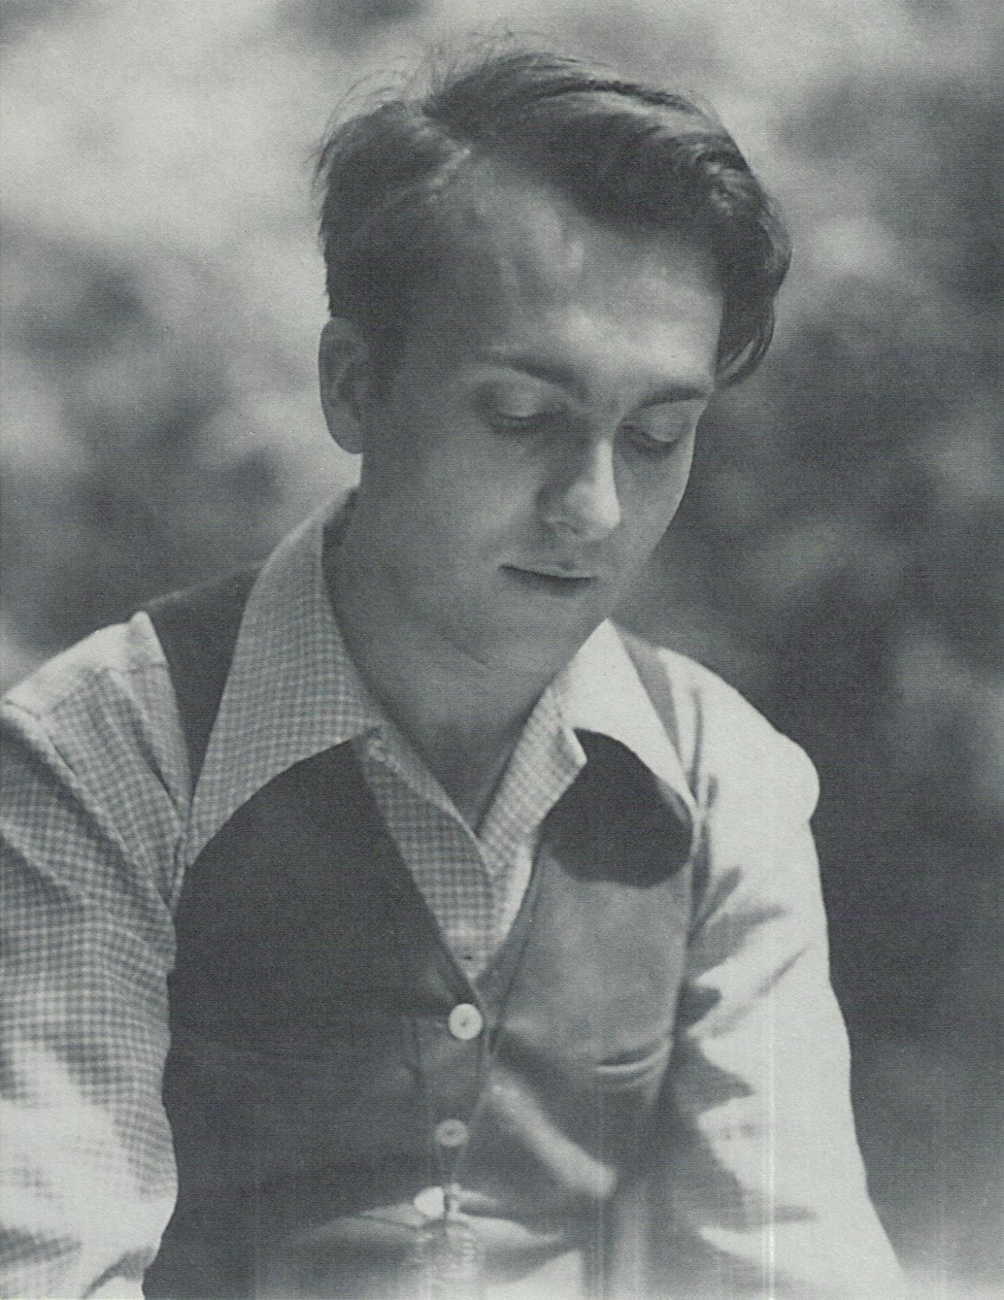

Slide 10
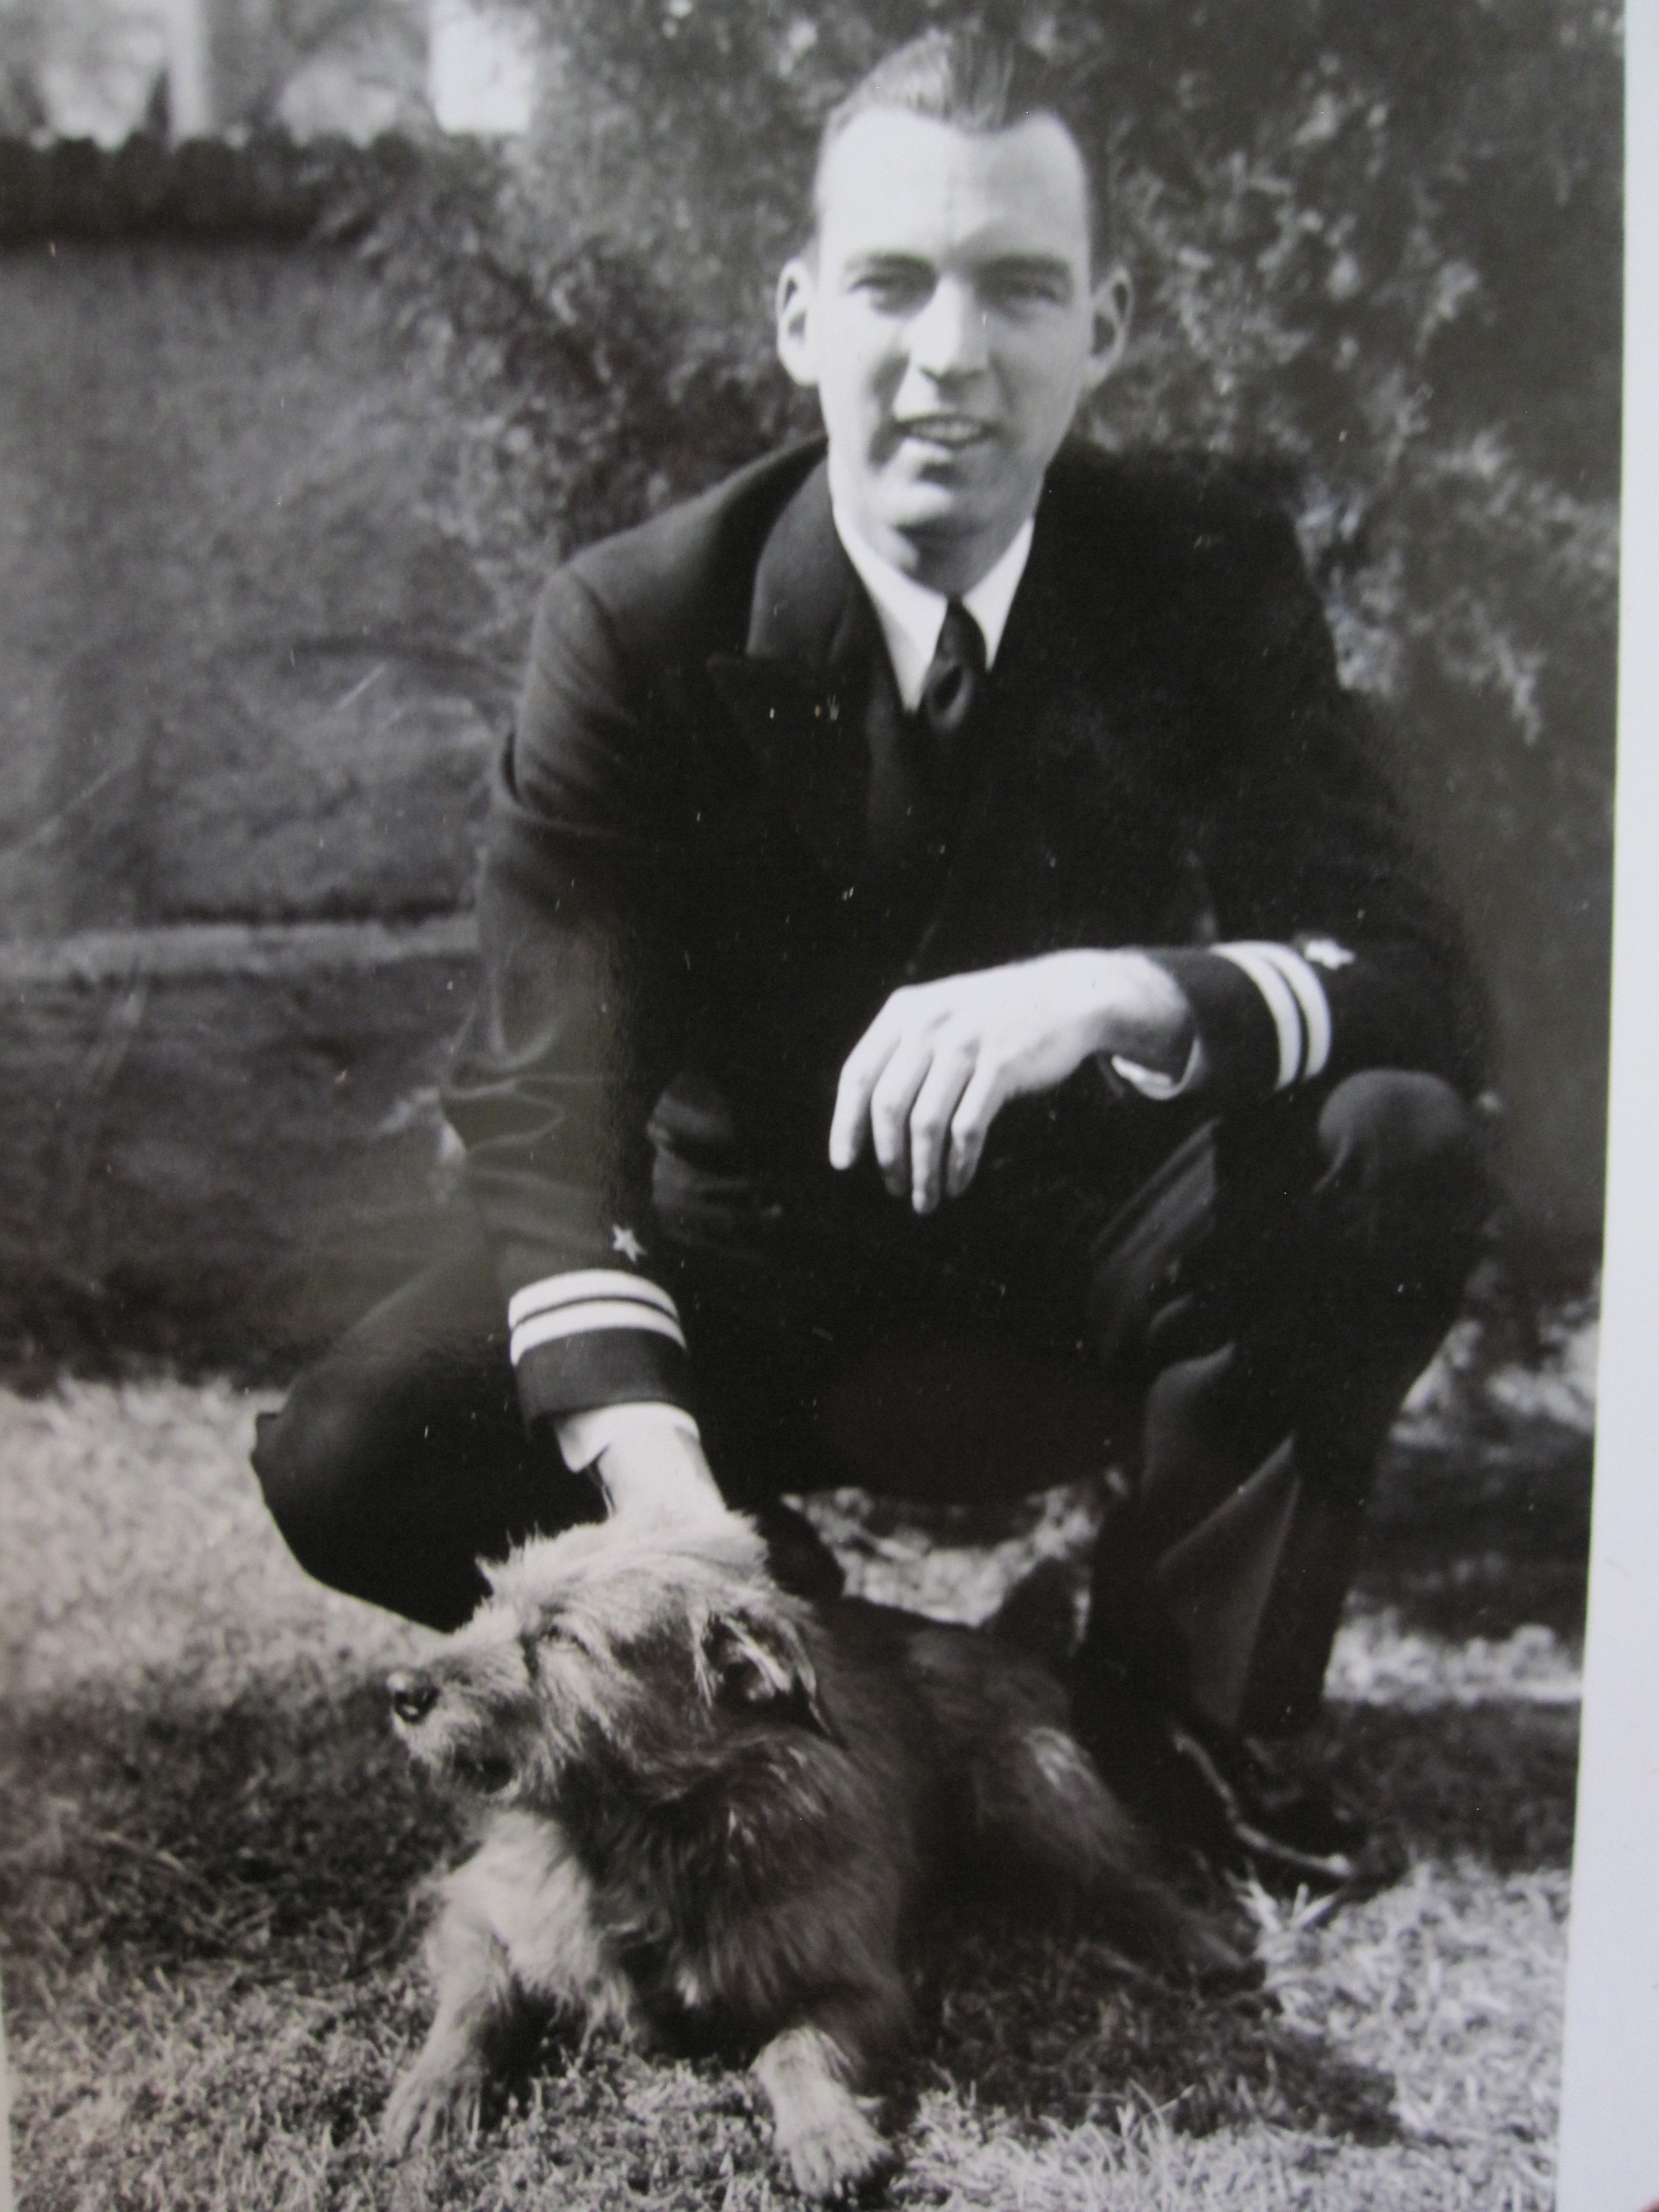

Slide 11
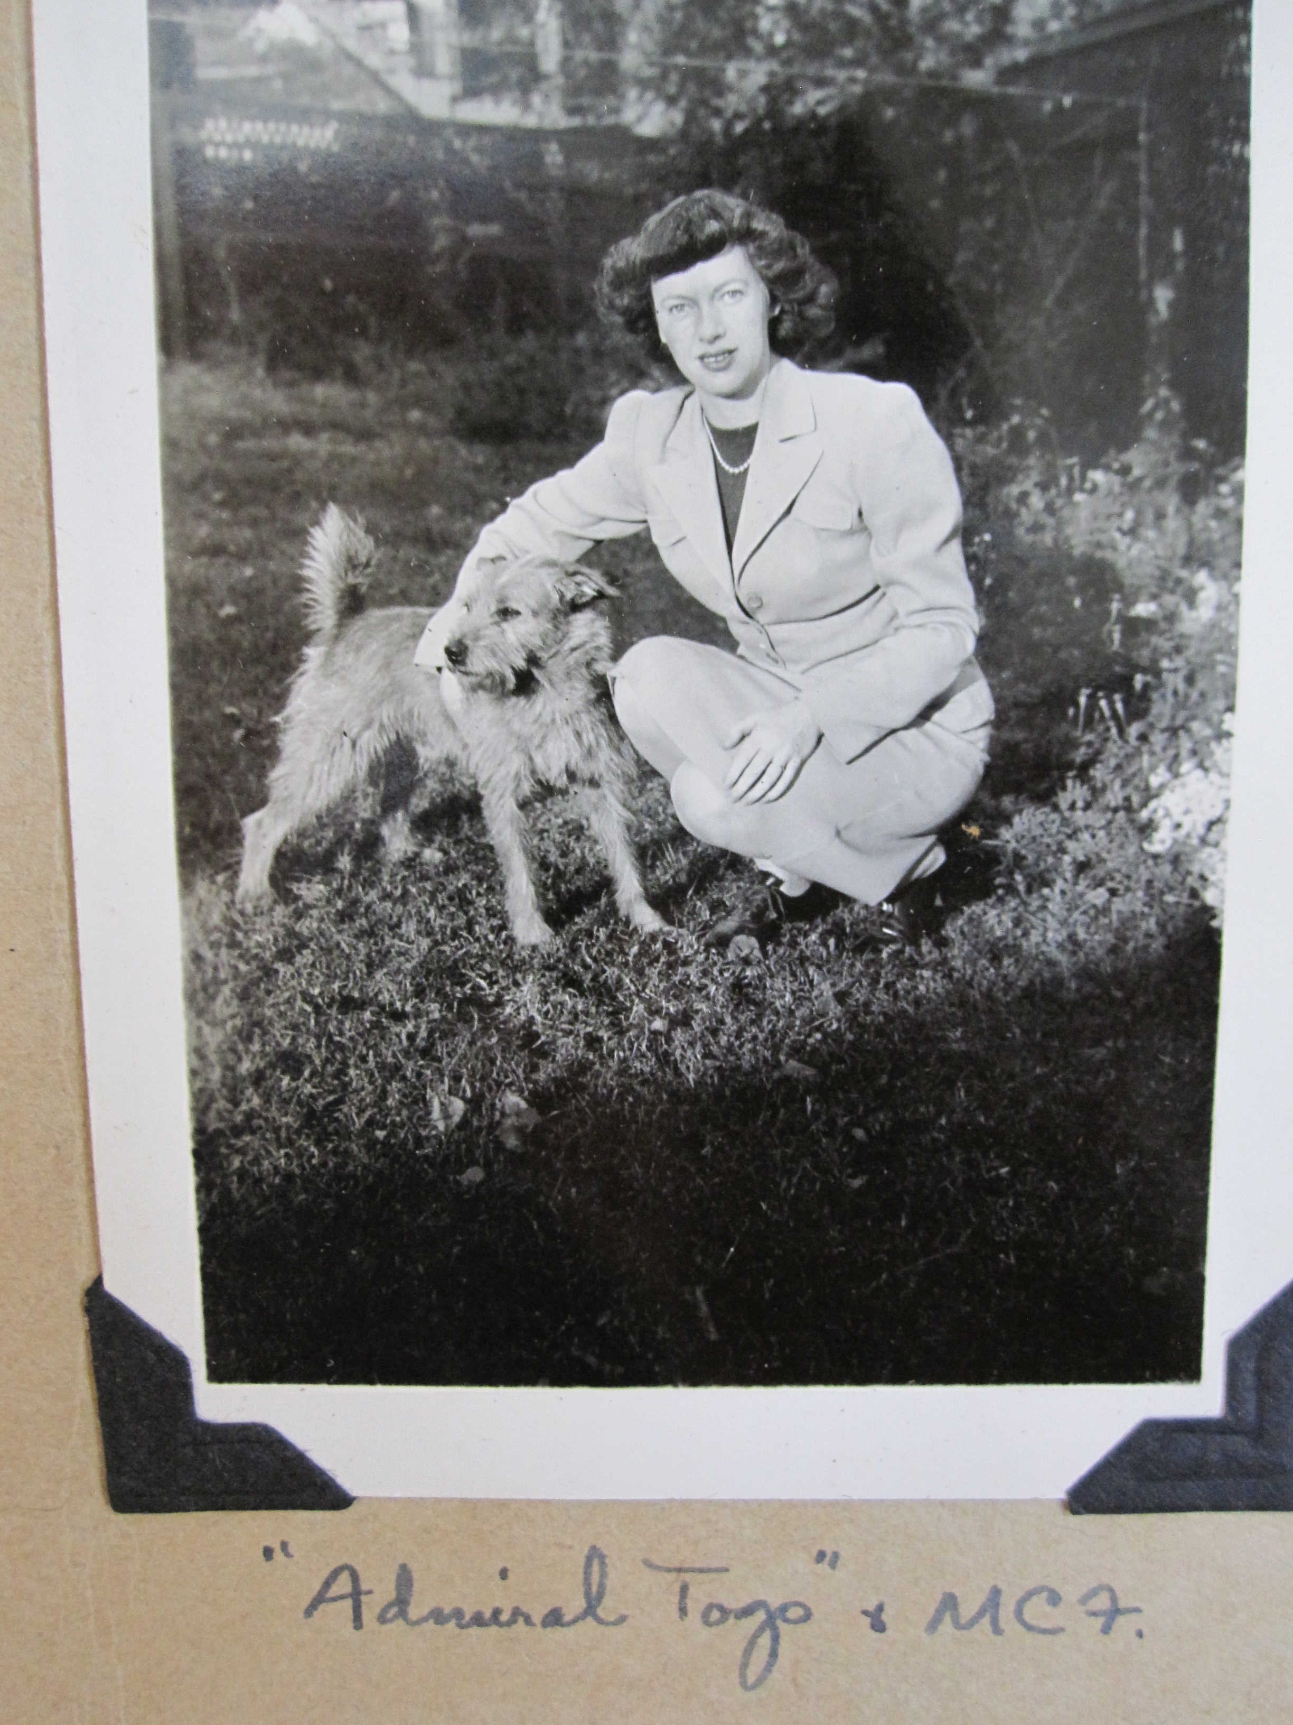

Slide 12
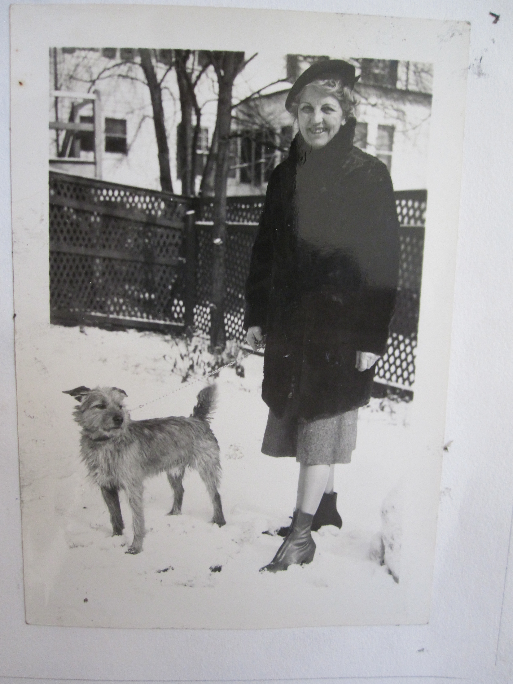

Slide 13
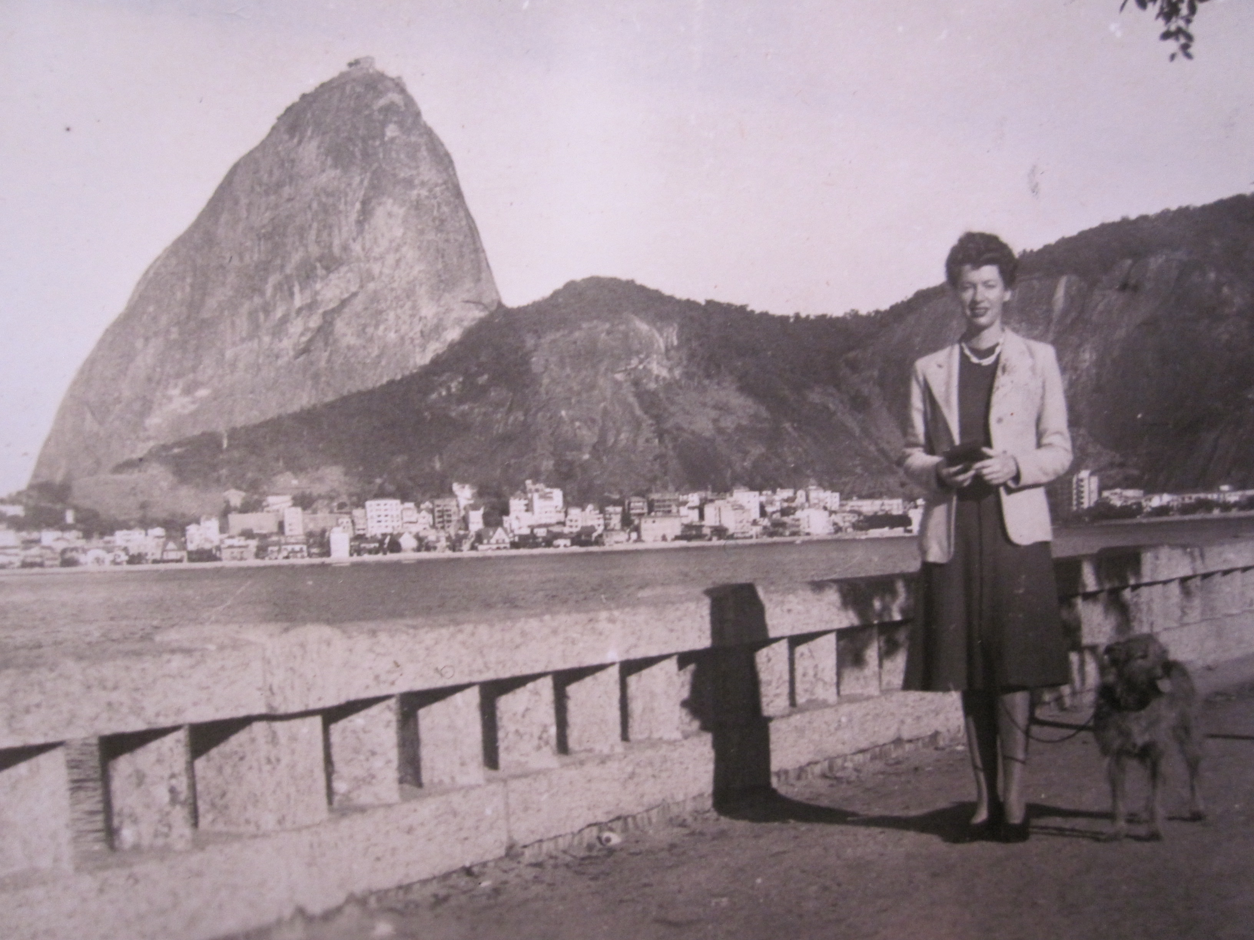
Margaret Cullen Fahs with Admiral Togo in Rio de Janeiro

Slide 14
Robert Duncan
with Admiral Togo in Annapolis, 1940

Slide 15
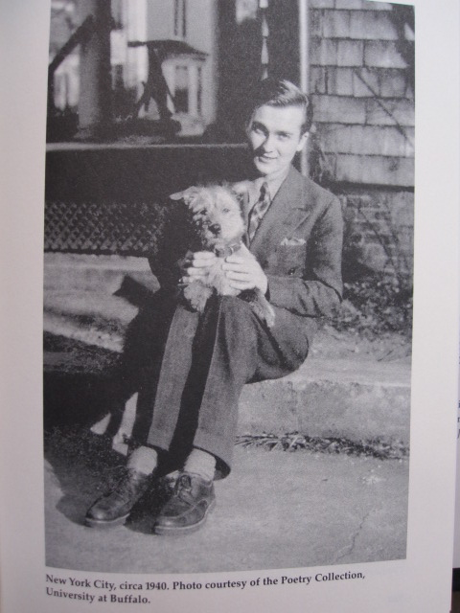

Slide 16
Robert Duncan,
September 1939

Slide 17
Robert Duncan,
September 1939

Slide 18
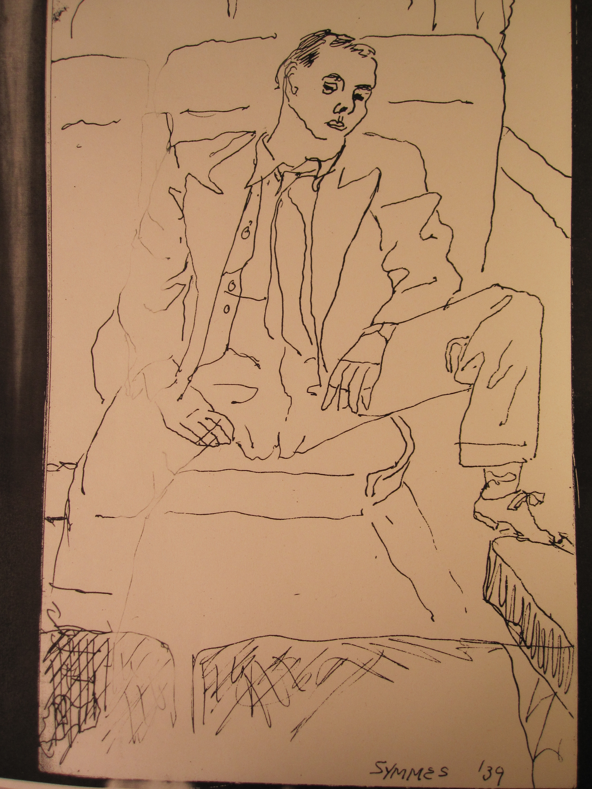

Slide 19
Robert Duncan,
drawing of Ned Fahs,
September 1939

Slide 20
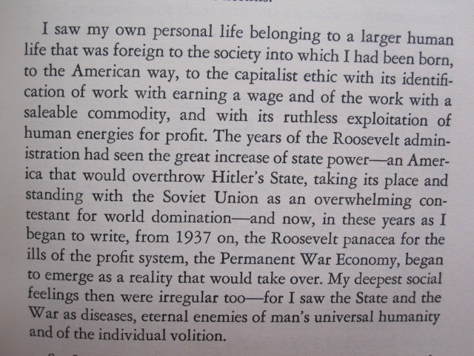
From the Preface to The Years As Catches, 1966

Slide 21
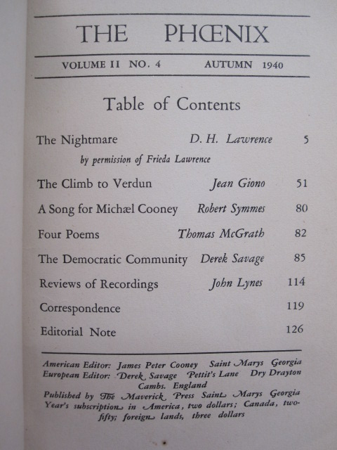

Slide 22
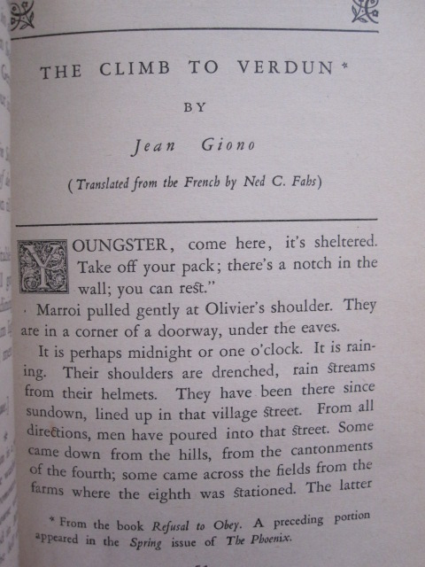

Slide 23
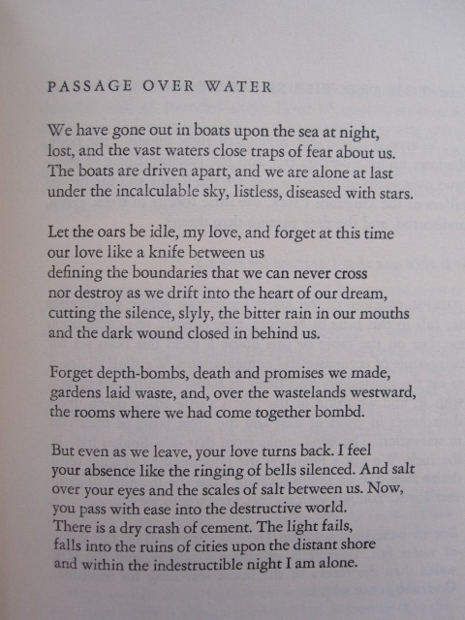

Slide 24
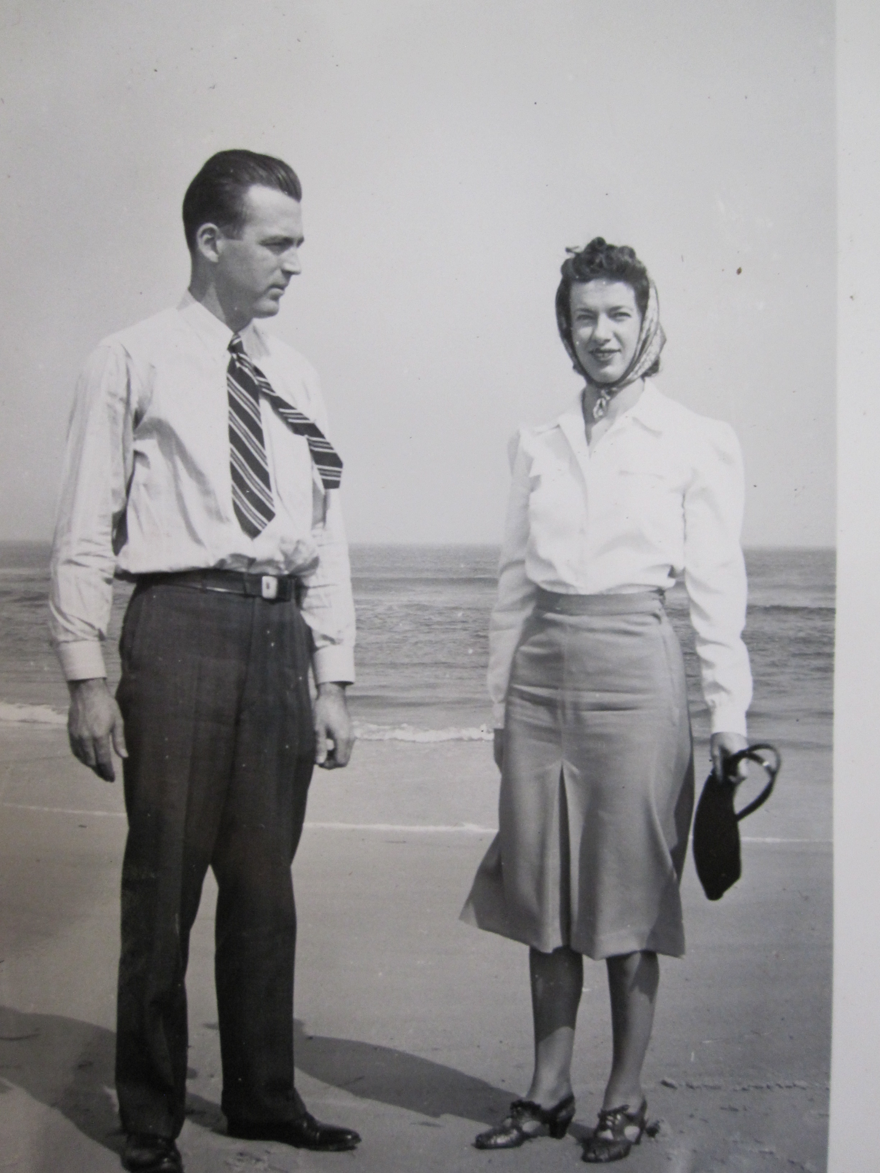

Slide 25
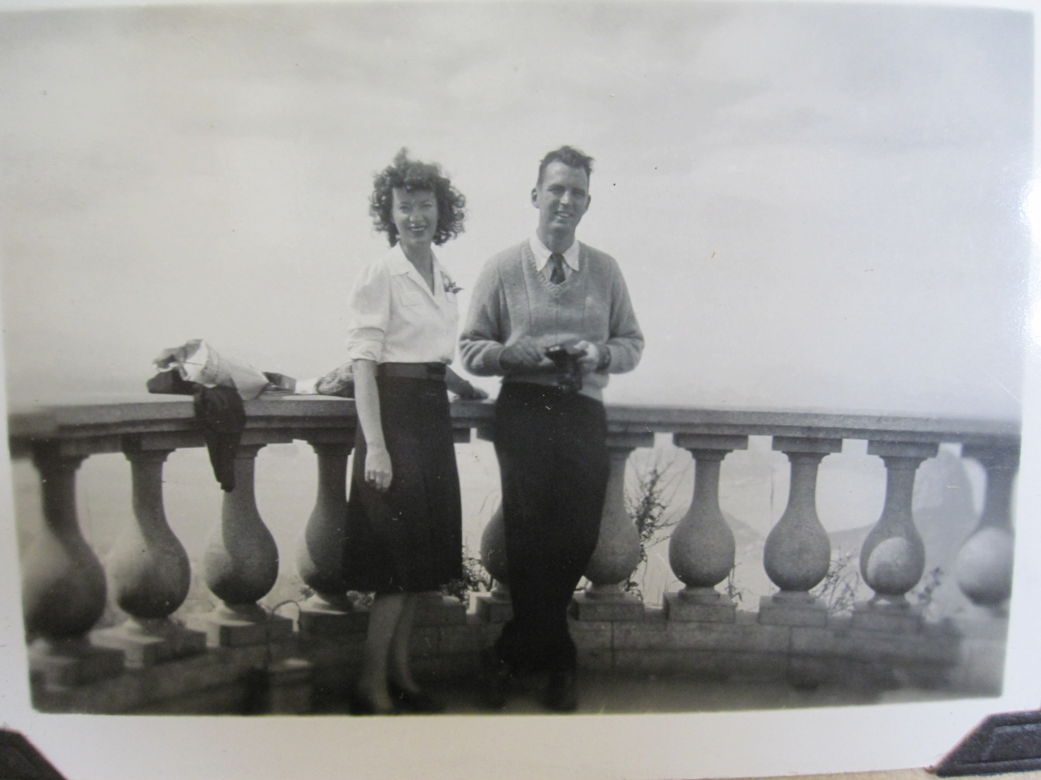

Slide 26
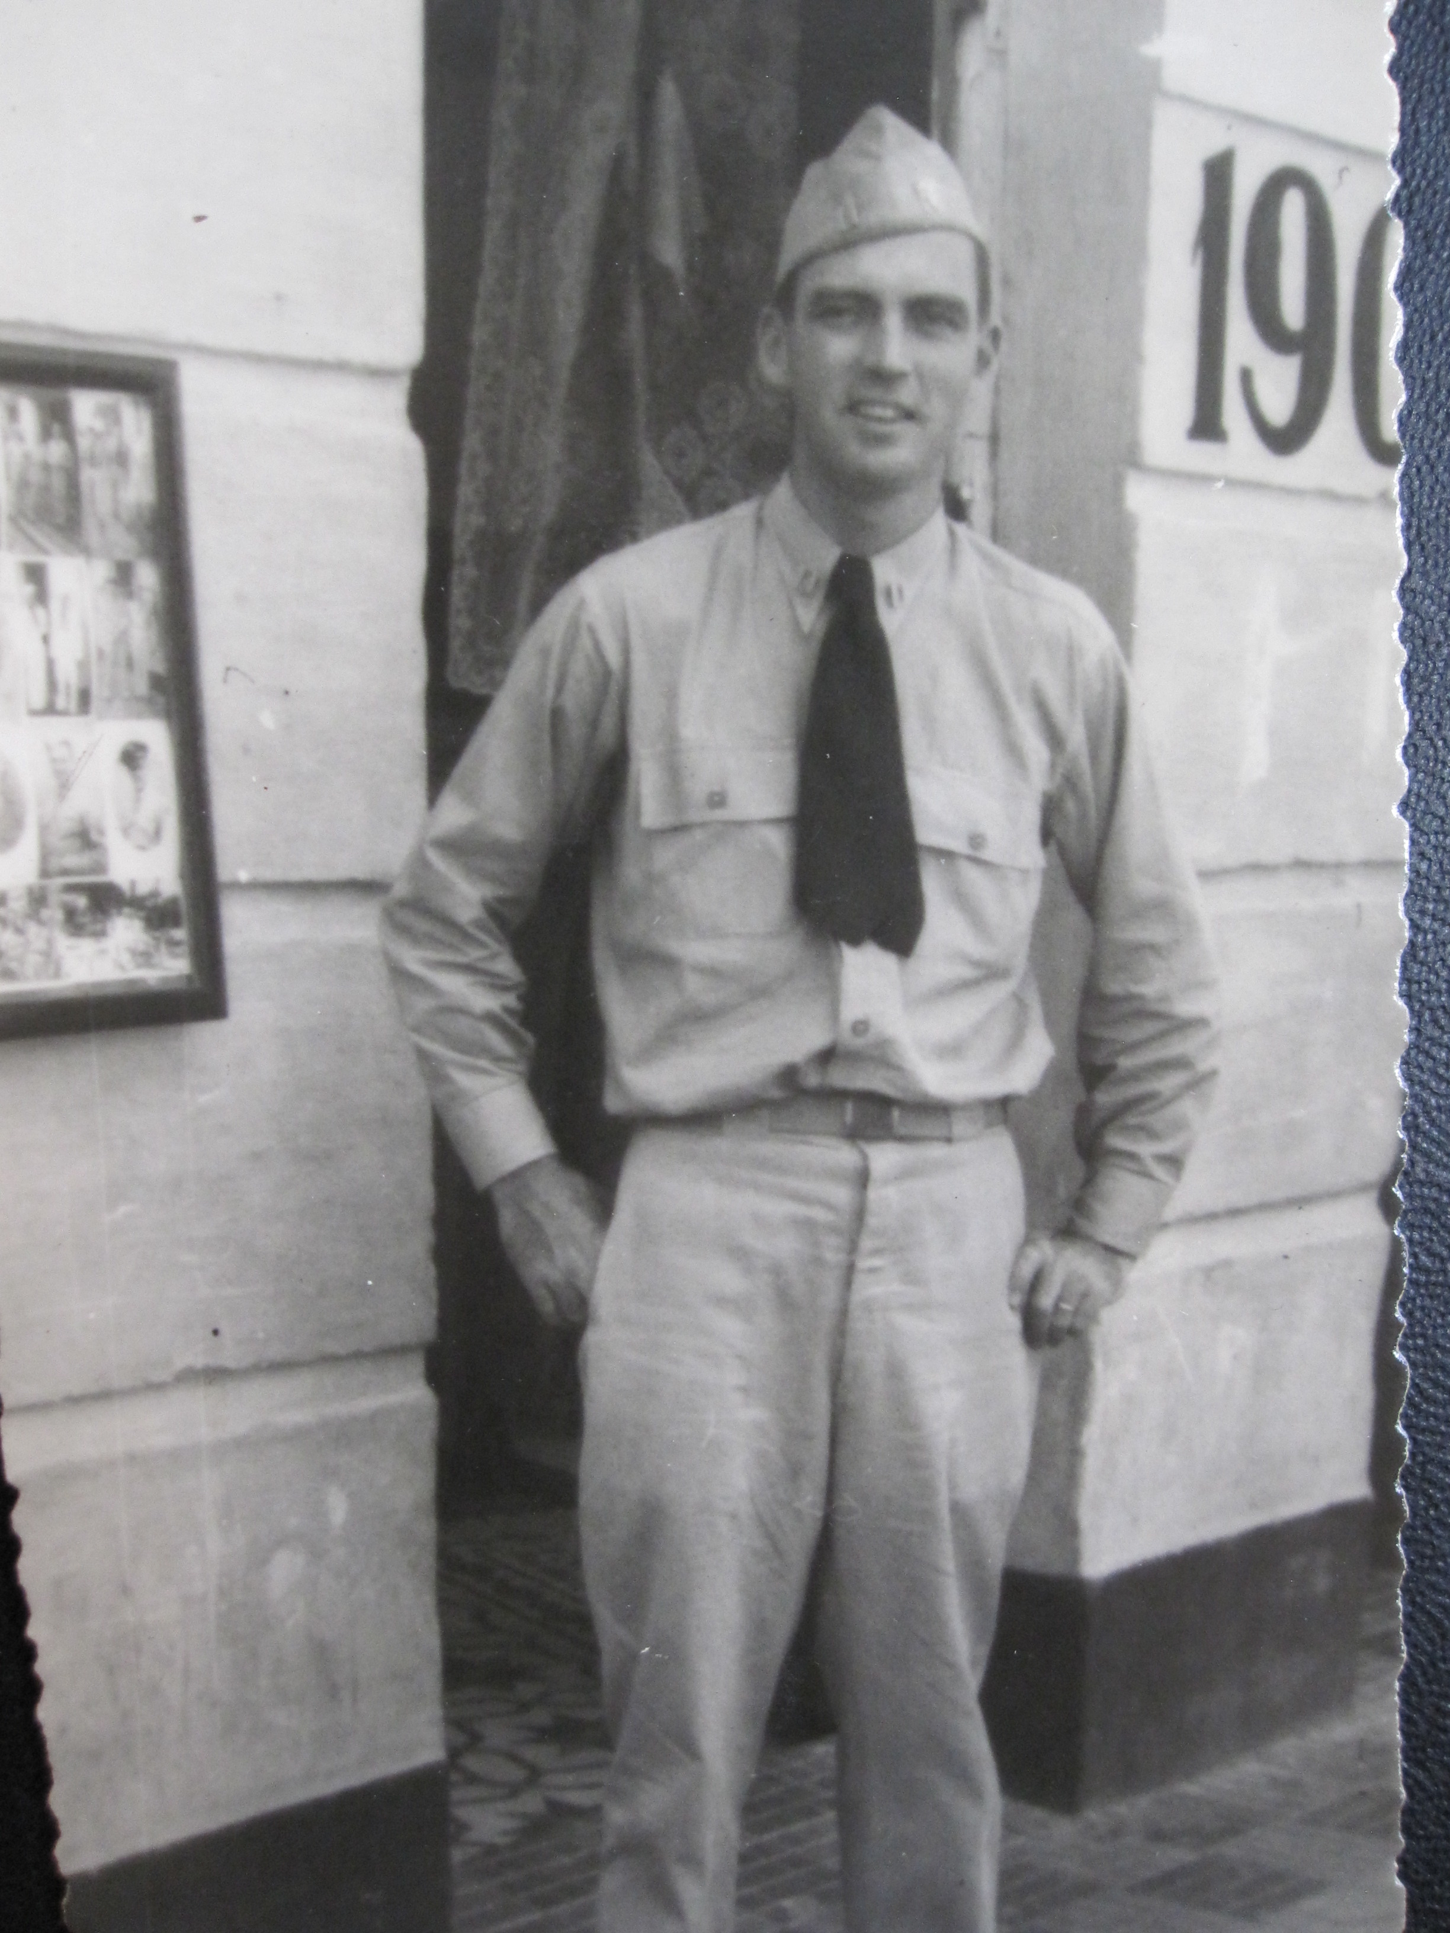

Slide 27
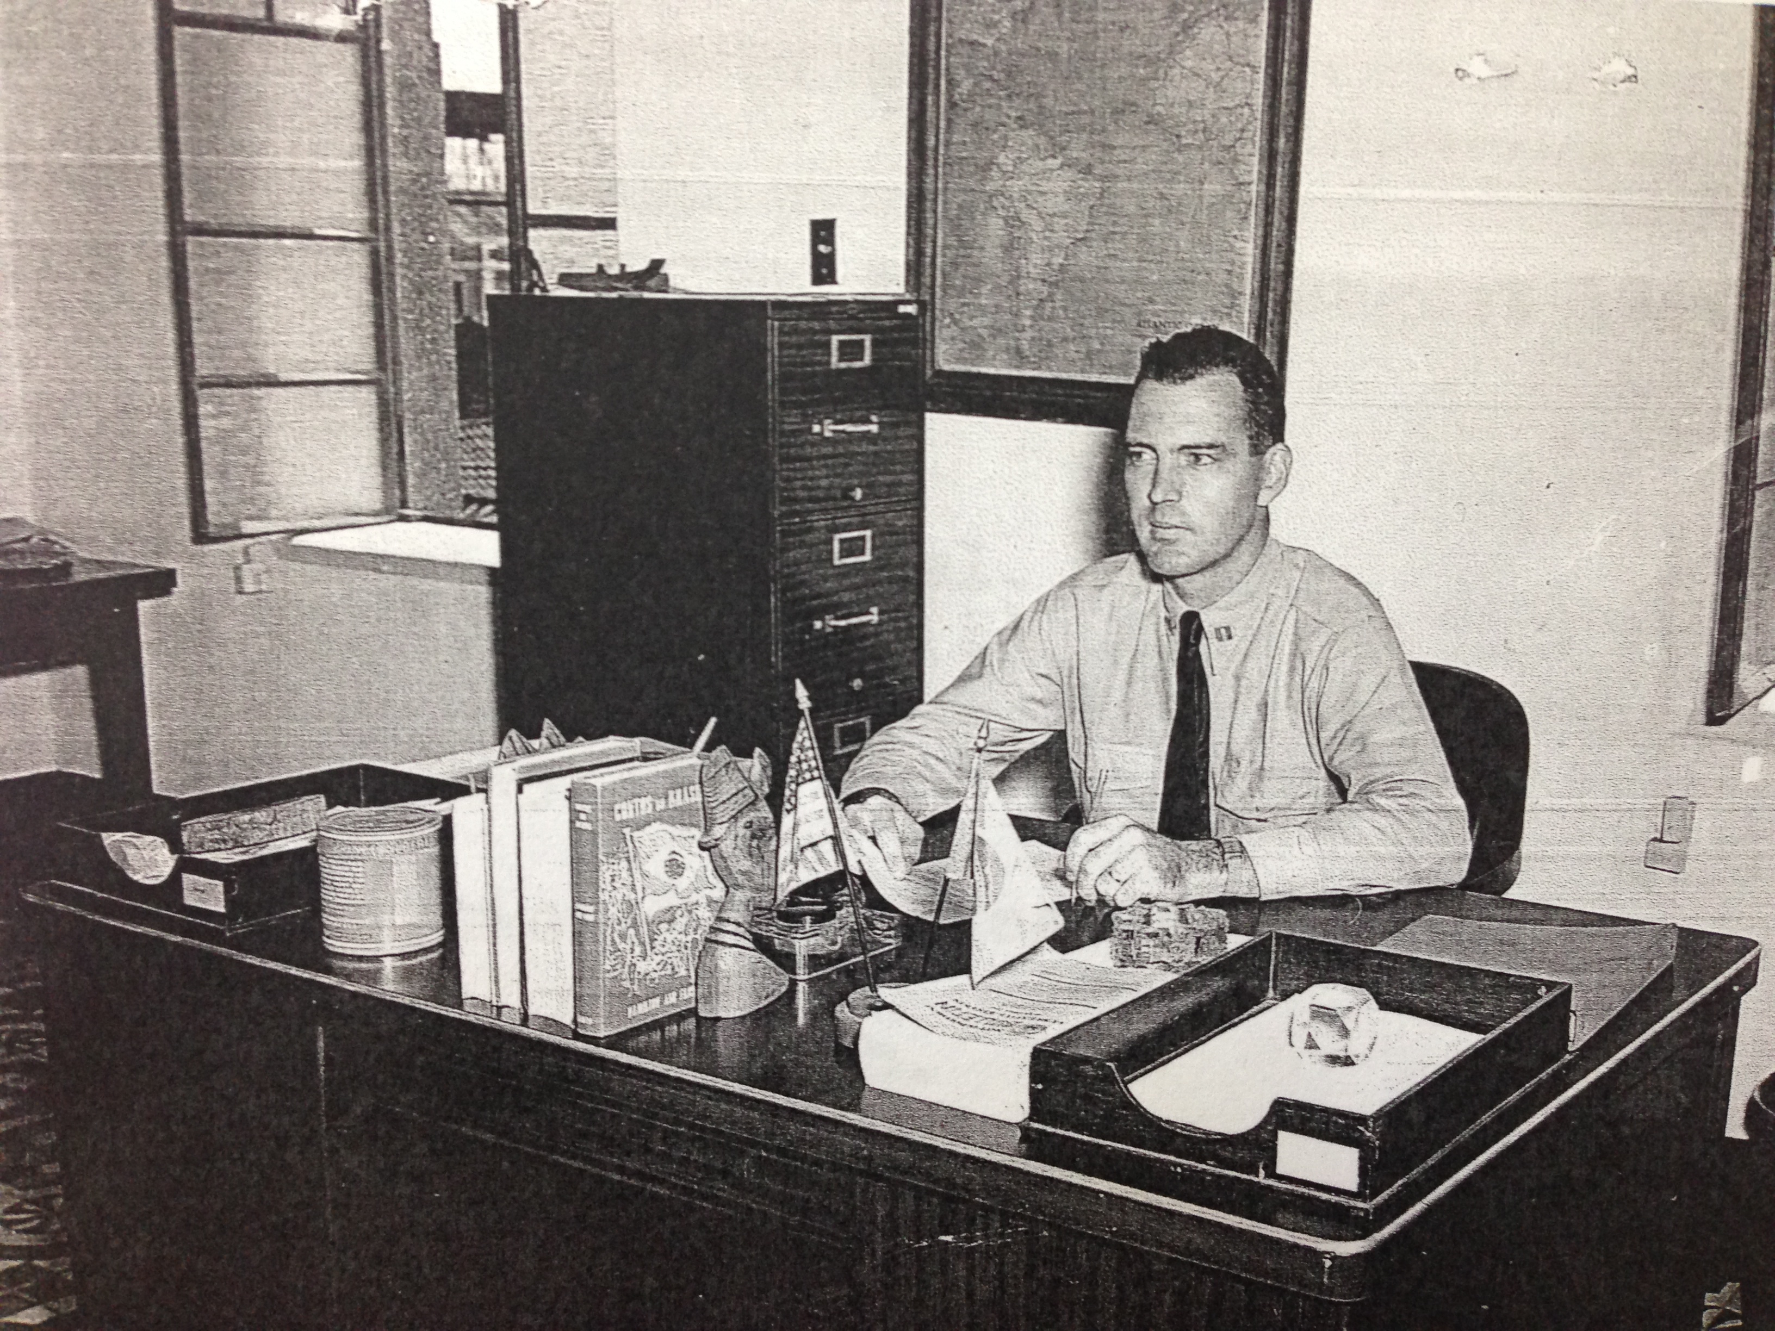

Slide 28
Robert Duncan's answers to a Draft Questionnaire
1) on what grounds do you object to military service?
The illusion of possession is a manifestation of the ego. possession of a body, a name, an honor, a person, an object, a country, a law. In so far as we defend or seek to secure these, then we yield to this illusion, we dwell in the ego separation and we are at error.
2) Explain how, when, and from whom or from what source you received the training and acquired the belief which is the basis of your claim made in 1) above.
It is only in our direct contact with reality, with a human being, a tree, a river, a mountain, with movement thru space and time, only within ourselves, in our own revelation that we may discover the essential, the meaning and the way of our own life. (expanded in note one)

Slide 29
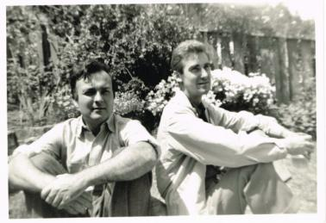
Robert Duncan and Jess, 1959

Slide 30
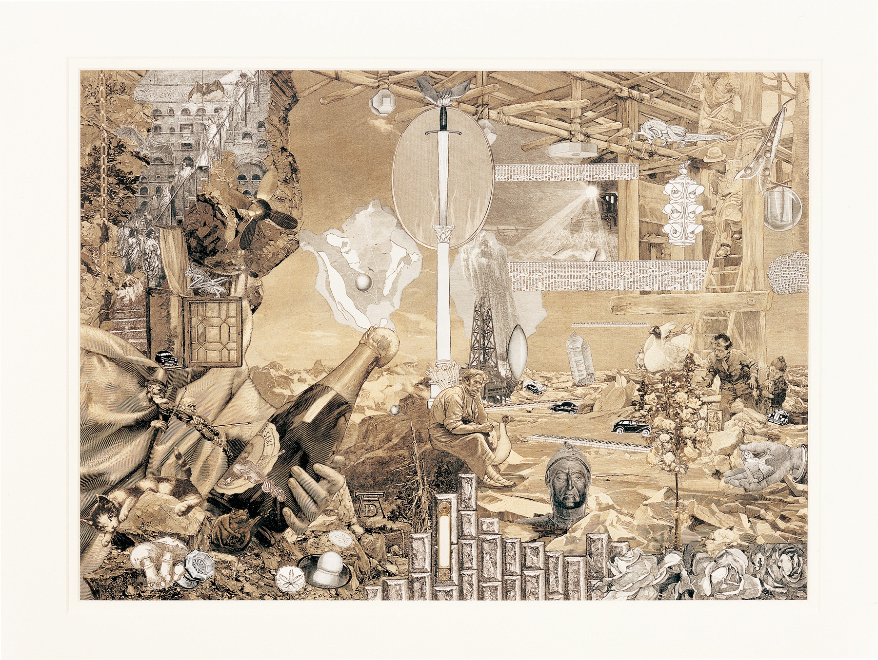

Slide 31
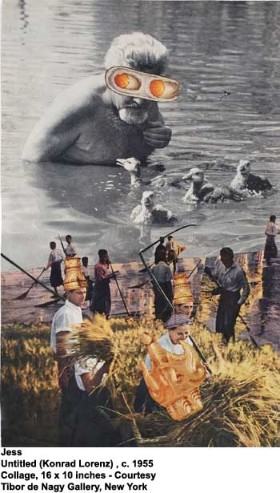

Slide 32
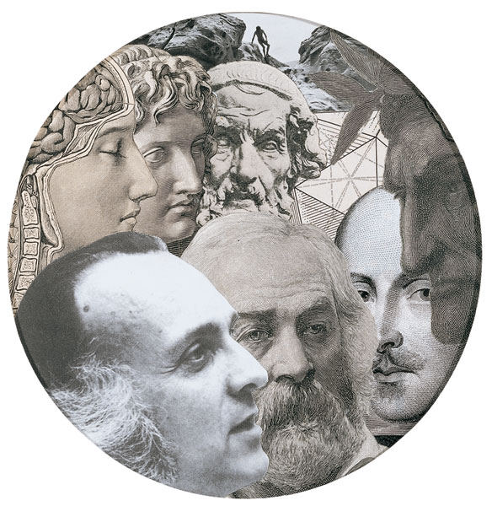
Jess, Emblems
For Robert Duncan,
1989

Slide 33
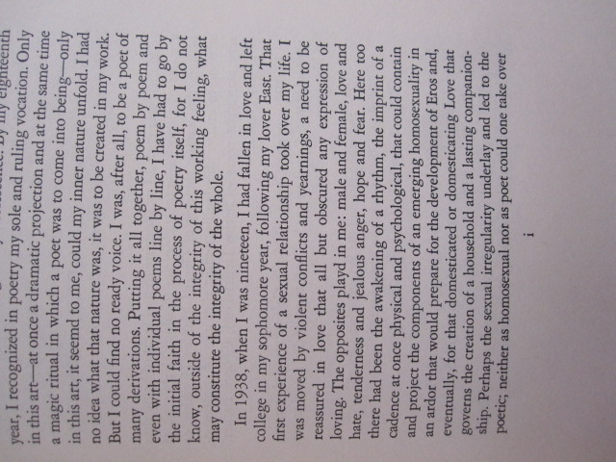
Robert Duncan,
Preface,
The Years As
Catches, 1966

Slide 34
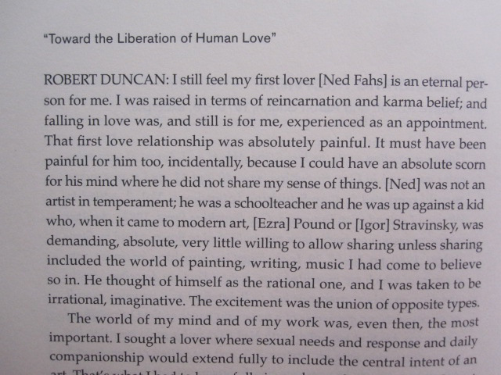
Gay Sunshine Interview, 1978-1979

Slide 35
The unknown man, Box 13, Robert Duncan Papers, University of Buffalo Poetry Collection

Slide 36
Unknown man #2,
Box 13, University of Buffalo Poetry Collection

Slide 37
THE STRUCTURE OF RIME XI
There are memories everywhere then. Rememberd, we go
out, as in the first poem, upon the sea at night--to the drifting.
Of my first lover there is a boat drifting. The oars have been cast
down into the shell. As if this were no water but a wall, there is
a repeated knock as of hollow against hollow, wood against
wood. Stooping to knock on wood against the traps of the night-
fishers, I hear before my knocking the sound of a knock drifting.
It goes without will thru the perilous sound a white sad wan-
derer where I no longer am. It taps at the posts of the deserted
wharf.
Now from the last years of my life I hear forerunners of a
branch creaking.
All night a boat swings as if to sink. Weight returning to weight
in the cold water. A hotel room returns from Wilmington into
morning. A boat sets out without boatmen into twenty years of
snow returning.

