Slide 1
The Cold War
1947–1989

Slide 2
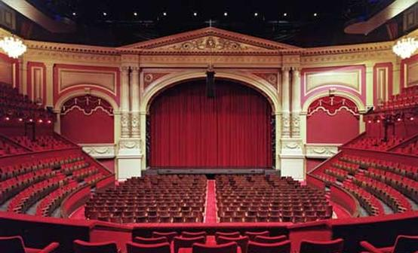
The Greek root of theater means “a place for viewing.”
The Oxford English Dictionary defines theater, in part, as “A place constructed in the open air, for viewing dramatic plays or other spectacles.”

Slide 3
“The Theater of War”
“Denotes properly such a portion of the space over which war prevails as has its boundaries protected, and thus possesses a kind of independence. This protection may consist in fortresses, or important natural obstacles presented by the country, or even in its being separated by a considerable distance from the rest of the space embraced in the war.”
Carl von Clausewitz, On War, 1832

Slide 4
Recall Professor Newman’s Lectures: “History from Above”
Battle of White Mountain, 1620
“As to us here our thoughts of everything at home are suspended, by our astonishment at the wonderful Spectacle which is exhibited in a Neighboring and rival Country—what Spectators, and what Actors!”
Edmund Burke, 1789
What kind of spectators are Burke’s English? What vantage or point of view do they have on the spectacle in France?

Slide 5
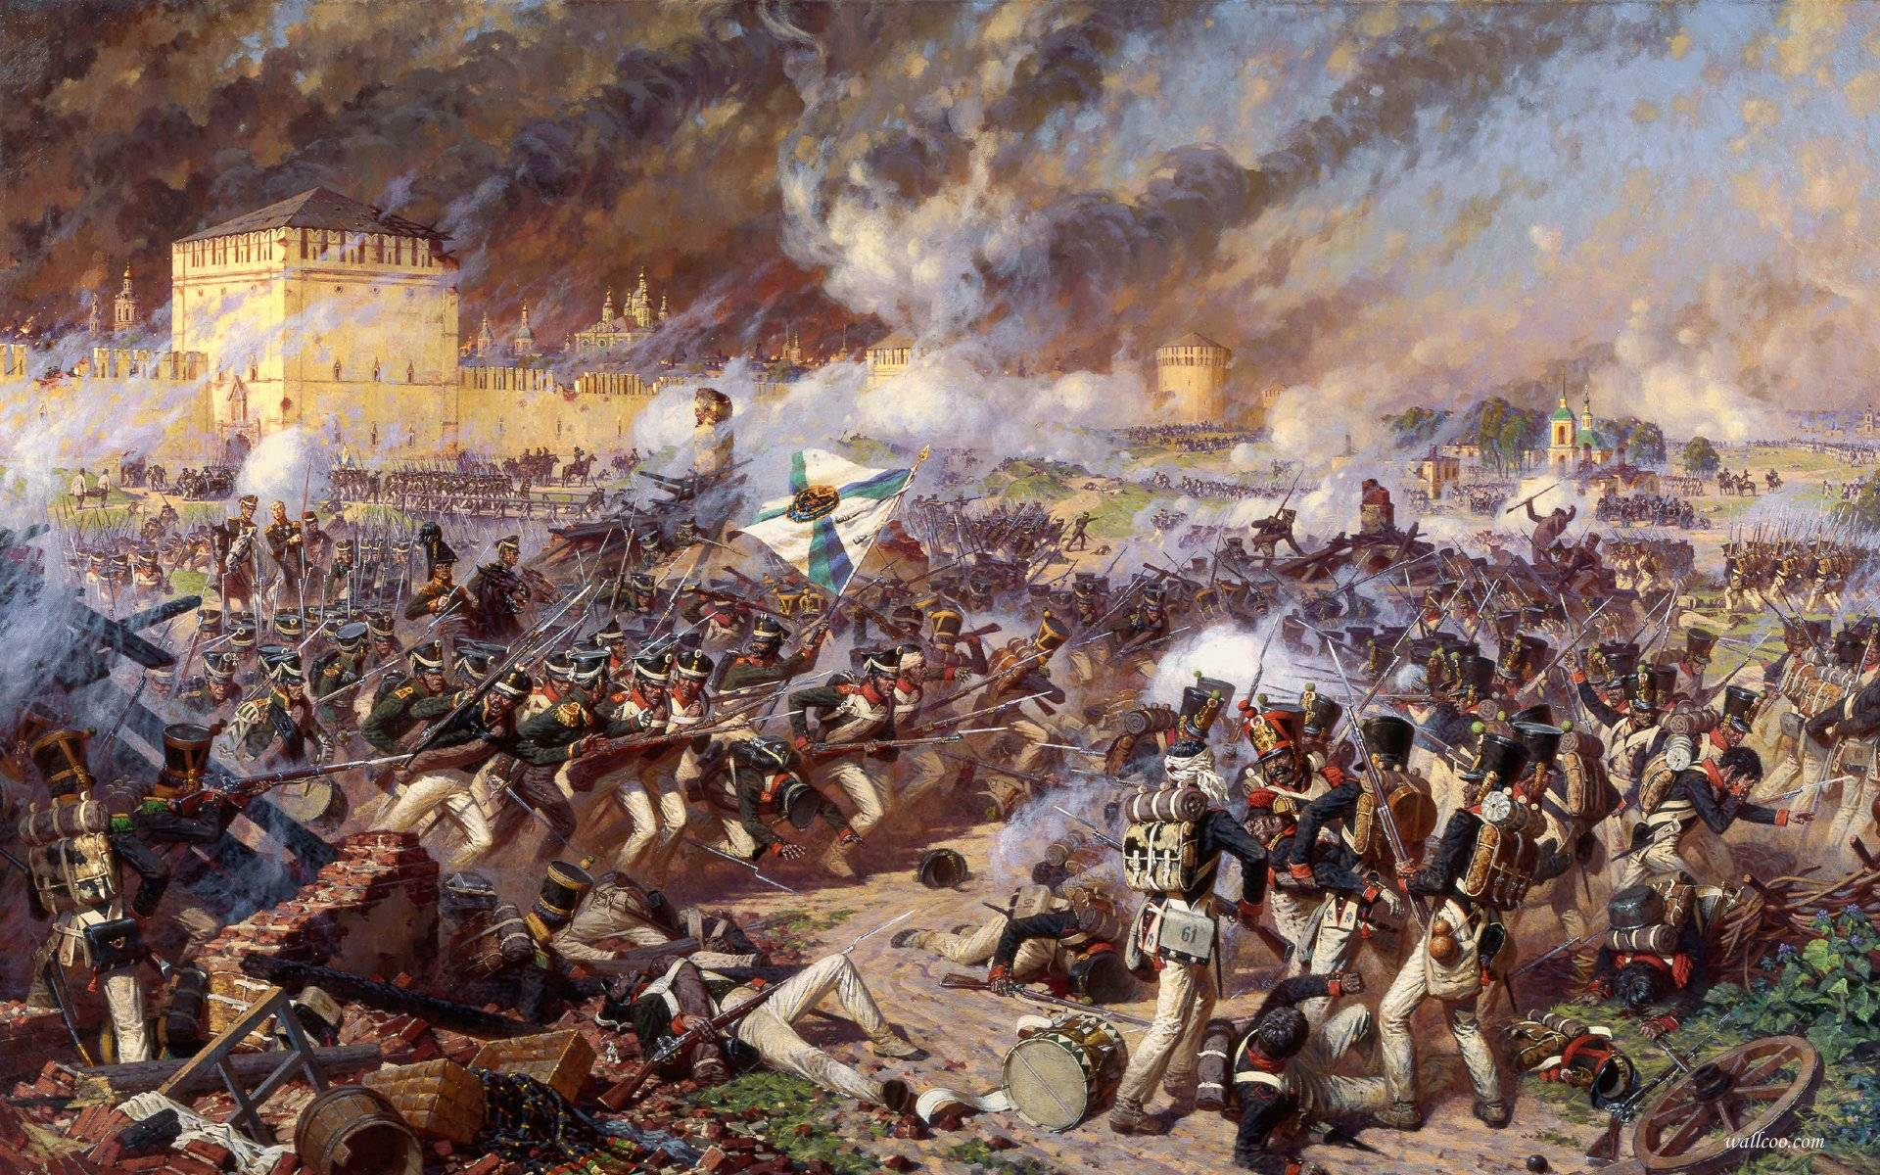
“In the Napoleonic era, at the very moment when clashes of troops were assuming unparalleled levels of destructiveness, laying waste to thousands of men by the hour, battles came to be understood as phenomena best grasped by the imagination.”
“Henceforth, waging a military campaign required managing the spectacle of battle consumed on the home front as much as defeating one’s foe on the field of combat, as clashes of armies came to be assessed not just with reference to the number of dead and wounded but also as objects of observation and analysis: What kinds of reports about them were available?”
Jan Mieszkowski, Watching War

Slide 6
“The Total War”
“Union generals William Tecumseh Sherman and Philip Sheridan saw more clearly than anyone else the nature of modern, total war, a war between peoples rather than simply between armies.”
James McPherson, Abraham Lincoln and the Second American Revolution
“The prevailing forms of social organization have given war a character of national totality—that is, the entire population and all the resources of a nation are sucked into the maw of war. . . it is within the power of human foresight to see now that all future wars will be total in character and scope.”
Giulio Douhet, 1921 (cited in Mark Neely, On the Road to Total War)
How to picture, imagine, or represent a total war? From whose point of view can this be done?

Slide 7
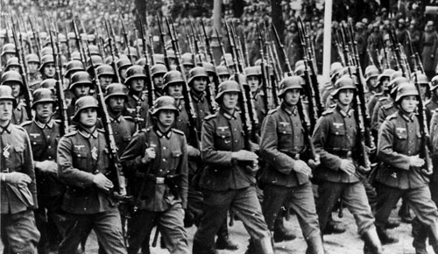
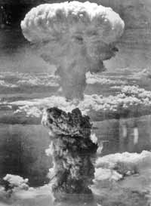
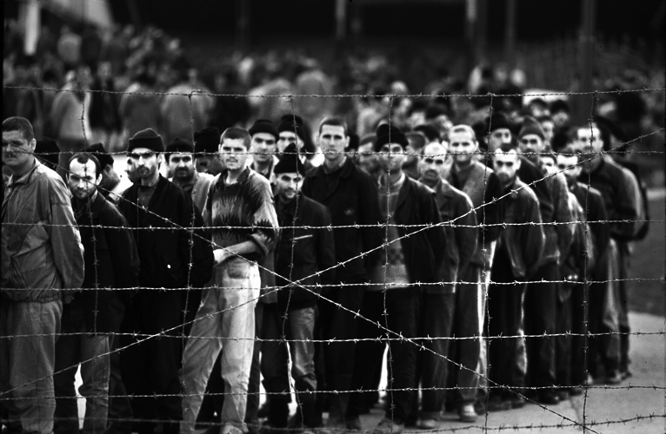
World War II

Slide 8
The Cold War as Total War
“It may be doubted whether ‘war’ is the correct word to describe the threat of mutual annihilation that prevailed during the ‘Cold War.’”
Michael Howard, A World at Total War
“The Cold War arrived at the midpoint of the twentieth century’s communications revolution. The earliest and most dangerous years of the Cold War happened just as radio, press, and film media were reaching maturity, coinciding with the advent of television and the expansion of the public relations and advertising professions. These developments provided many of the media techniques that made the Cold War so ideological, so all-encompassing, so total.”
Kenneth Osgood, Total Cold War

Slide 9
“Mediation”
Recall Professor Newman’s Lectures: History is not “immediate” to us. It is, rather, “mediated,” filtered through a particular medium and from a particular point of view…
Over the next three weeks, we will look at one film, one TV series, and one novel. We will ask how each mediates the experience of the Cold War and the War in Iraq.
We will ask: Are these media themselves “theaters of war”? Can they capture what is total about war? (Can any medium capture totality?)

Slide 10
Let’s begin by asking simpler questions: Through what media do we get news of traditional war theaters? Who makes that news?
Recall Prof. Lazo’s discussion of historia and the difference between official histories of nation states and their conflicts and more personal stories about individual lives.

Slide 11
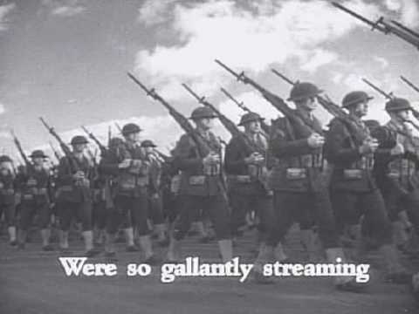
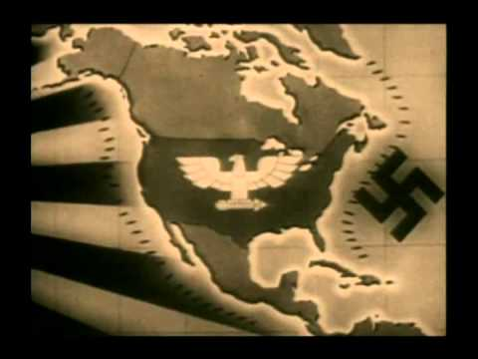
Newsreels (made by Hollywood Studios and U.S. Office of War Information)
News and World War Two

Slide 12
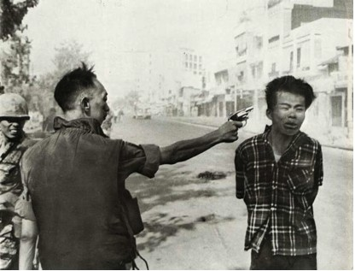
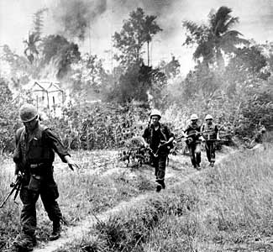
The First Television War: Vietnam
Reporters were relatively uncensored and moved freely about the war zone. Filmed TV reports aired 2-7 days after they are filmed.
In 1965, CBS aired a report which showed Marines lighting the thatched roofs of the village of Cam Ne with Zippo lighters, and included critical commentary on the treatment of the villagers.
In 1968, during the Tet offensive, viewers of NBC news saw Col. Nguyen Ngoc Loan shoot his captive in the head on a Saigon street.

Slide 13
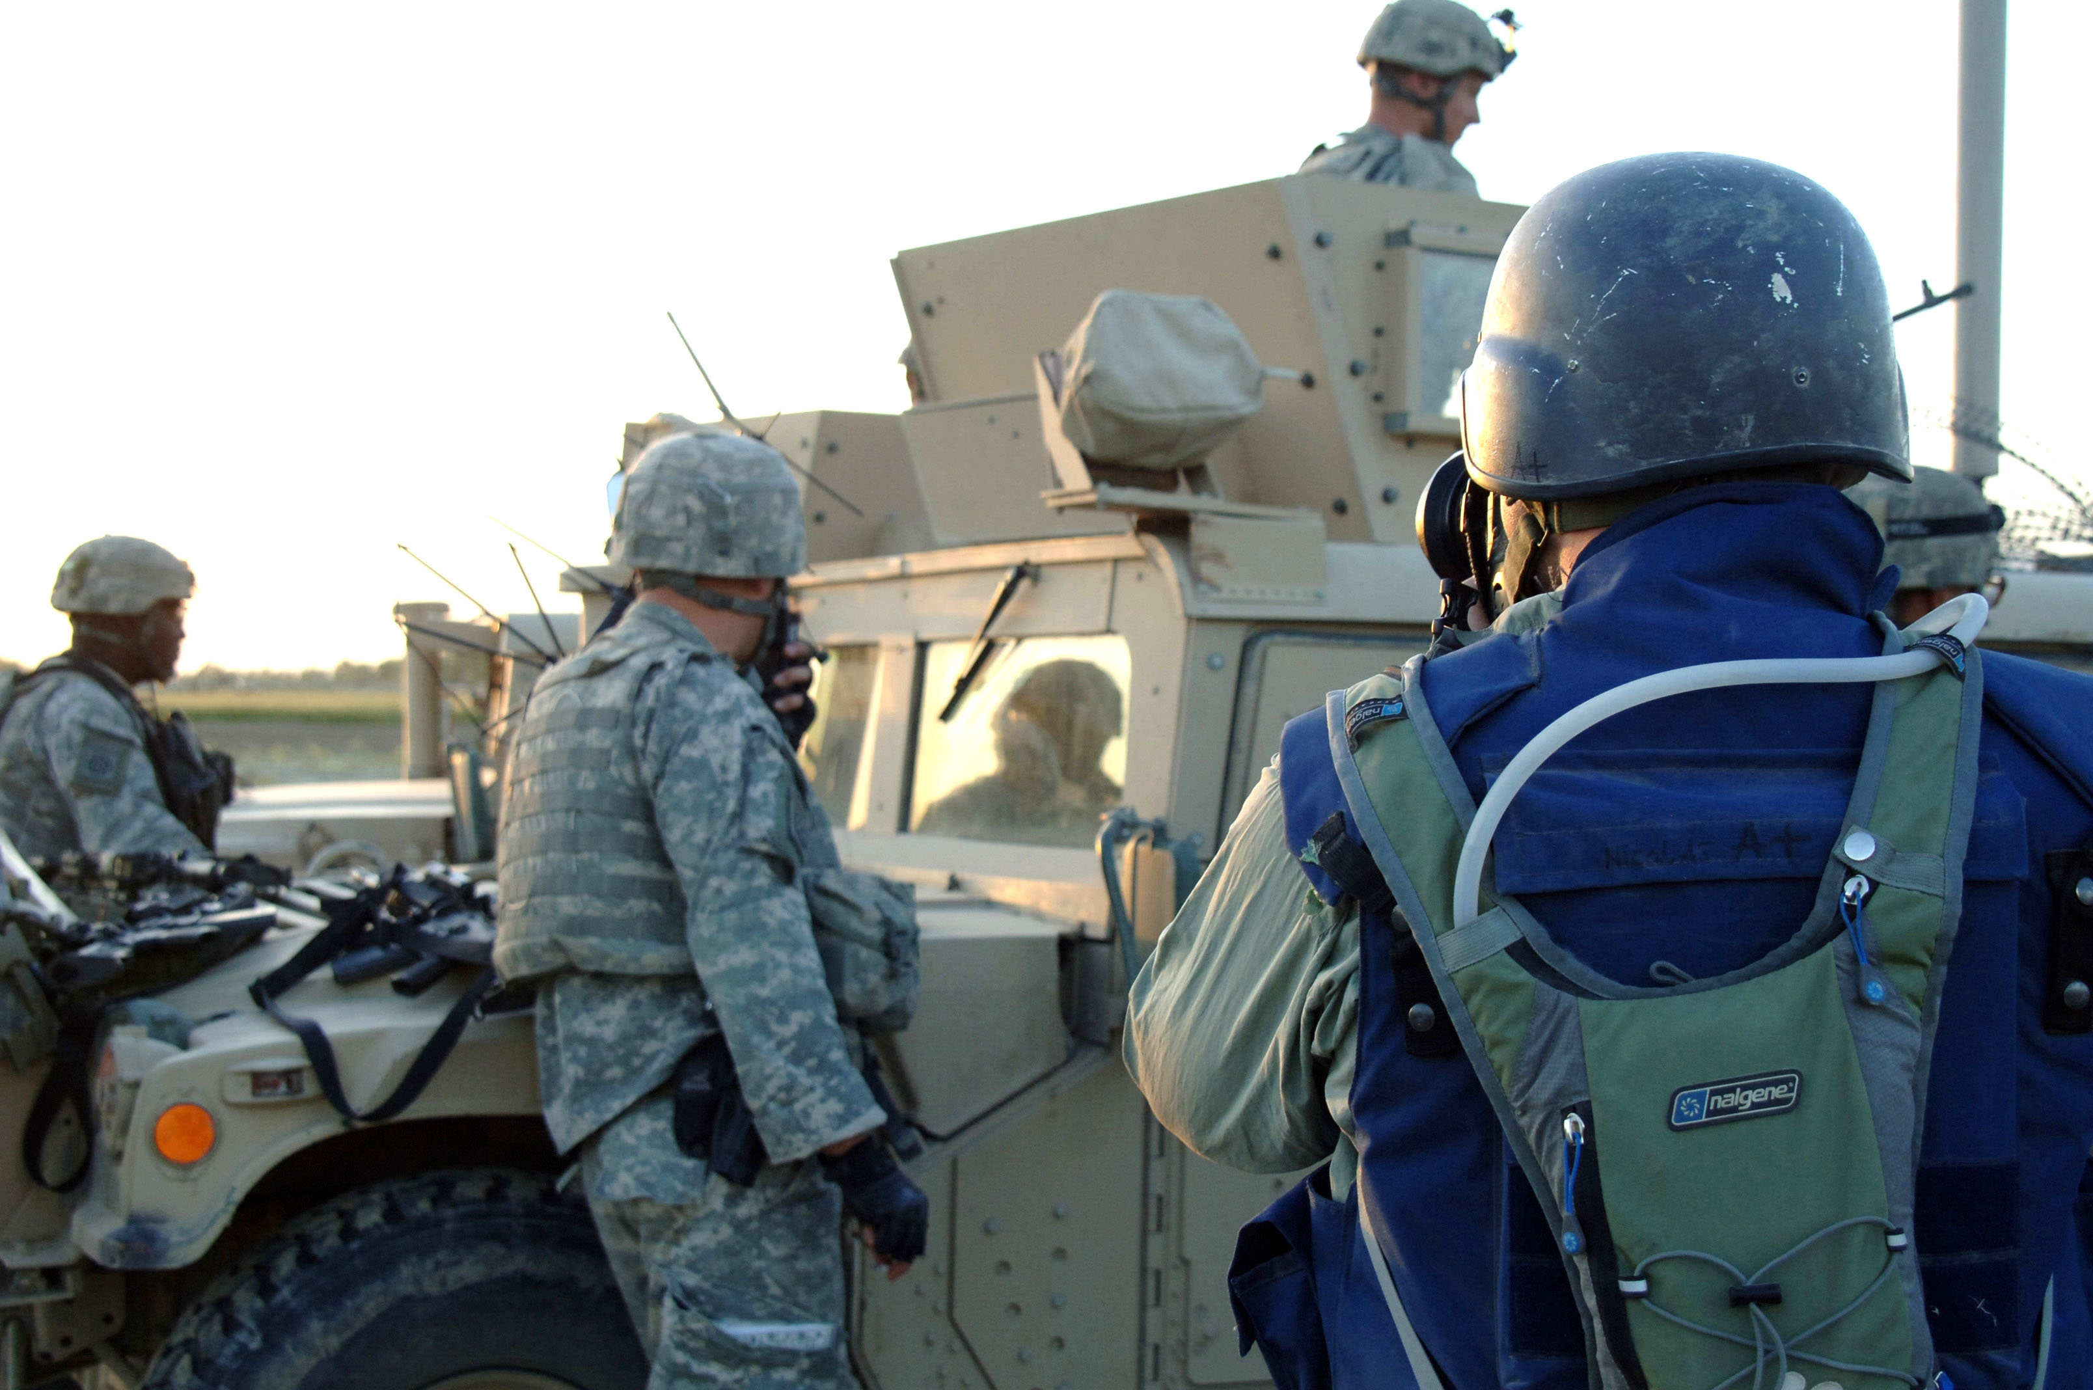
Journalists were far more restricted when they were “embedded” during the 2003 Invasion of Iraq

Slide 14
“Facts” Courtesy of the JFK Library Website:
“After World War II, the United States and its allies and the Soviet Union and its satellite states began a decades-long struggle for supremacy known as the Cold War.”
“The Soviet Union and the United States had fought as allies against Nazi Germany during World War II. But the alliance began to crumble as soon as the war in Europe ended in May 1945.”
“Soldiers of the Soviet Union and the United States did not do battle directly during the Cold War. But the two superpowers continually antagonized each other through political maneuvering, military coalitions, espionage, propaganda, arms buildups, economic aid, and proxy wars between other nations.”
Some “Official History” of the Cold War

Slide 15
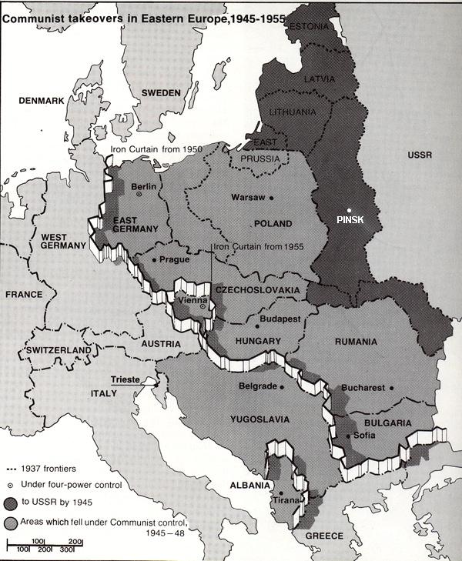
“From Stettin in the Baltic to Trieste in the Adriatic an iron curtain has descended across the Continent.”
Winston Churchill, March 5, 1946
What do we learn from quotes? From maps and images?

Slide 16
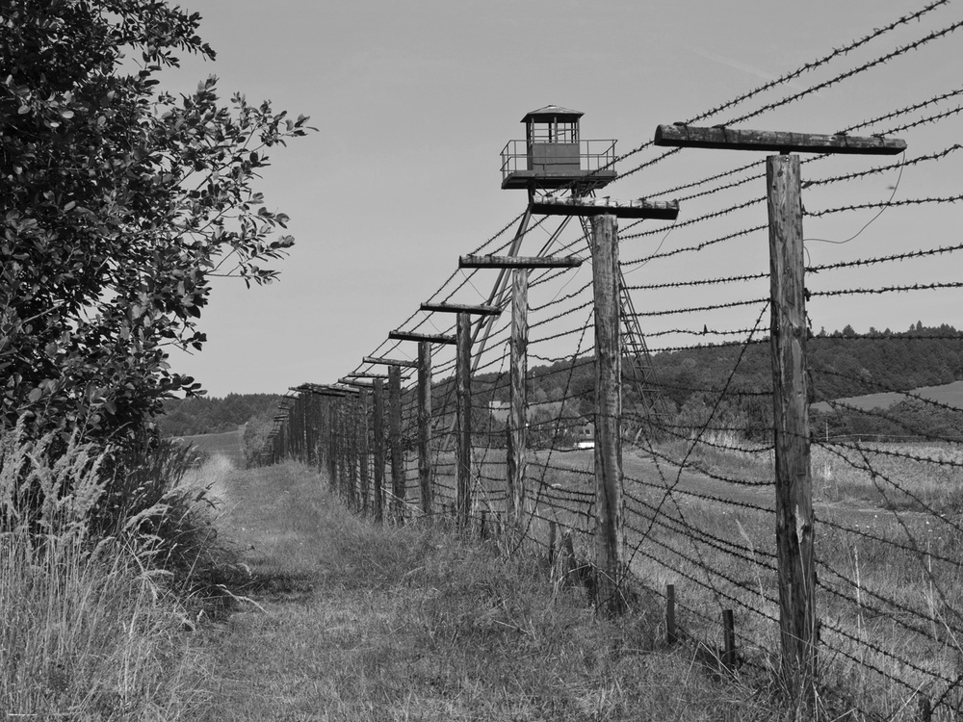
The Iron Curtain

Slide 17
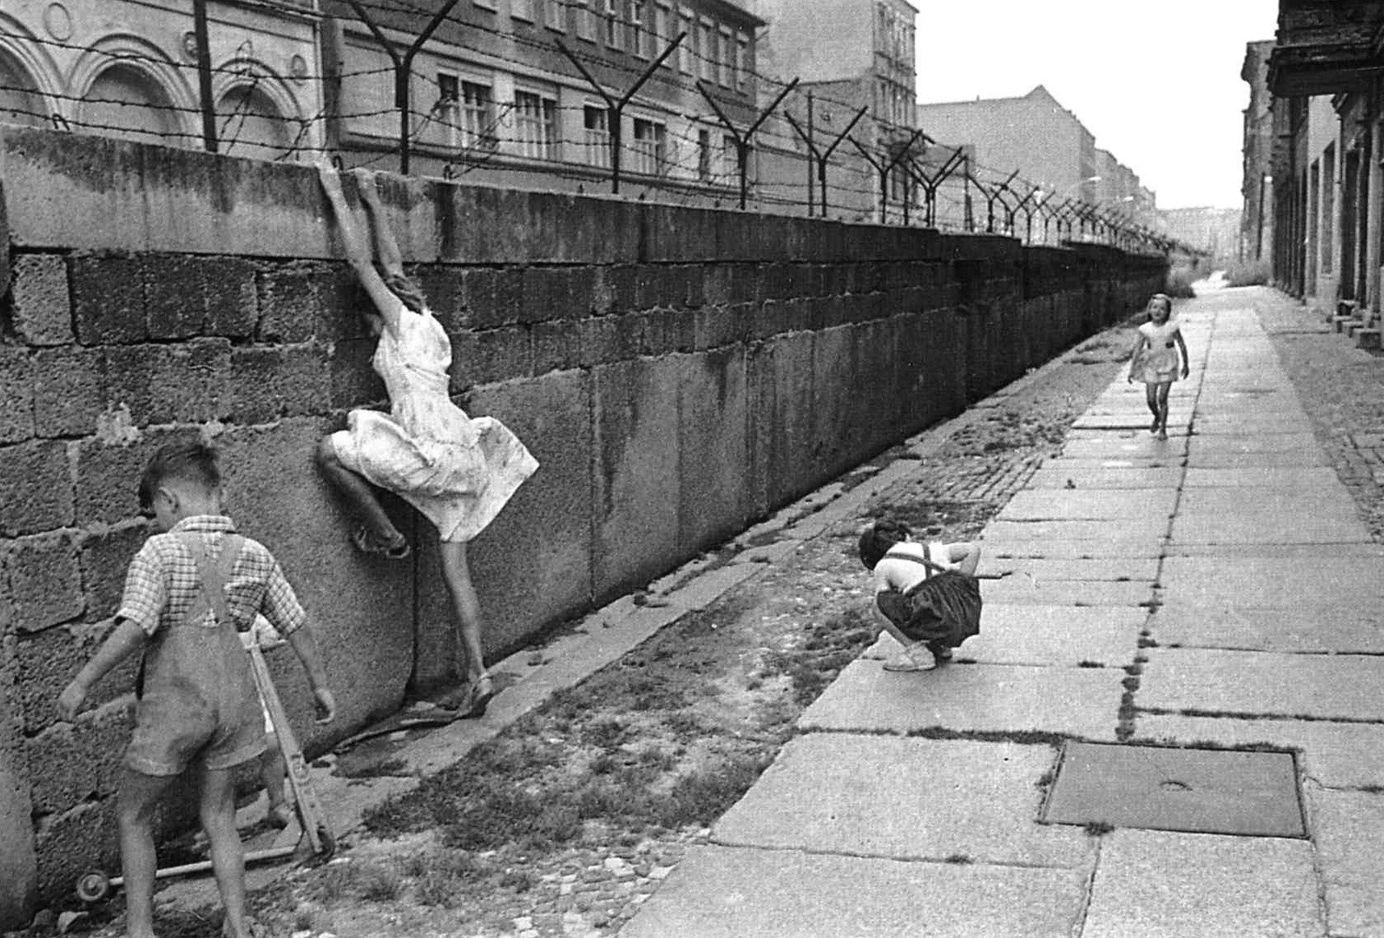

Slide 18
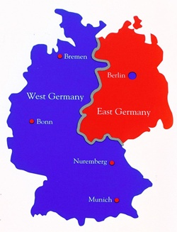
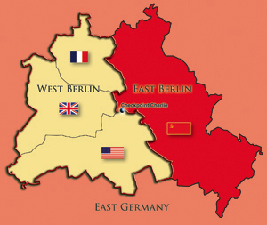
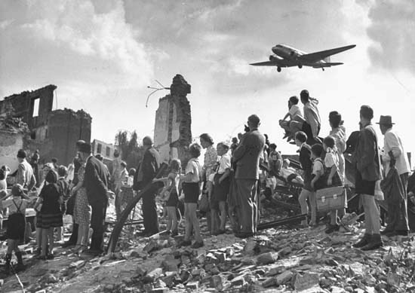
The Partition of Germany and the Berlin Blockade (June 1948-May 1949)
“During the Berlin airlift, an Allied supply plane took off or landed in West Berlin every 30 seconds. The planes made nearly 300,000 flights in all.”
From The History Channel (owned by Hearst Corporation and Disney)

Slide 19
From Google Images (what kind of source is this?)

Slide 20
In 1949, the communists triumphed in the Chinese civil war, and the world's most populous nation joined the Soviet Union as a Cold War adversary. In 1950, North Korea invaded South Korea, and the United Nations and the United States sent troops and military aid. Communist China intervened to support North Korea, and bloody campaigns stretched on for three years until a truce was signed in 1953.
In 1954, the colonial French regime fell in Vietnam. The United States supported a military government in South Vietnam and worked to prevent free elections that might have unified the country under the control of communist North Vietnam.
From JFK Library Website

Slide 21
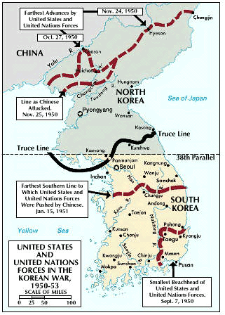
A very short history of the Korean War:
http://www.bbc.co.uk/history/worldwars/coldwar/korea_hickey_01.shtml

Slide 22
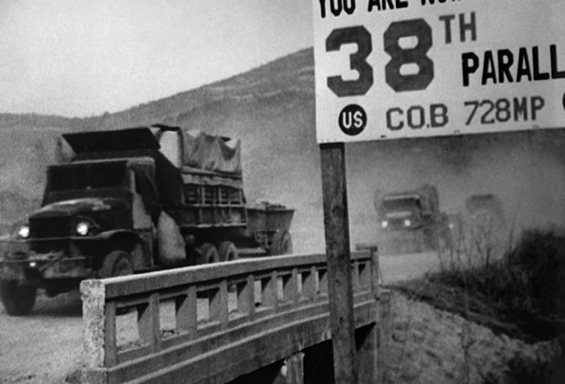

Slide 23
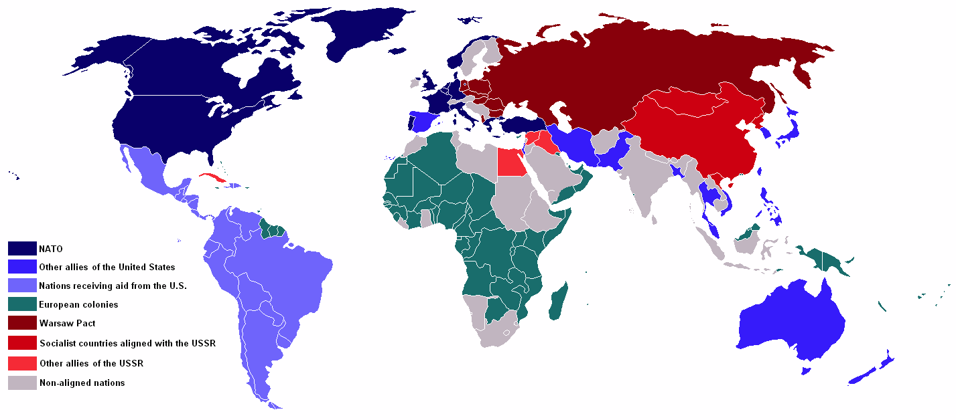
“In Europe, the dividing line between East and West remained essentially frozen during the next decades. But conflict spread to Asia, Africa, and Latin America. The struggle to overthrow colonial regimes frequently became entangled in Cold War tensions, and the superpowers competed to influence anti-colonial movements.” (JFK Library)
Map Circa 1959

Slide 24
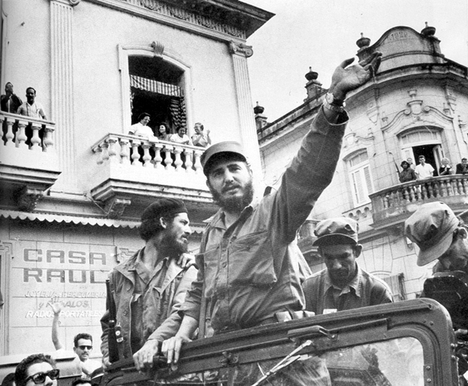
The Cuban Revolution (1953-1959): Waged by Fidel Castro and The 26th of July Movement against Cuban President Fulgencio Batista
(In compliance with a 1903 treaty, the U.S. sends rent checks to Cuba for its Naval Base in Guantanamo Bay. After the Revolution, Castro refused to cash these checks.)

Slide 25
From U.S. Cold War Foreign Policy To the Dirty Wars
From 1945-1976, “Cold War national security concerns had dominated U.S. relations with the developing world. It was an approach particularly evident in U.S. policy toward Latin America; guided by visceral anticommunism combined with an abiding fear of Latin American leftist insurgencies in the aftermath of the 1959 Cuban Revolution, American policymakers cultivated close ties with politically ambitious Latin American military leaders.”
William Schmidil, The Fate of Freedom Elsewhere (Cornell University Press)

Slide 26
“George Kennan, a career Foreign Service Officer, formulated the policy of ‘containment,’ the basic United States strategy for fighting the cold war with the Soviet Union.
“Kennan’s ideas, which became the basis of the Truman administration’s foreign policy, first came to public attention in 1947 in the form of an anonymous contribution to the journal Foreign Affairs, the so-called ‘X-Article.’ ‘The main element of any United States policy toward the Soviet Union,’ Kennan wrote, ‘must be that of a long-term, patient but firm and vigilant containment of Russian expansive tendencies.’ To that end, he called for countering ‘Soviet pressure against the free institutions of the Western world’ through the ‘adroit and vigilant application of counter-force at a series of constantly shifting geographical and political points, corresponding to the shifts and maneuvers of Soviet policy.’”
From U.S. Department of State, Office of the Historian

Slide 27
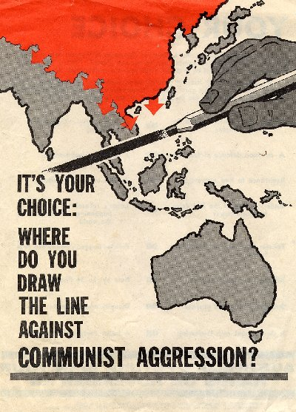
But, by definition, it is impossible to contain a total war…
Where is “where”?
“Over there”?
Or closer to home?

Slide 28
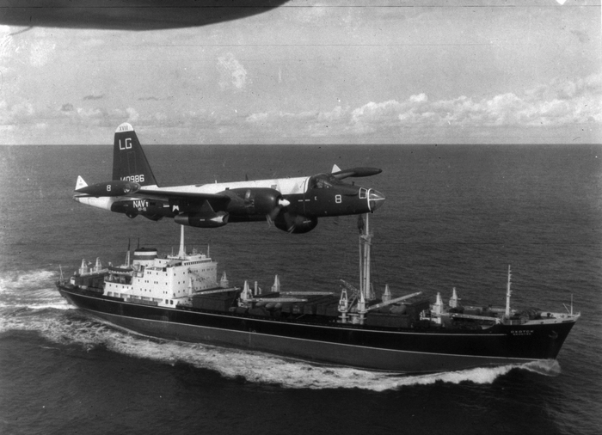
The Cuban Missile Crisis
In the summer of 1962, Khrushchev reached a secret agreement with the Cuban government to supply nuclear missiles capable of protecting the island against another U.S.-sponsored invasion. In mid-October, American spy planes photographed the missile sites under construction. Kennedy responded by placing a naval blockade, which he referred to as a "quarantine," around Cuba.

Slide 29
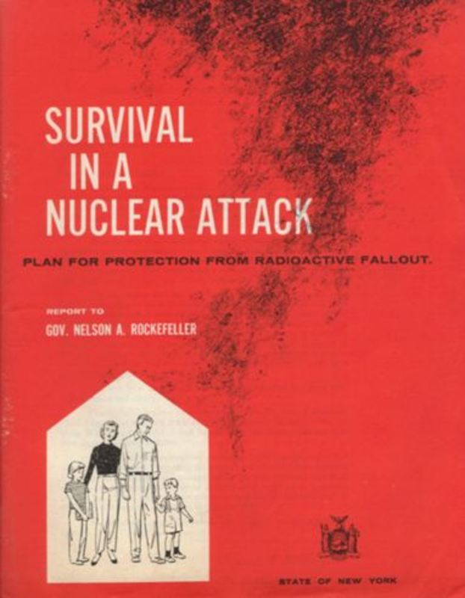
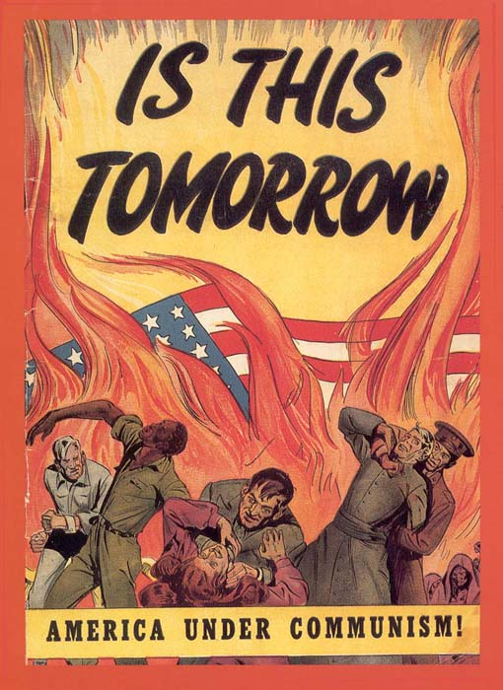
In his 1949 best-seller The Vital Center, Arthur Schlesinger, Jr. named anxiety “the official emotion of our time.”

Slide 30
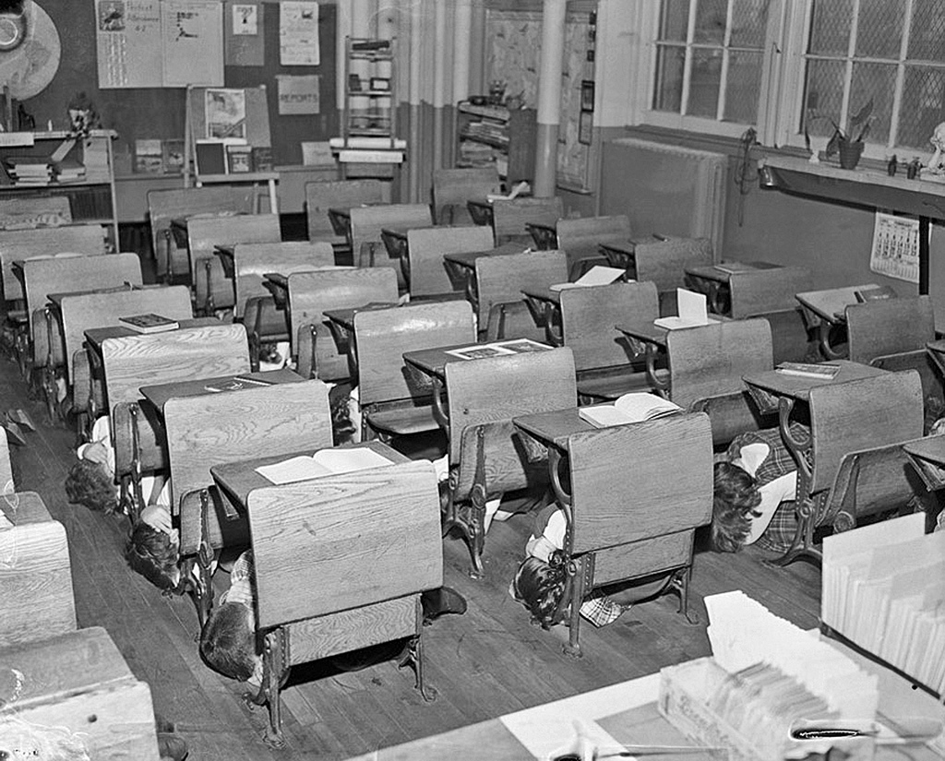

Slide 31
“PROBABLY, WE WILL never be able to determine the psychic havoc of the concentration camps and the atom bomb upon the unconscious mind of almost everyone alive in these years. For the first time in civilized history, perhaps for the first time in all of history, we have been forced to live with the suppressed knowledge that the smallest facets of our personality or the most minor projection of our ideas, or indeed the absence of ideas and the absence of personality could mean equally well that we might still be doomed to die as a cipher in some vast statistical operation in which our teeth would be counted, and our hair would be saved, but our death itself would be unknown, unhonored, and unremarked.”
Norman Mailer, 1957

Slide 32
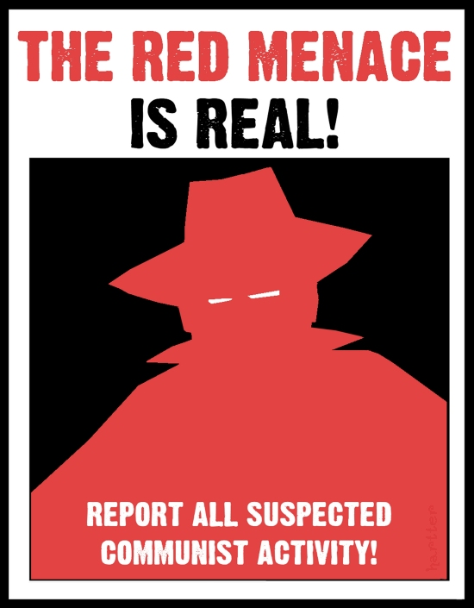
Anti-Communism

Slide 33
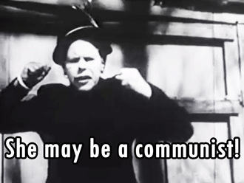
How to Spot a Communist!
https://www.youtube.com/watch?v=KQVXHlMvOoU

Slide 34
“The House Un-American Activities Committee (HUAC) was created in 1938 to investigate alleged disloyalty and subversive activities on the part of private citizens, public employees, and those organizations suspected of having Communist ties. . . . [Led by] Martin Dies of Texas, HUAC's strident attacks on the Roosevelt administration prior to the outbreak of the war did not suit the political mood of a nation that was largely in favor of FDR’s leadership. All that changed, however, in the postwar atmosphere of fear and contempt for the Soviet Union, at which time HUAC's activities commanded broad popular support and consistently attracted major headlines.”
http://www.gwu.edu/~erpapers/teachinger/glossary/huac.cfm

Slide 35
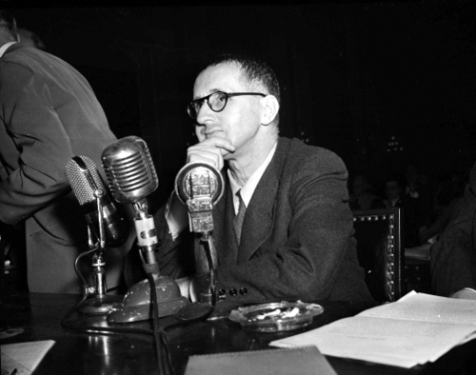
Brecht testifying before HUAC

Slide 36
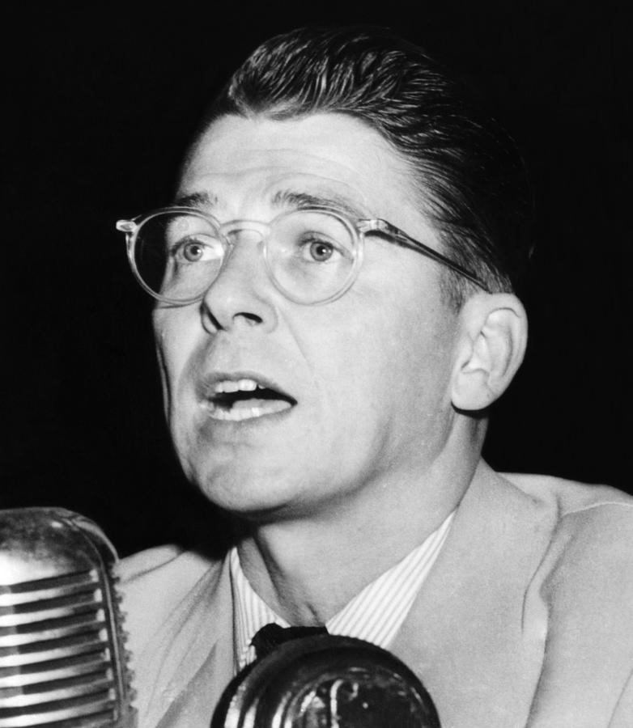
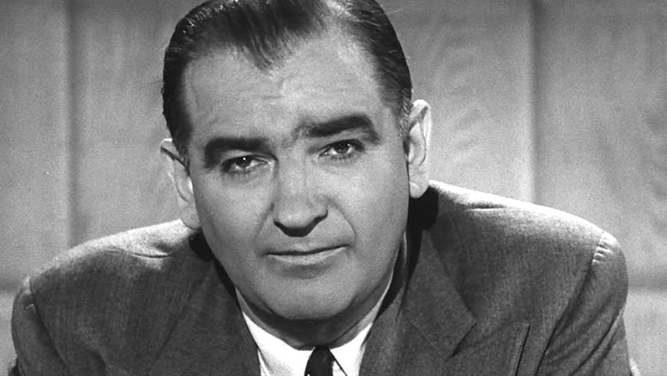
HUAC and Joseph McCarthy
https://www.youtube.com/watch?v=MnUf30oefQw
https://www.youtube.com/watch?v=MnUf30oefQw

