Slide 1
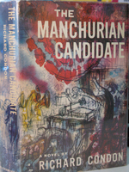
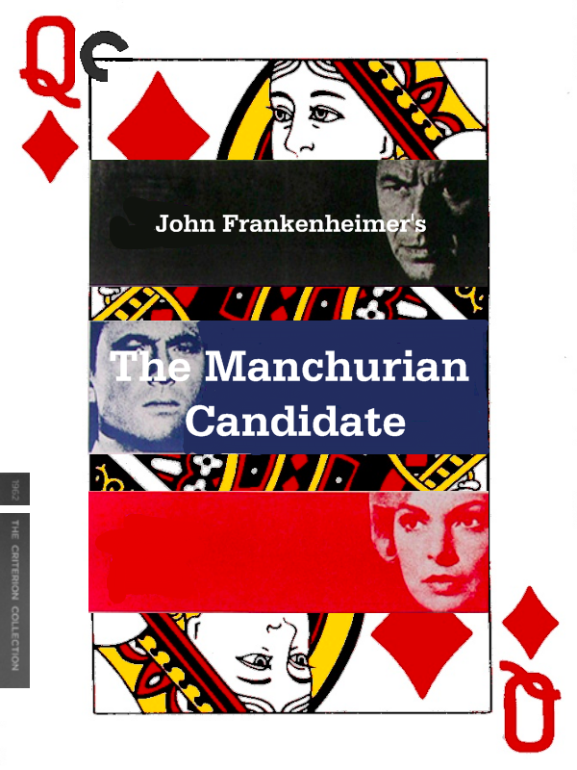
Translated into 19 languages and the basis of two major motion pictures, Richard Condon’s novel The Manchurian Candidate (1959) describes an American GI captured by the Chinese during the Korean War.
Raymond Shaw, the GI, returns to the States with his brains “not merely washed” but “dry-cleaned.”
Though he doesn’t realize it, he is the shooter in a Communist conspiracy—organized in China and the Soviet Union and led in the United States by his mother Eleanor Shaw—to catapult his stepfather, a U.S. Senator, into the Oval Office.

Slide 2
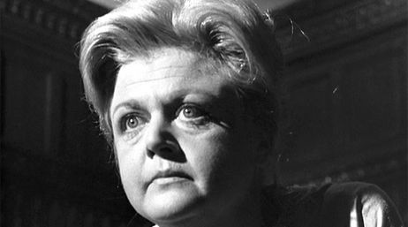
Clip: Eleanor Shaw
https://www.youtube.com/watch?v=LCjBOZ4r9Ck

Slide 3
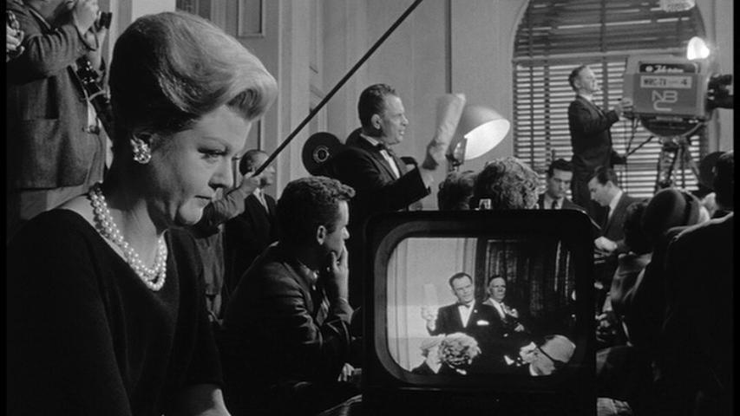
Eleanor Shaw plans to stage a media event. That plan involves “rallying a nation of television viewers into hysteria.” Crucial to this plan is a bullet, and a speech (each is weapon to be used in an expanded theater of war): “It’s the most rousing speech I’ve ever read. It’s been worked on here and in Russia over the last eight years.”

Slide 4
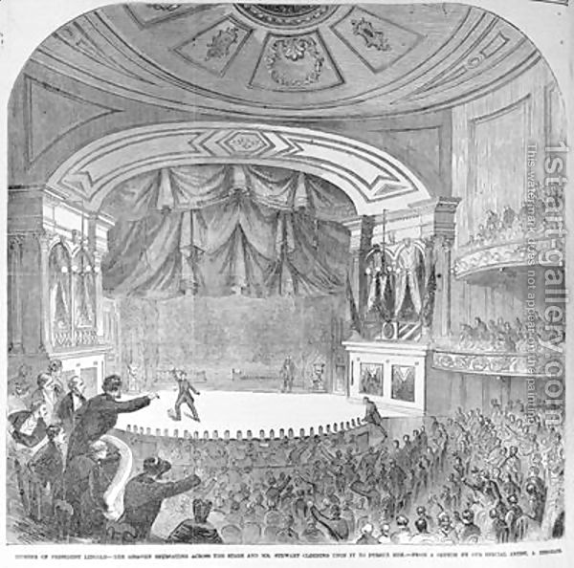
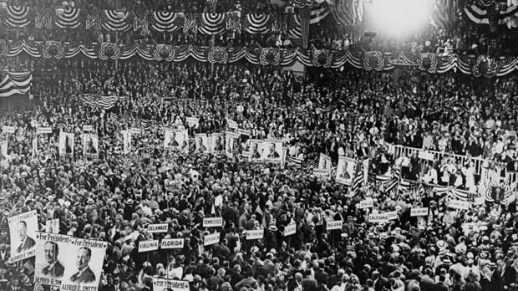
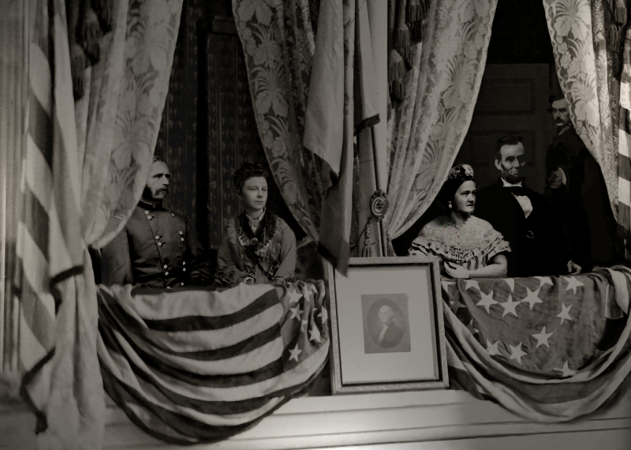
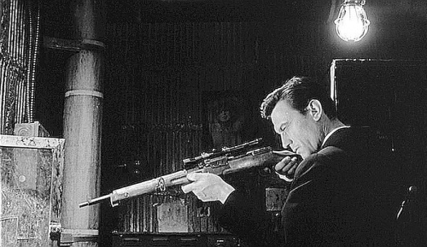
From the Ford Theater to Madison Square Garden

Slide 5
McCarthy’s “Lincoln Day Speech” of February 9, 1950
"The State Department is infested with Communists. I have here in my hand a list of 205—a list of names that were made known to the Secretary of State Secretary as being members of the Communist Party and who nevertheless are still working and shaping policy in the State Department."
What is this doing here? ➔

Slide 6
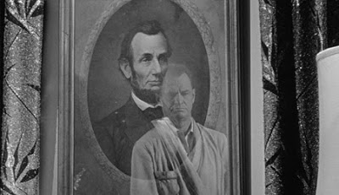
Other Echoes of the Civil War…
Lincoln Imagery in The Manchurian Candidate…

Slide 7
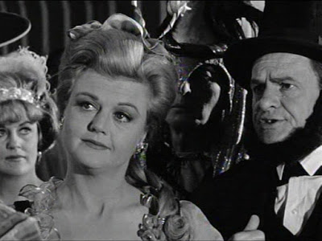

Slide 8
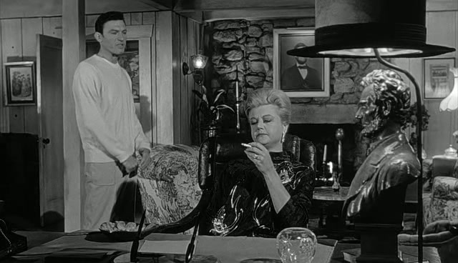

Slide 9
Recall Prof. Fahs on “Historical contingency”
The idea that historical events are dependent (or contingent) on multiple causes that shape when, how, and why an event occurs
The ways culture, history, and environment shape human character, beliefs, and values at specific moments in time
The opposite of inevitability
(A war is a good example of an event with many causes. How do we represent that multiplicity of causes?)

Slide 10
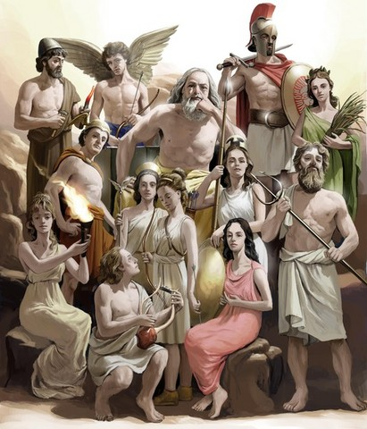
Recall Prof. Izenberg on: “Agency”
"The true hero, the true subject, the centre of the Iliad, is force. Force employed by man, force that enslaves man, force before which man's flesh shrinks away. In this work at all times, the human spirit is shown as modified by its relation to force, as swept away, blinded, by the very force it imagined it could handle, as deformed by the weight of the force it submits to.”
Simone Weil, “The Iliad, or the Poem of Force”
The Greek Gods as Figures for and Personifications of a problem: how to represent over- and under-determination?

Slide 11
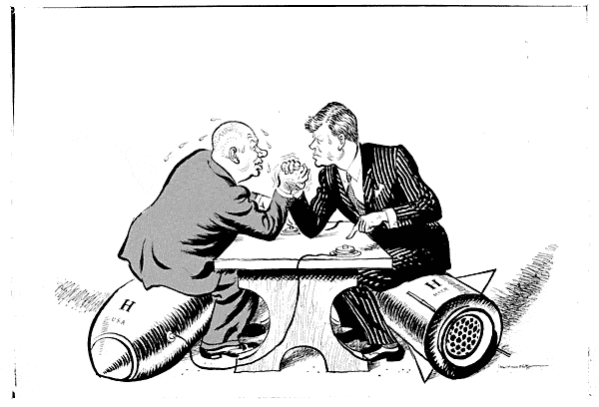
Raymond’s Agency?
Ben Marco: “They are inside your mind now, Raymond, and they are feeding on you. You are a host body.”
Who are they? The Gods? National leaders? Generals? Those (men) who make “official history” and look down at battles and wars from above?

Slide 12
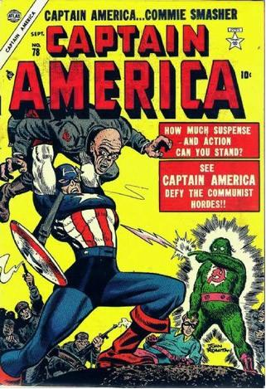
“What Yen Lo had done was concentrate the purpose of all propaganda upon the mind of one man.”
Richard Condon, The Manchurian Candidate
What is “all propaganda”? Whose propaganda is that?
In the name of what ideology?

Slide 13
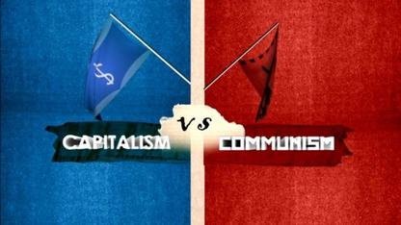
The “official story”:
“At the present moment in world history, nearly every nation must chose between alternative ways of life. One way of life is based upon the will of the majority, and is distinguished by free institutions, representative government, free elections, guarantees of individual liberty, freedom of speech and religion, and freedom from political repression. The second way of life is based upon the will of the minority forcibly imposed upon the majority.”
President Harry Truman, 1947

Slide 14
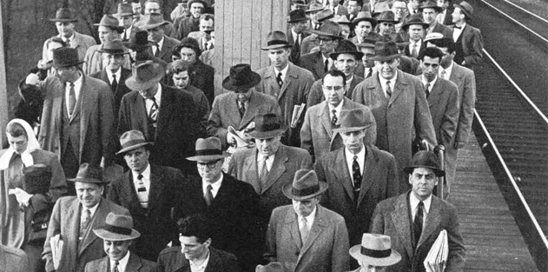
“The collectivization so visible in the corporation has affected almost every field of work. . . . Listen to [these organization men] talk to each other over the front lawns of their suburbia and you cannot help but be struck by how well they grasp the common denominators which bind them. . . The word collective most of them can’t bring themselves to use—except to describe foreign countries or organizations they don’t work for—but they are keenly aware of how much more deeply beholden they are to organizations than were their elders.”
Whilliam H. Whyte Jr., The Organization Man
James Burnham on “Bureaucratic Collectivism” and “The Managerial Revolution”
(Burnham also wrote a book about Machiavelli)

Slide 15
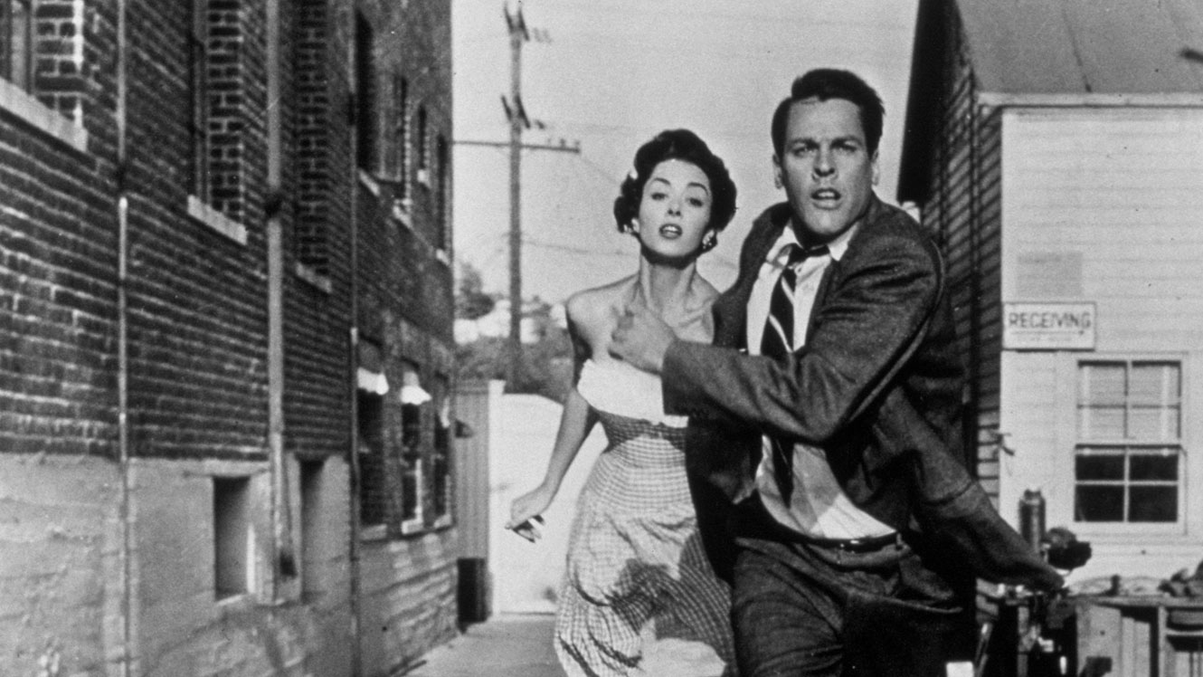
What kind of allegory is this?
In The Manchurian Candidate, Raymond Shaw is controlled by his mother. She works for the Chinese and the Soviets, but also considers herself a true blue American conservative.
In The Invasion of the Body Snatchers (1956) offers the same confusion of left and right. Critics still debate whether the pod-aliens in the movie who make everybody the same are Communists or anti-Communists.

Slide 16
Ideology or …?
“Ideology: a. (a) The study of ideas; that branch of philosophy or psychology which deals with the origin and nature of ideas. (b) spec. The system introduced by the French philosopher Étienne Condillac (1715–80), according to which all ideas are derived from sensations.”
Oxford English Dictionary
“Was the Cold War a contest of two ideologies—liberal democracy and Marxism Leninism—or was it driven mainly by considerations of power and material interests? No definitive answer to this question has yet emerged. Indeed, deep divisions remain amount Western analysts about the precise role of ideology in the making of the Cold War.”
Mark Kramer, Review of International Studies, 1999

Slide 17
Ideology as physical sensation and compulsion
(mind control as body control)
In Brainwashing in Red China (1951), Edward Hunter writes that “Our age of gadgets and electronics had discovered the brain and we were learning how to manipulate it. This was something drastically new, like the splitting of the atom, that had come upon this earth in the middle of the twentieth century.”
In Every War But One (1959), Eugene Kincaid explains the defection of 21 GIs captured during the Korean War. He attributes their defection to “brainwashing,” and to the skillful application by the Chinese of “a highly novel blend of leniency and pressure.”

Slide 18
Richard Condon insisted that The Manchurian Candidate was about an “all-American brainwashing” that had nothing to do with Red China: Americans invented “words such as communism [and] fascism” to distract themselves from home-grown realities. “I am suspicious,” he said, “of the term ‘free will.’” In fact, he claims to have written The Manchurian Candidate because he “had been conditioned to do so by successful merchandising.”
Condon worked in Disney’s marketing department for 20 years. He promoted the films Fantasia and Dumbo, among others.

Slide 19
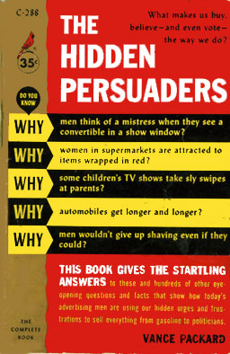
Capitalist Mind Control?
In The Hidden Persuaders (1957), Vance Packard claims that Americans had “a packaged soul.” He describes advertising’s newfound reliance on “psycho-seduction” and “subliminal communication.”
What account of agency is implicit here?

Slide 20
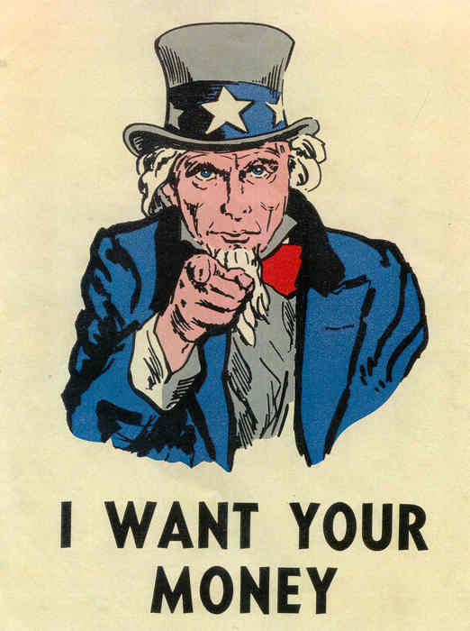
“Manchurian brainwashing and American-style public relations [in Condon’s novel] . . . are of a piece: Madison Avenue and the Pavlov Institute are joined at the hip. The term ‘brainwashing’ had entered Americans’ popular lexicon precisely during the Korean War. . . . But so had the American public become recently attuned to capitalist efforts in thought control—an unholy marriage of psychiatry and marketing, Madison Avenue’s new ‘depth probers of merchandizing,’ as Packard called them, had made ‘extreme attempts at probing and manipulating minds.’”
From Jacobson and Gonzalez, What Have They Built You To Do, 47

Slide 21
If The Manchurian Candidate is really about capitalism and consumer culture, then what kind of an agent is Raymond? What about Eleanor Shaw? What kind of conspiracy is this? Who or what conspires?
conspiracy, n.
a. The action of conspiring; combination of persons for an evil or unlawful purpose.
b. Law.
1863 H. Cox Inst. Eng. Govt. i. xi. 275 The crime of conspiracy consists in the agreement of two or more persons to do an illegal act, or to do a lawful act by unlawful means.

Slide 22
“The Paranoid Style in American Politics”
“American politics has often been an arena for angry minds. In recent years, we have seen angry minds at work, mainly among extreme right-wingers, who have now demonstrated, in the Goldwater movement, how much political leverage can be got out of the animosities and passions of a small minority. But, behind this, I believe, there is a style of mind that is far from new, and that is not necessarily right-wing. I call it the paranoid style, simply because no other word adequately evokes the sense of heated exaggeration, suspiciousness, and conspiratorial fantasy that I have in mind.”
Richard Hofstadter, 1964

Slide 23
“The Paranoid Style” Continued
“The paranoid spokesman, sees the fate of conspiracy in apocalyptic terms — he traffics in the birth and death of whole worlds, whole political orders, whole systems of human values. He is always manning the barricades of civilization... he does not see social conflict as something to be mediated and compromised, in the manner of the working politician. Since what is at stake is always a conflict between absolute good and absolute evil.”
“The enemy is clearly delineated: he is a perfect model of malice, a kind of amoral superman — sinister, ubiquitous, powerful, cruel, sensual, luxury-loving. Unlike the rest of us, the enemy is not caught in the toils of the vast mechanism of history, himself a victim of his past, his desires, his limitations. He wills, indeed, he manufactures, the mechanism of history, or tries to deflect the normal course of history in an evil way.”

Slide 24
“Discrete individuals and groups become, in the countersubversive imagination, members of a single political body directed by its head. The countersubversive needs monsters to give shape to his anxieties and to permit him to indulge his forbidden desires. Demonization allows the countersubversive, in the name of battling the subversive, to imitate his enemy.”
Michael Rogin, Ronald Reagan: The Movie, xiii

Slide 25
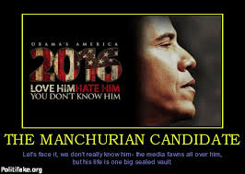
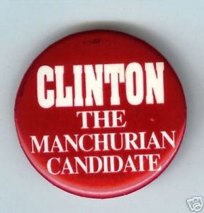
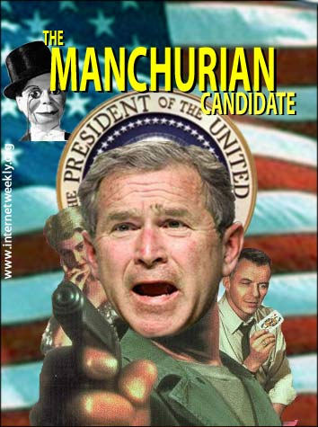
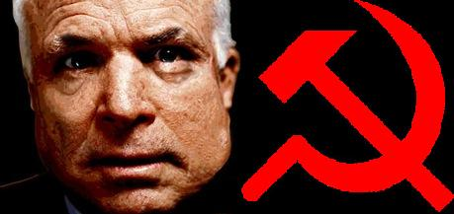
Who is to blame?

Slide 26
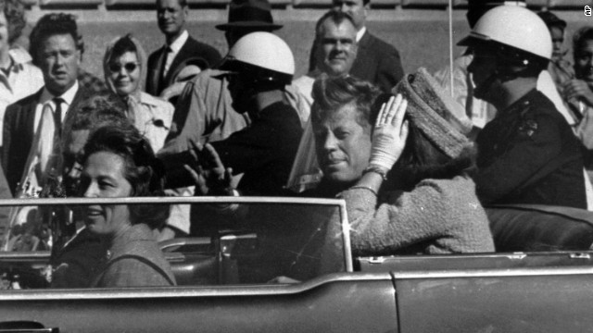
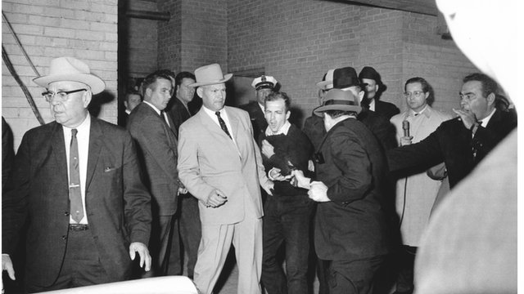
Do we comfort ourselves when we believe in the “the lone gunman”? Does conspiracy theory offer a different comfort? An assassin is a human agent. What kind of agent is capitalism? What kind of agent is “force”?

Slide 27
A Film’s Agency?
Frank Sinatra helped produce The Manchurian Candidate (1962). He was friends with President Kennedy. Sinatra’s co-stars had campaigned for Kennedy throughout 1960.
United Artists made the film. UA president Arthur Krim was national finance chairman of the Democratic Party.
Kennedy had read and loved the novel. He convinced Krim that it was OK to proceed with the politically explosive material.
One year after the release of the film, Lee Harvey Oswald kills Kennedy. Like Raymond Shaw, Oswald had spent time behind the Iron Curtain.
Oswald likely saw The Manchurian Candidate (playing two blocks from his apartment) just weeks before he shot Kennedy.
Supposedly consume by guilt, Frank Sinatra pulled the film from circulation. It was not seen for decades.

